Slide 1
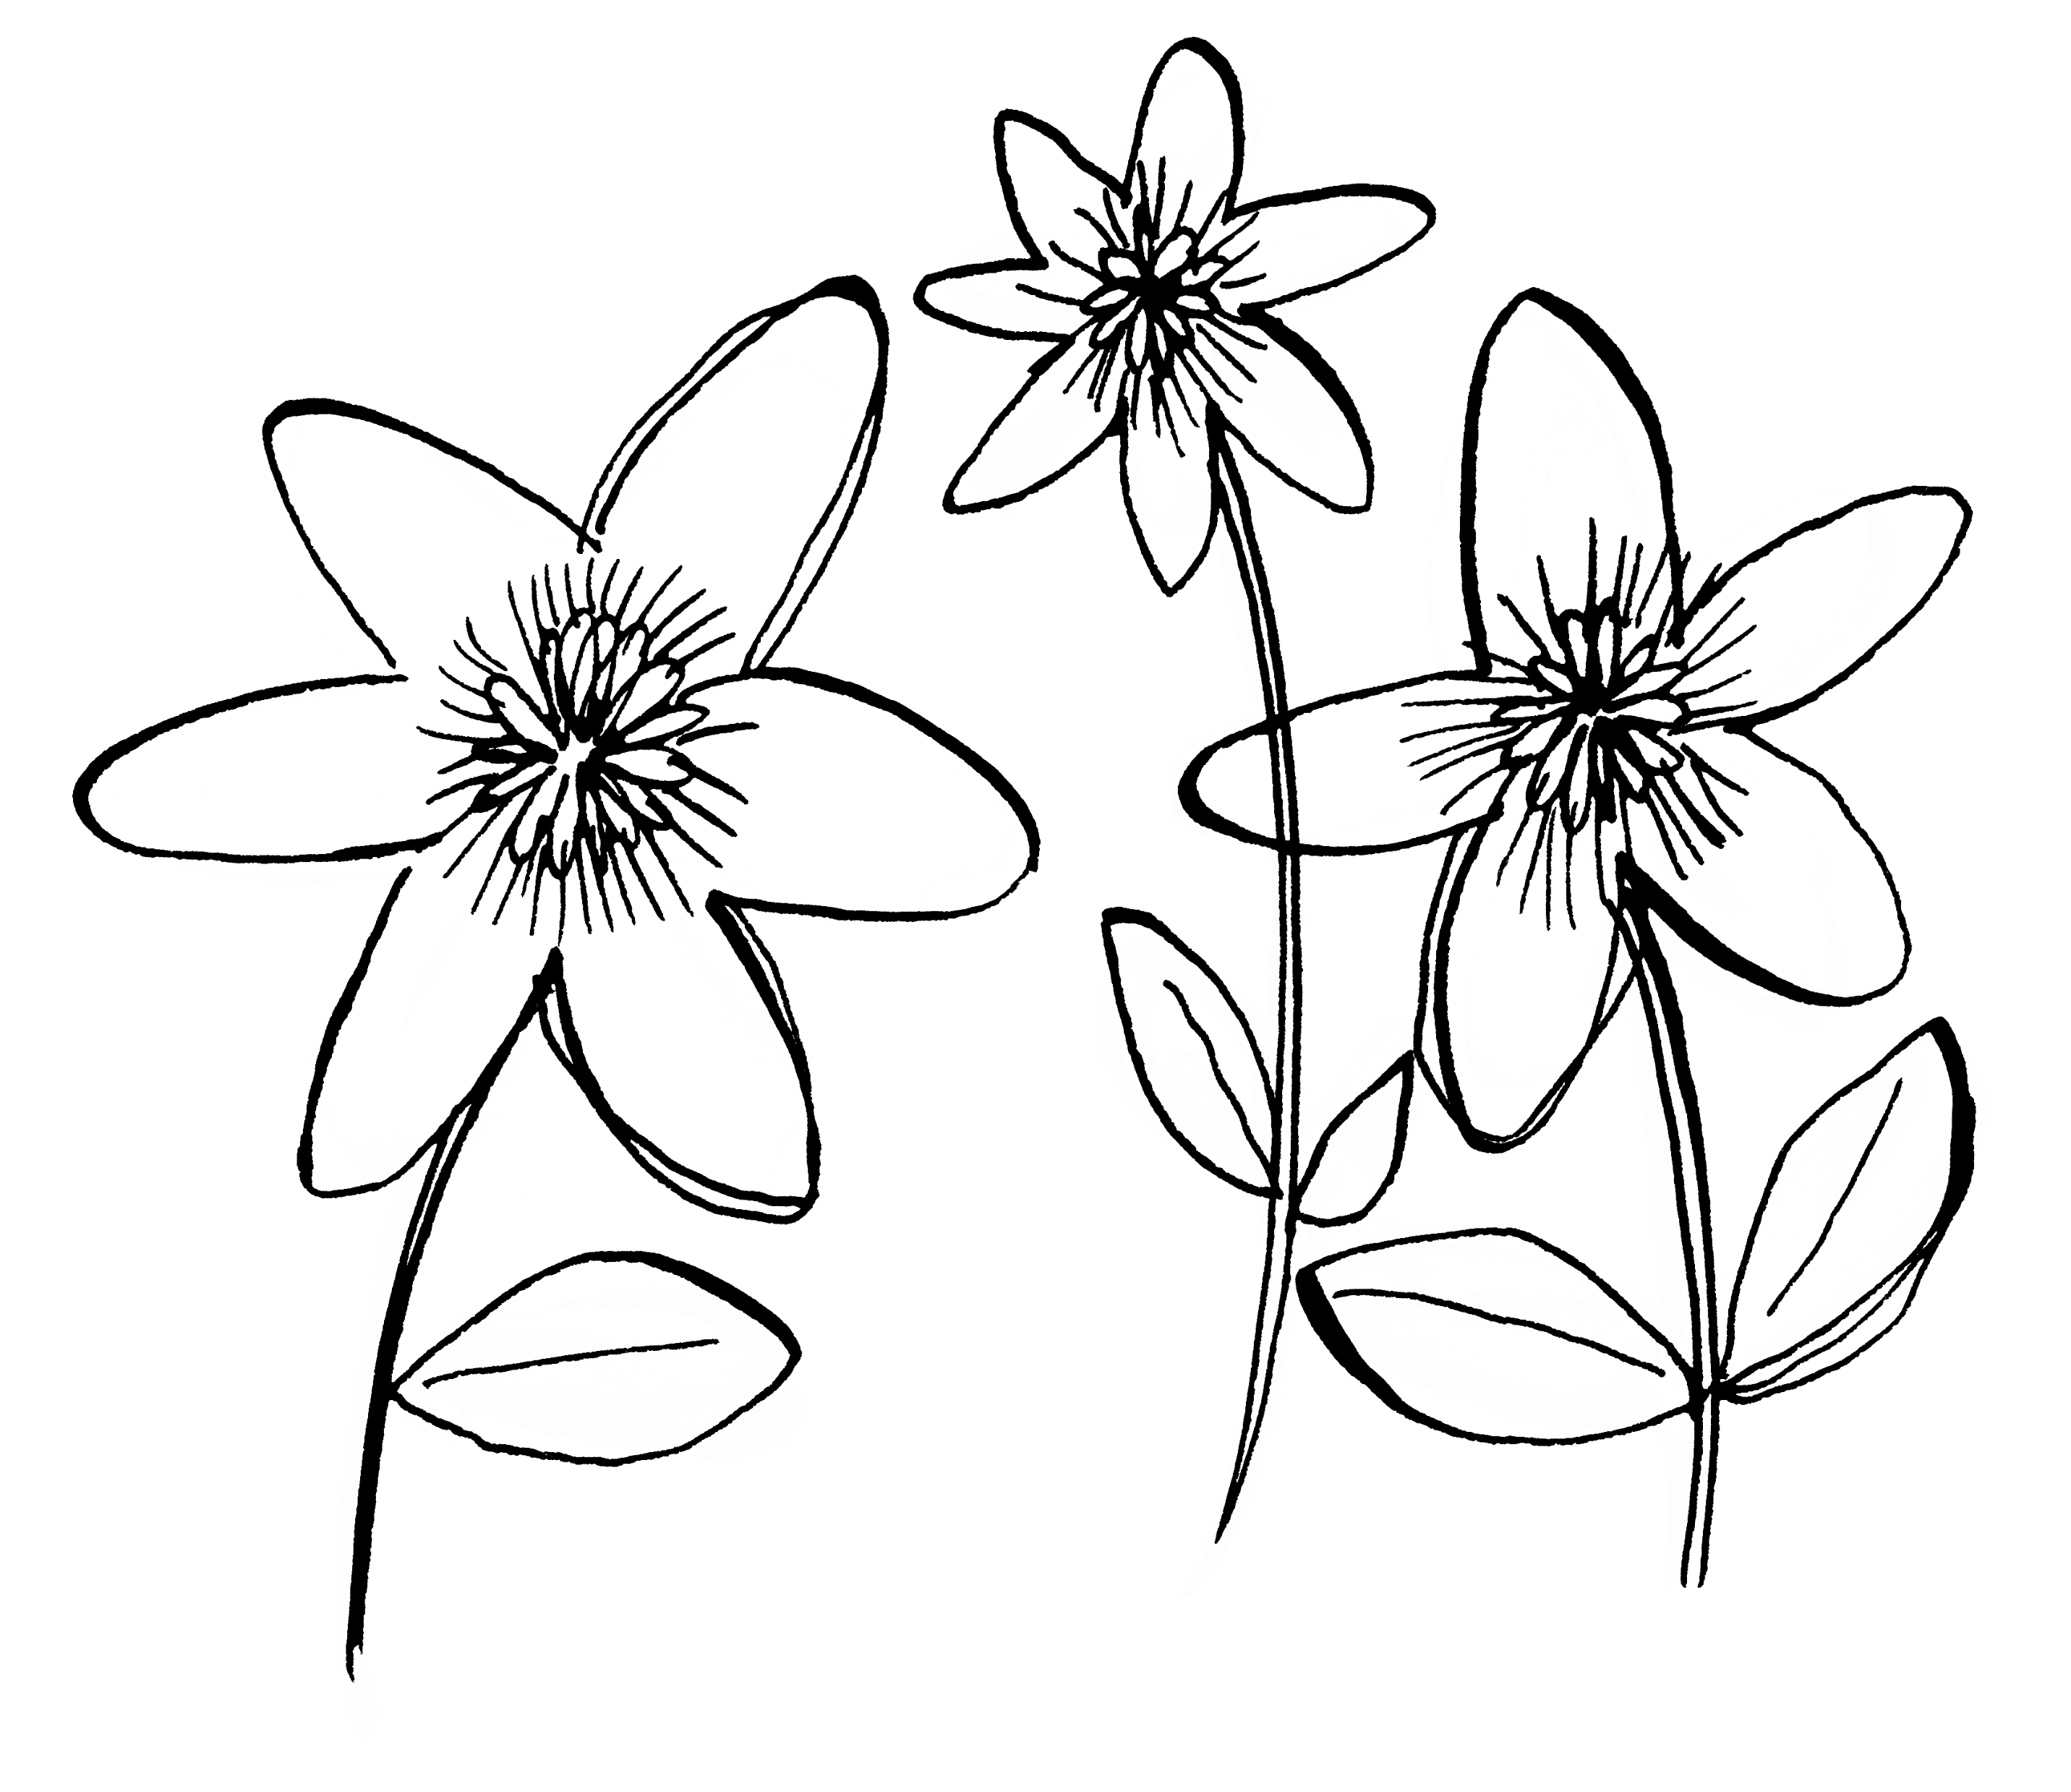
National Garden Scheme
SOCIAL MEDIA

Slide 2
SOCIAL MEDIA CHANNELS
Instagram
All about sharing photography
Visual storytelling of the year in your garden
Facebook
Great for linking to external websites
Offers space for detailed content, such as gardening tips
Twitter
Quick, in the moment content
Large gardening community to connect with

Slide 3
The facts about social media
Instagram
Over one billion users
Facebook
2,375 billion users!
Almost all National Garden Scheme county teams run social media accounts, with a joint following of over 150,000!
Twitter
Over 330 million users

Slide 4
What can social media be used for?

Slide 5
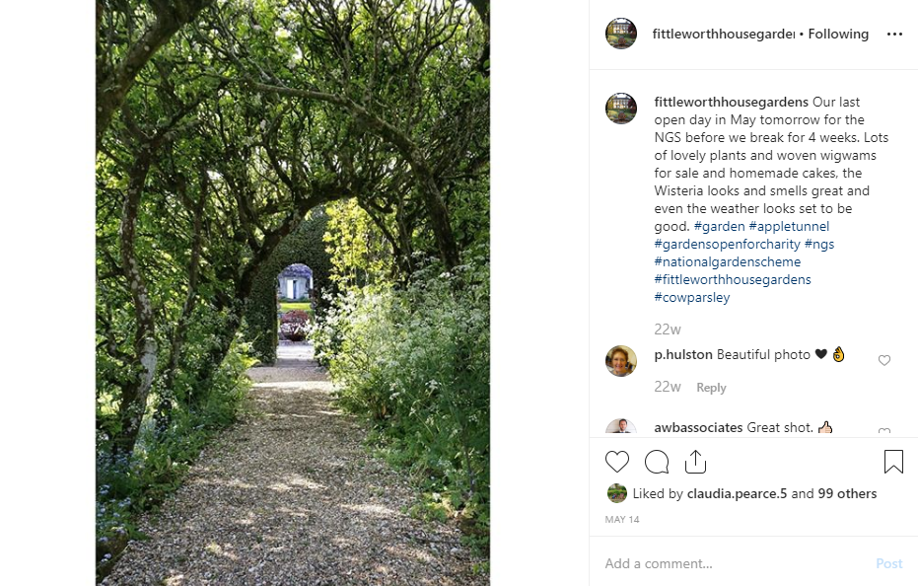
What can social media be used for?
To promote your garden opening
Share details of your garden opening in the lead up to your event
Share fresh photography and videos to attract new visitors
Work with the National Garden Scheme Hatchlands team and county teams to showcase your upcoming opening

Slide 6
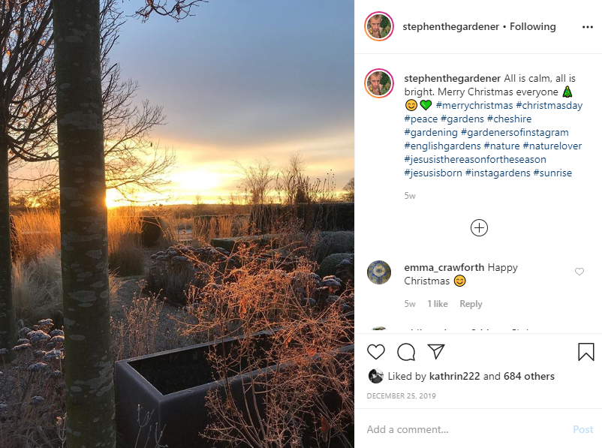
Tell your story
What can social media be used for?
To tell your story throughout the year
Keep garden visitors engaged throughout the year by sharing the story of your garden through photography and videos
A glimpse into the behind the scenes before your garden opening
Show your garden transform through the seasons
Easy content as it’s all just outside your backdoor!

Slide 7
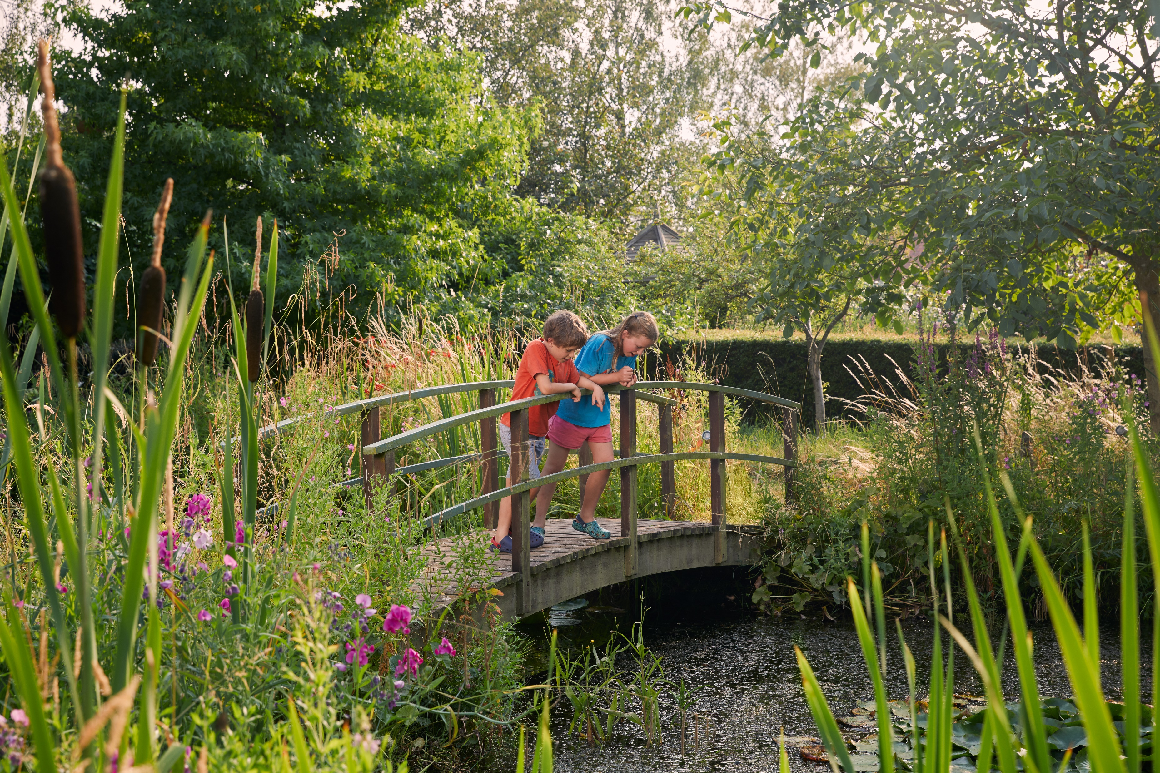
What can social media be used for?
To help you reach new audiences
With millions of people online everyday, being on social media can help you engage with new garden visitors
Such as;
Tourists: wanting a local experience
New gardeners: in search of ideas and inspiration
Families: looking for an afternoon outdoors

Slide 8
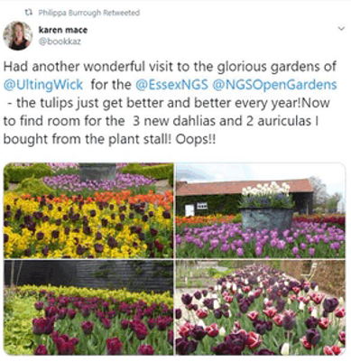
What can social media be used for?
To connect with your community
Connect with your county team to promote your opening
Share content from National Garden Scheme beneficiaries to showcase the impact of the money you raise in your garden
Meet National Garden Scheme garden owners and volunteers across England and Wales
Discover your garden visitor’s experiences

Slide 9
Frequently asked questions

Slide 10
Do I have to post all day, everyday?
No! There is no ‘right’ amount of times to post on social media.
Whether you login to social media every day or just a few times a month, the most important thing is that you enjoy creating and sharing your content.

Slide 11
What if no one follows my new account?
New social media accounts take time to grow (but don’t give up!)
Make sure to get in touch with your county team, as well as the Hatchlands team. They will be able to help you reach new audiences by engaging with your fantastic content, and tagging you in anything they might post about your garden.

Slide 12
I don’t know how to set up a social media account!
There are lots of resources available to help you with social media, these include;
A series of how to videos
Real time guides to setting up different accounts, creating content, and managing your account.
Guide to creating content
Provides ideas for creating content throughout the year
Social media glossary

Slide 13
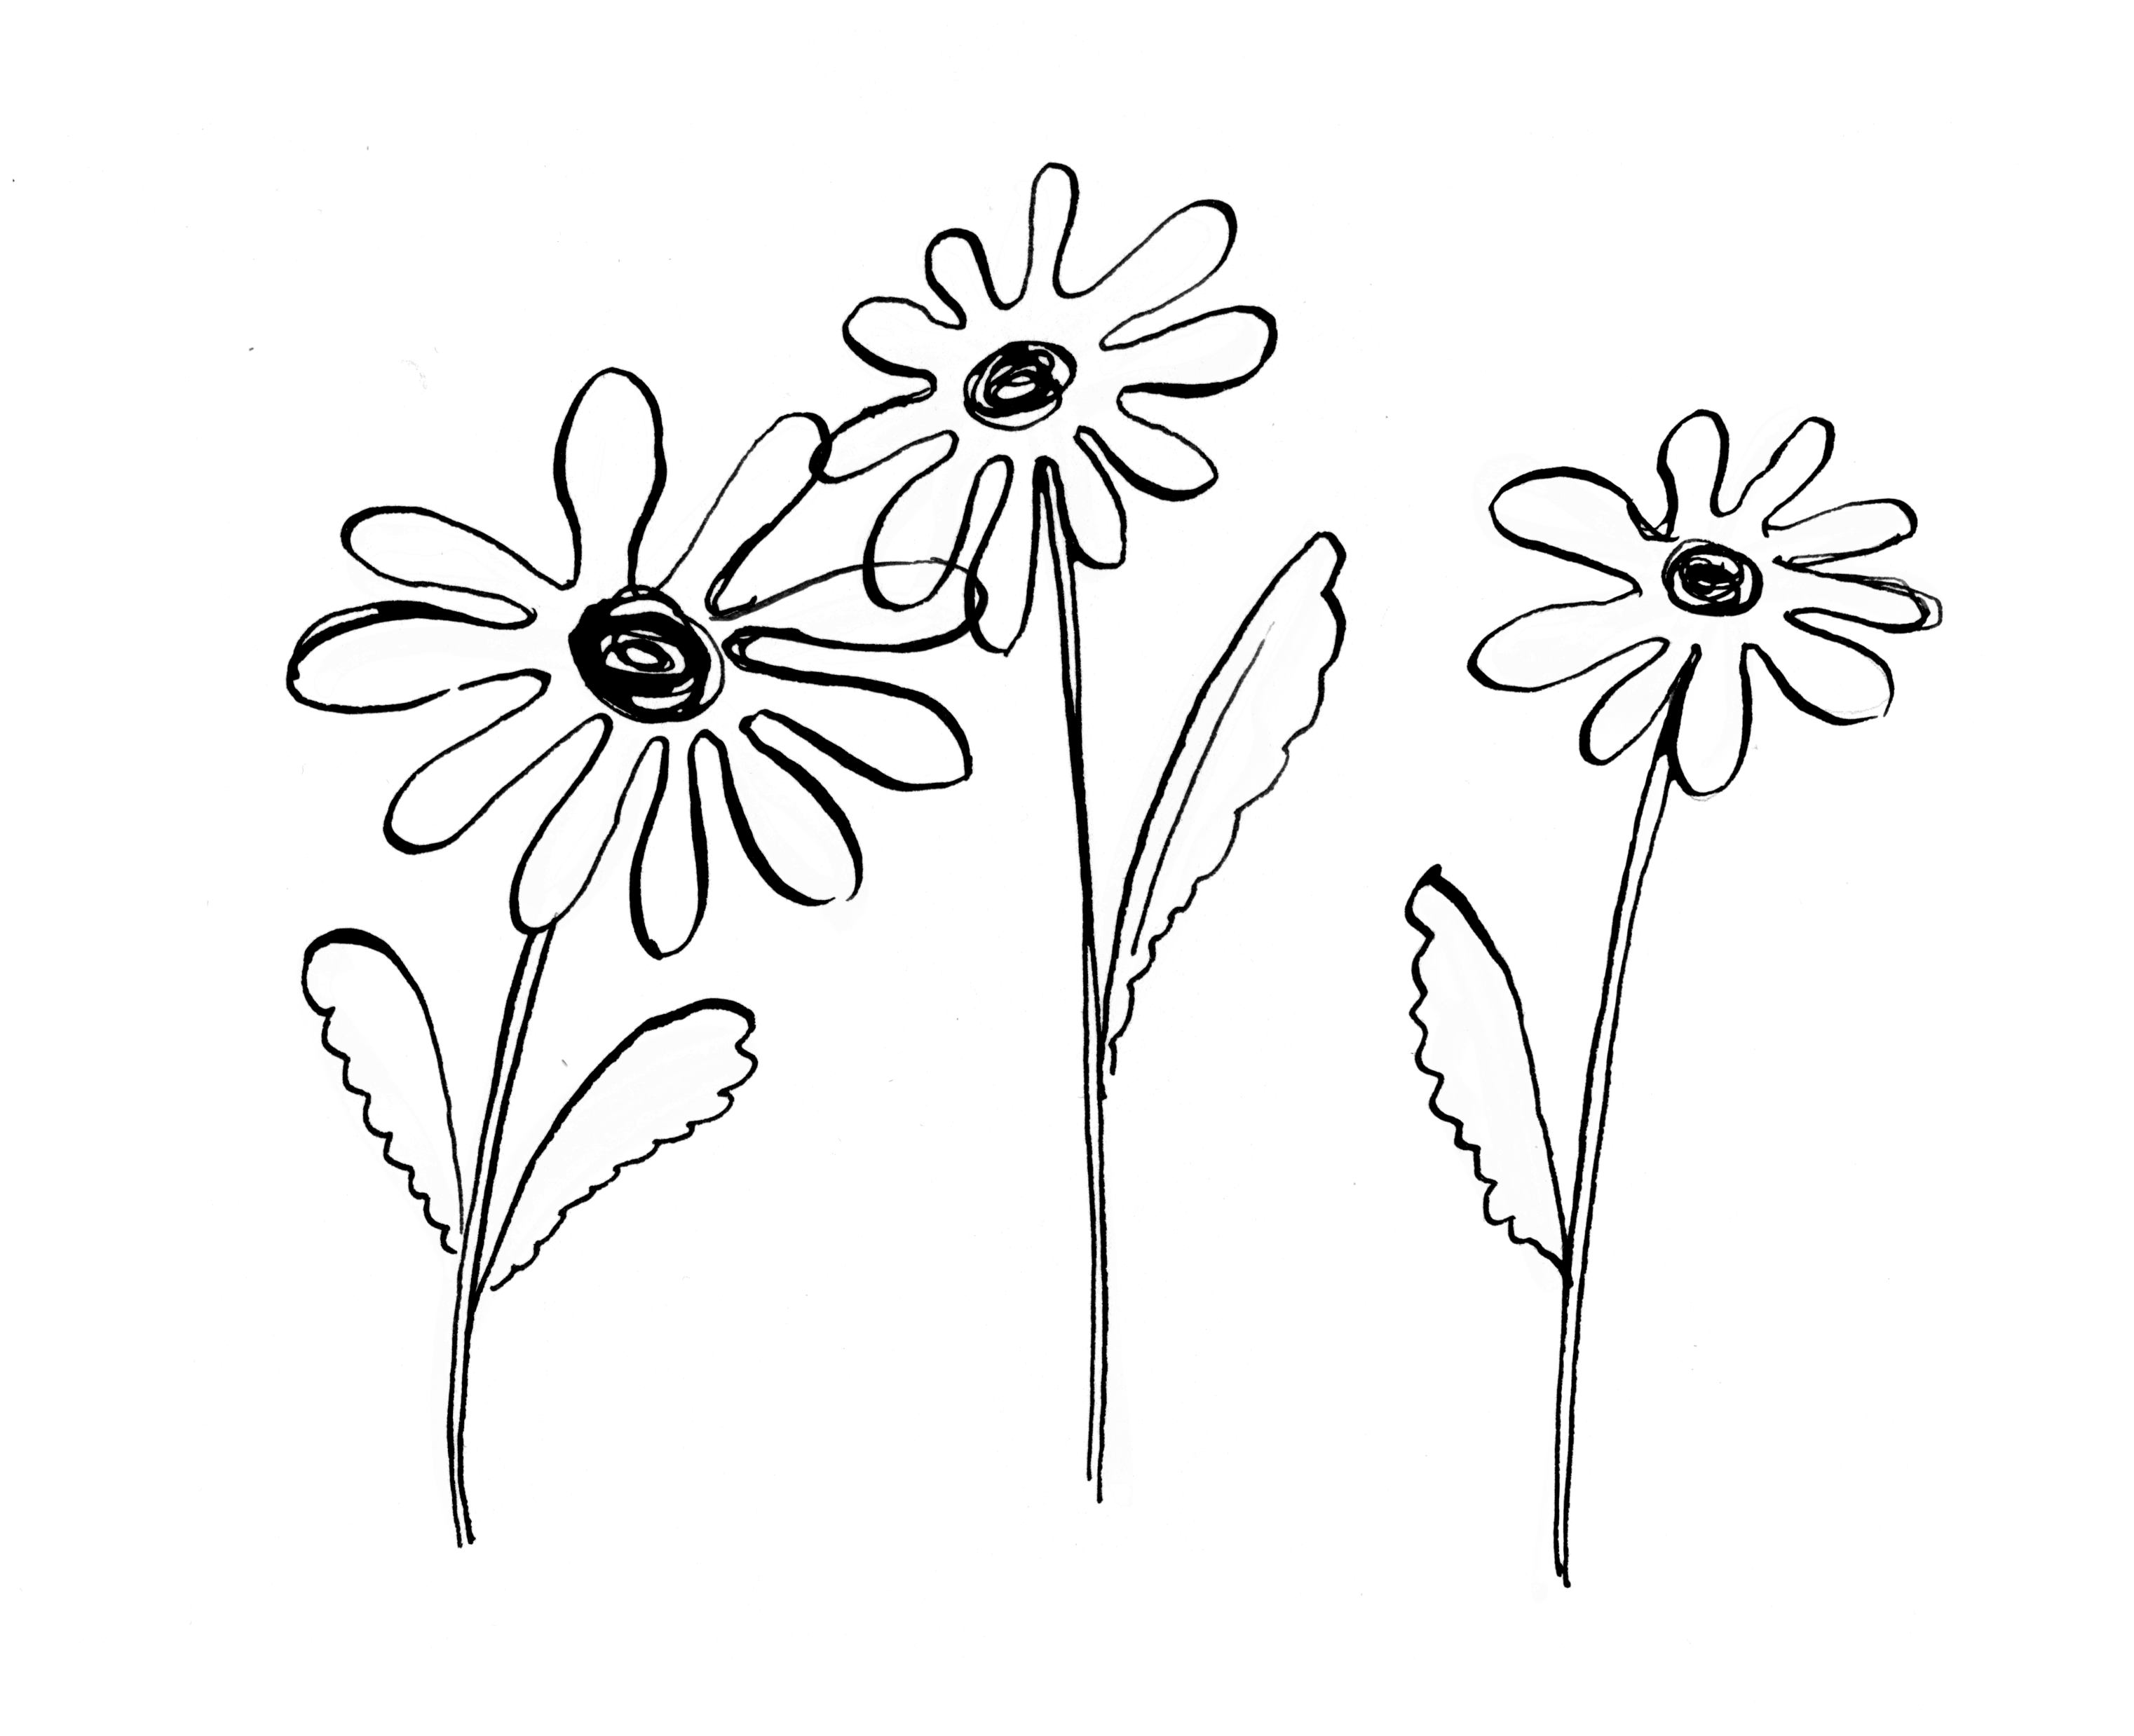
Questions and
ideas

