Slide 1
Gardens & Health

Slide 2
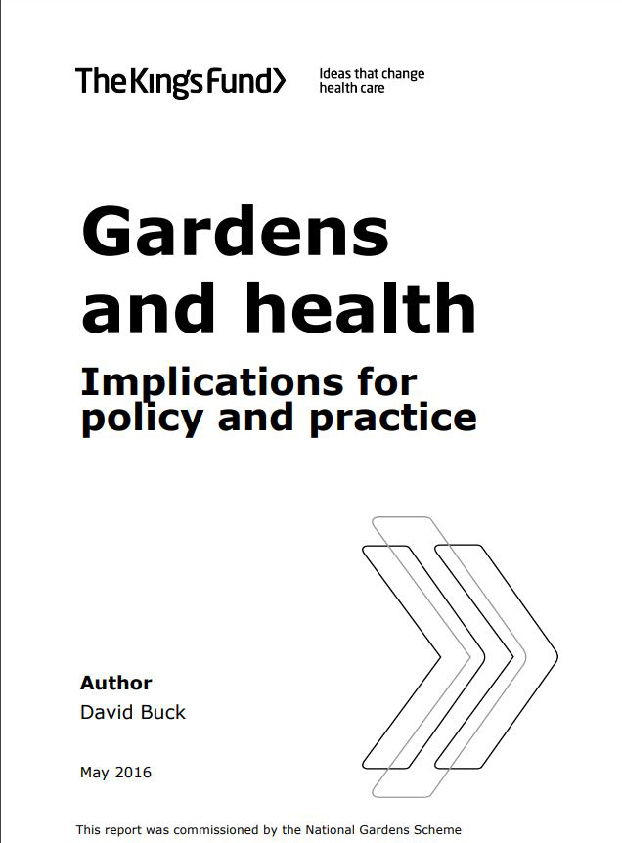
Gardens & Health
2016 - commissioned the King’s Fund report and began an annual funding programme to support gardens and health-related projects 2017 - launched our annual Gardens & Health programme to continue raising awareness of the impact gardens and gardening can have on everyone’s physical and mental health.
2021 - our Gardens & Health projects received £235,000.
Annually – promotion of Gardens & Health, linking beneficiary service users with free garden visits
Notes:
The National Garden Scheme isn’t just about opening beautiful gardens for charity – we are passionate about the physical and mental health benefits of gardens and gardening too.
In 2016, we commissioned the King’s Fund to produce a report on the topic and began an annual funding programme to support gardens and health-related projects run by charities. A year later, in 2017, we launched our annual Gardens & Health programme to continue raising awareness of the impact gardens and gardening can have on everyone’s physical and mental health. In 2021, our Gardens & Health projects received £235,000.
Our Gardens & Health Week in 2022 runs from 7th–15th May but we work to promote Gardens & Health throughout the year, linking service users from our beneficiaries with free garden visits and funding Garden & Health projects.
The National Garden Scheme isn’t just about opening beautiful gardens for charity – we are passionate about the physical and mental health benefits of gardens and gardening too.
2016 - commissioned the King’s Fund report and began an annual funding programme to support gardens and health-related projects 2017 - launched our annual Gardens & Health programme to continue raising awareness of the impact gardens and gardening can have on everyone’s physical and mental health.
2021 - our Gardens & Health projects received £235,000.
Annually – promotion of Gardens & Health, linking beneficiary service users with free garden visits

Slide 3
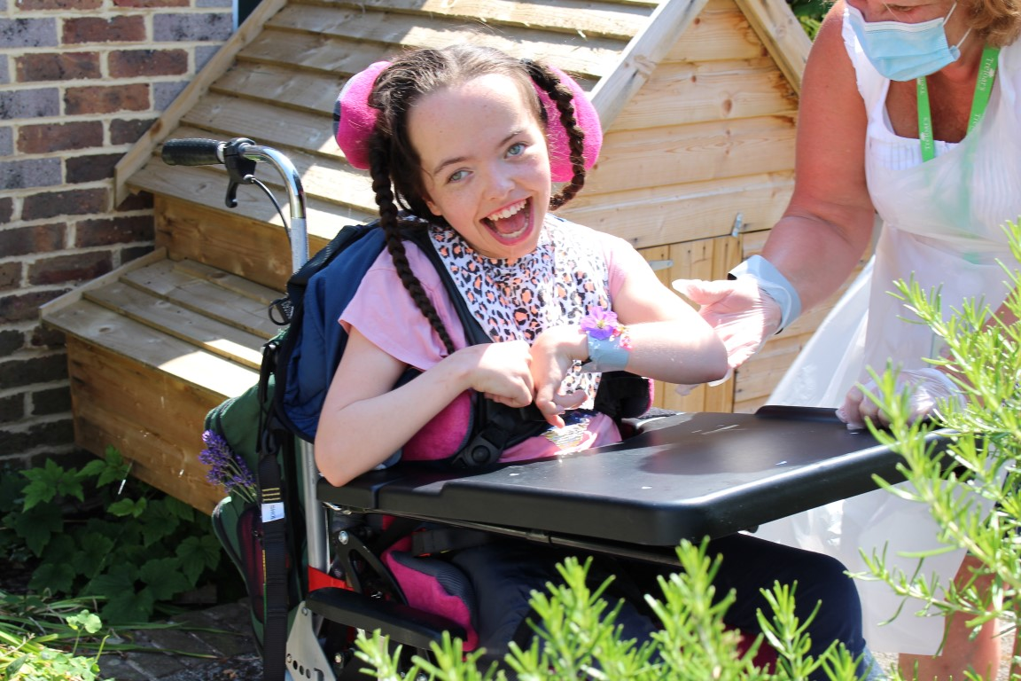
Gardens & Health
£845,000
Donated to Gardens & Health projects since 2019
Notes:
The National Garden Scheme isn’t just about opening beautiful gardens for charity – we are passionate about the physical and mental health benefits of gardens and gardening too.
In 2016, we commissioned the King’s Fund to produce a report on the topic and began an annual funding programme to support gardens and health-related projects run by charities. A year later, in 2017, we launched our annual Gardens & Health programme to continue raising awareness of the impact gardens and gardening can have on everyone’s physical and mental health. In 2021, our Gardens & Health projects received £235,000.
Our Gardens & Health Week in 2022 will run from 7th – 15th May but we work to promote Gardens & Health throughout the year, linking service users from our beneficiaries with free garden visits and funding Garden & Health projects.

Slide 4
Gardens & Health projects include:
Maggie’s
In 2021 our £100,000 donation supported new gardens in Oxford and Cheltenham. We’ve also supported the centres in Southampton and Newcastle.
Many Maggie’s gardens have open days for the National Garden Scheme.
Notes:
Maggie’s is a network of drop-in centres across the UK which help anyone who has been affected by cancer. The centres link inside and outside with fabulous gardens to create a place of tranquility at busy hospital sites.
In 2021 we donated £100,000 to support new gardens in Oxford and Cheltenham. We have also supported the centres in Southampton and Newcastle.
Many Maggie’s gardens have open days for the National Garden Scheme.

Slide 5
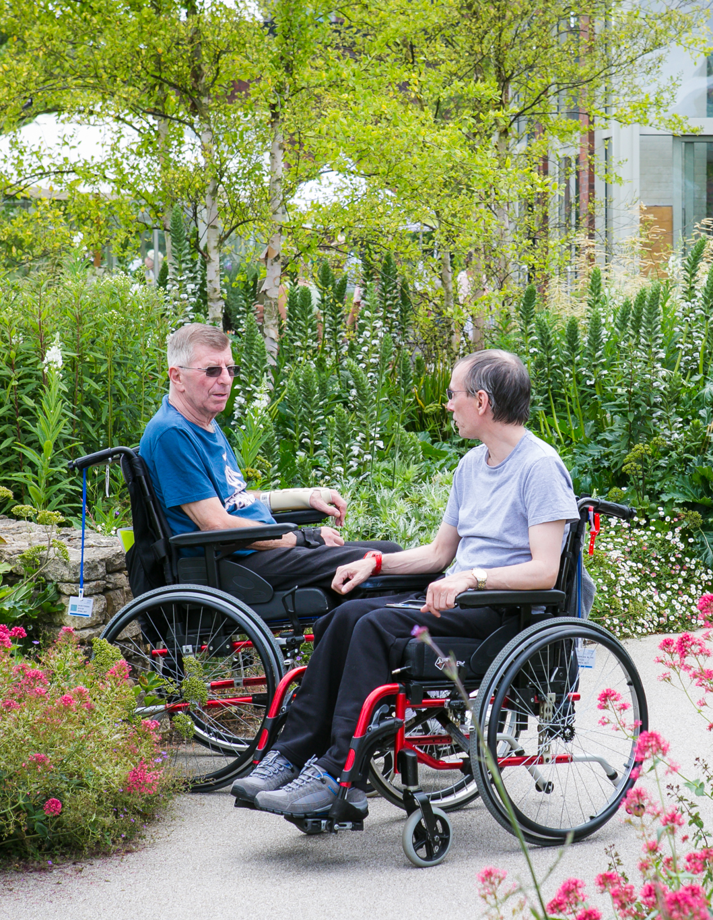
Gardens & Health projects include:
Horatio’s Garden
We’ve supported Horatio’s Garden since 2015
In 2019 we committed funding for the completion of all eleven gardens across the UK.
In 2021, the donation of £75,000 was allocated to the creation of Horatio’s Garden, Wales.
Horatio’s Garden sites also open for the National Garden Scheme.
Notes:
We have been supporting Horatio’s Garden since 2015 to help the charity create and care for beautiful, accessible gardens in NHS Regional spinal injury centres.
In 2019 we committed funding for the completion of all eleven gardens across the UK.
In 2021, the donation of £75,000 was allocated to the creation of Horatio’s Garden, Wales.
Horatio’s Garden sites also open for the National Garden Scheme.

Slide 6
Gardens & Health projects include:
ABF The Soldiers’ Charity
We’ve been supporting the charity since 2010, with total donations £590,000 to date.
2021 – an annual donation of £60,000 helped support the provision of horticultural-related assistance to soldiers, veterans and their immediate families, to improve their health and wellbeing.
Notes:
The National Garden Scheme has been supporting the charity since 2010, with donations in 2010 and 2011, then annual donations from 2017, totalling £590,000.
In 2021, we made a donation of £60,000 to help support the provision of horticultural-related assistance to soldiers, veterans and their immediate families, to improve their health and wellbeing.
Our funding contributes to the care and recovery of some of the most vulnerable veterans.

Slide 7
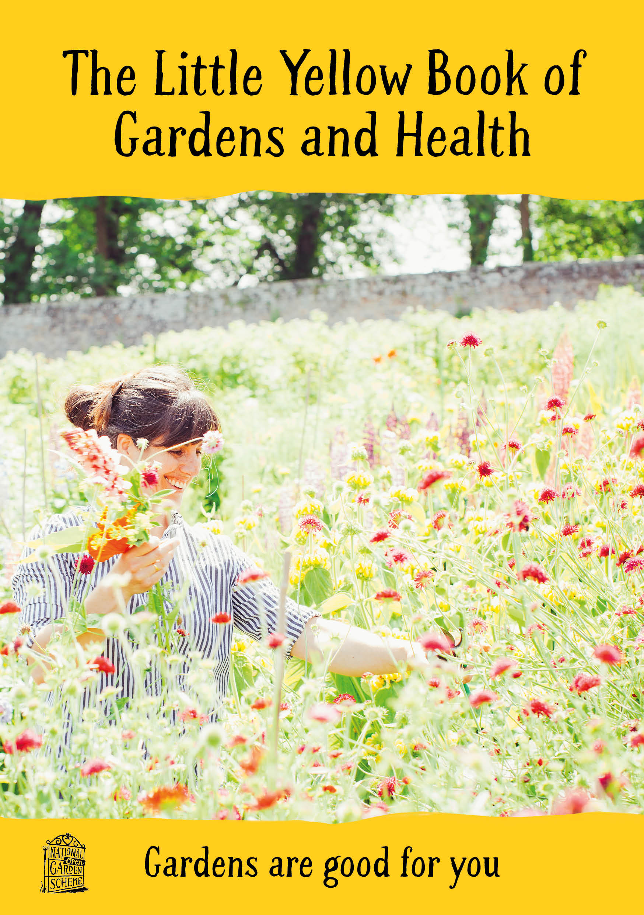
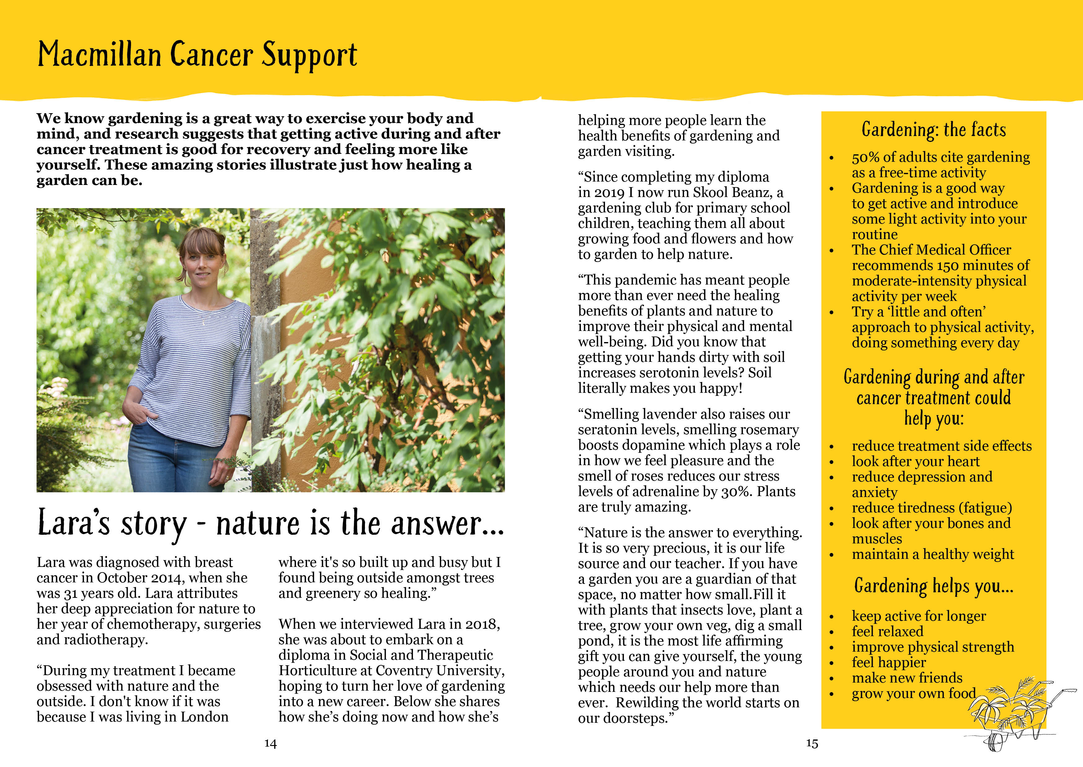
Gardens & Health Week
We celebrate Gardens & Health Week in May each year.
In 2021 this centred on ‘Gardens Are Good for You’.
We published a digital booklet ‘The Little Yellow Book of Gardens & Health’ which celebrates everything that is good about gardens and gardening.
It includes expert advice and case studies from our beneficiaries, garden owners and volunteers, and looks not only at human health but the health, sustainability and biodiversity of gardens too.
Notes:
We celebrate Gardens & Health Week in May each year, bringing focus to our work in the area and linking with topical subjects in the field through a PR and social media campaign.
In 2021 this centred on ‘Gardens Are Good for You’ and we published a popular digital booklet called ‘The Little Yellow Book of Gardens & Health’ which celebrated everything that is good about gardens and gardening. It includes expert advice and case studies from our beneficiaries, garden owners and volunteers, and looks not only at human health but the health, sustainability and biodiversity of gardens too.
In 2022 we will continue the ‘Gardens Are Good for You’ theme and introduce some exciting new research.

Slide 8
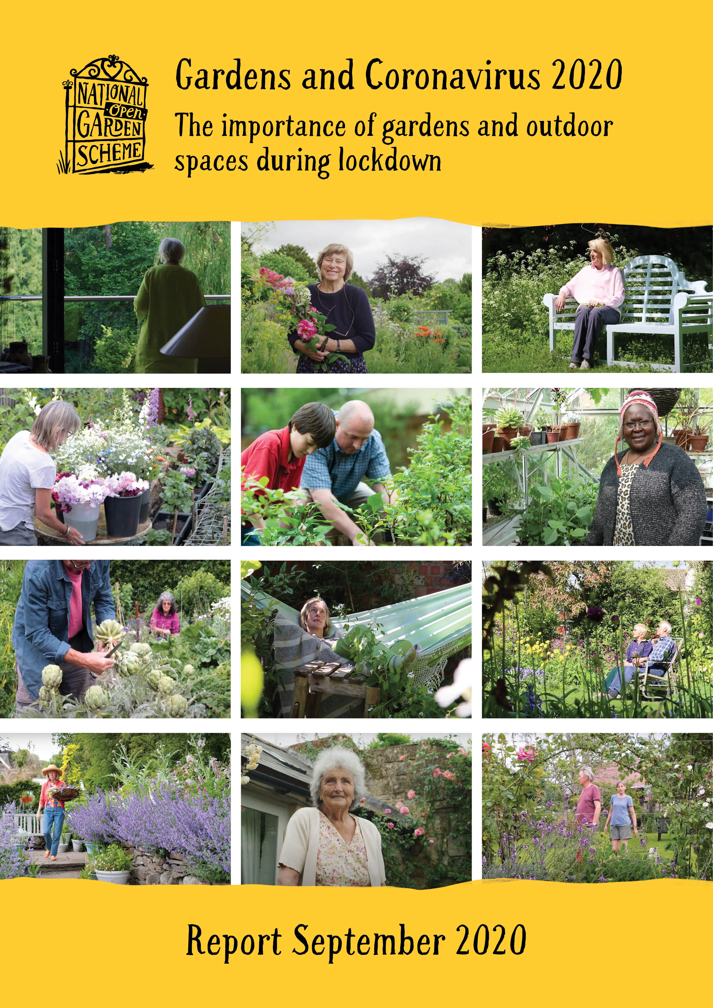
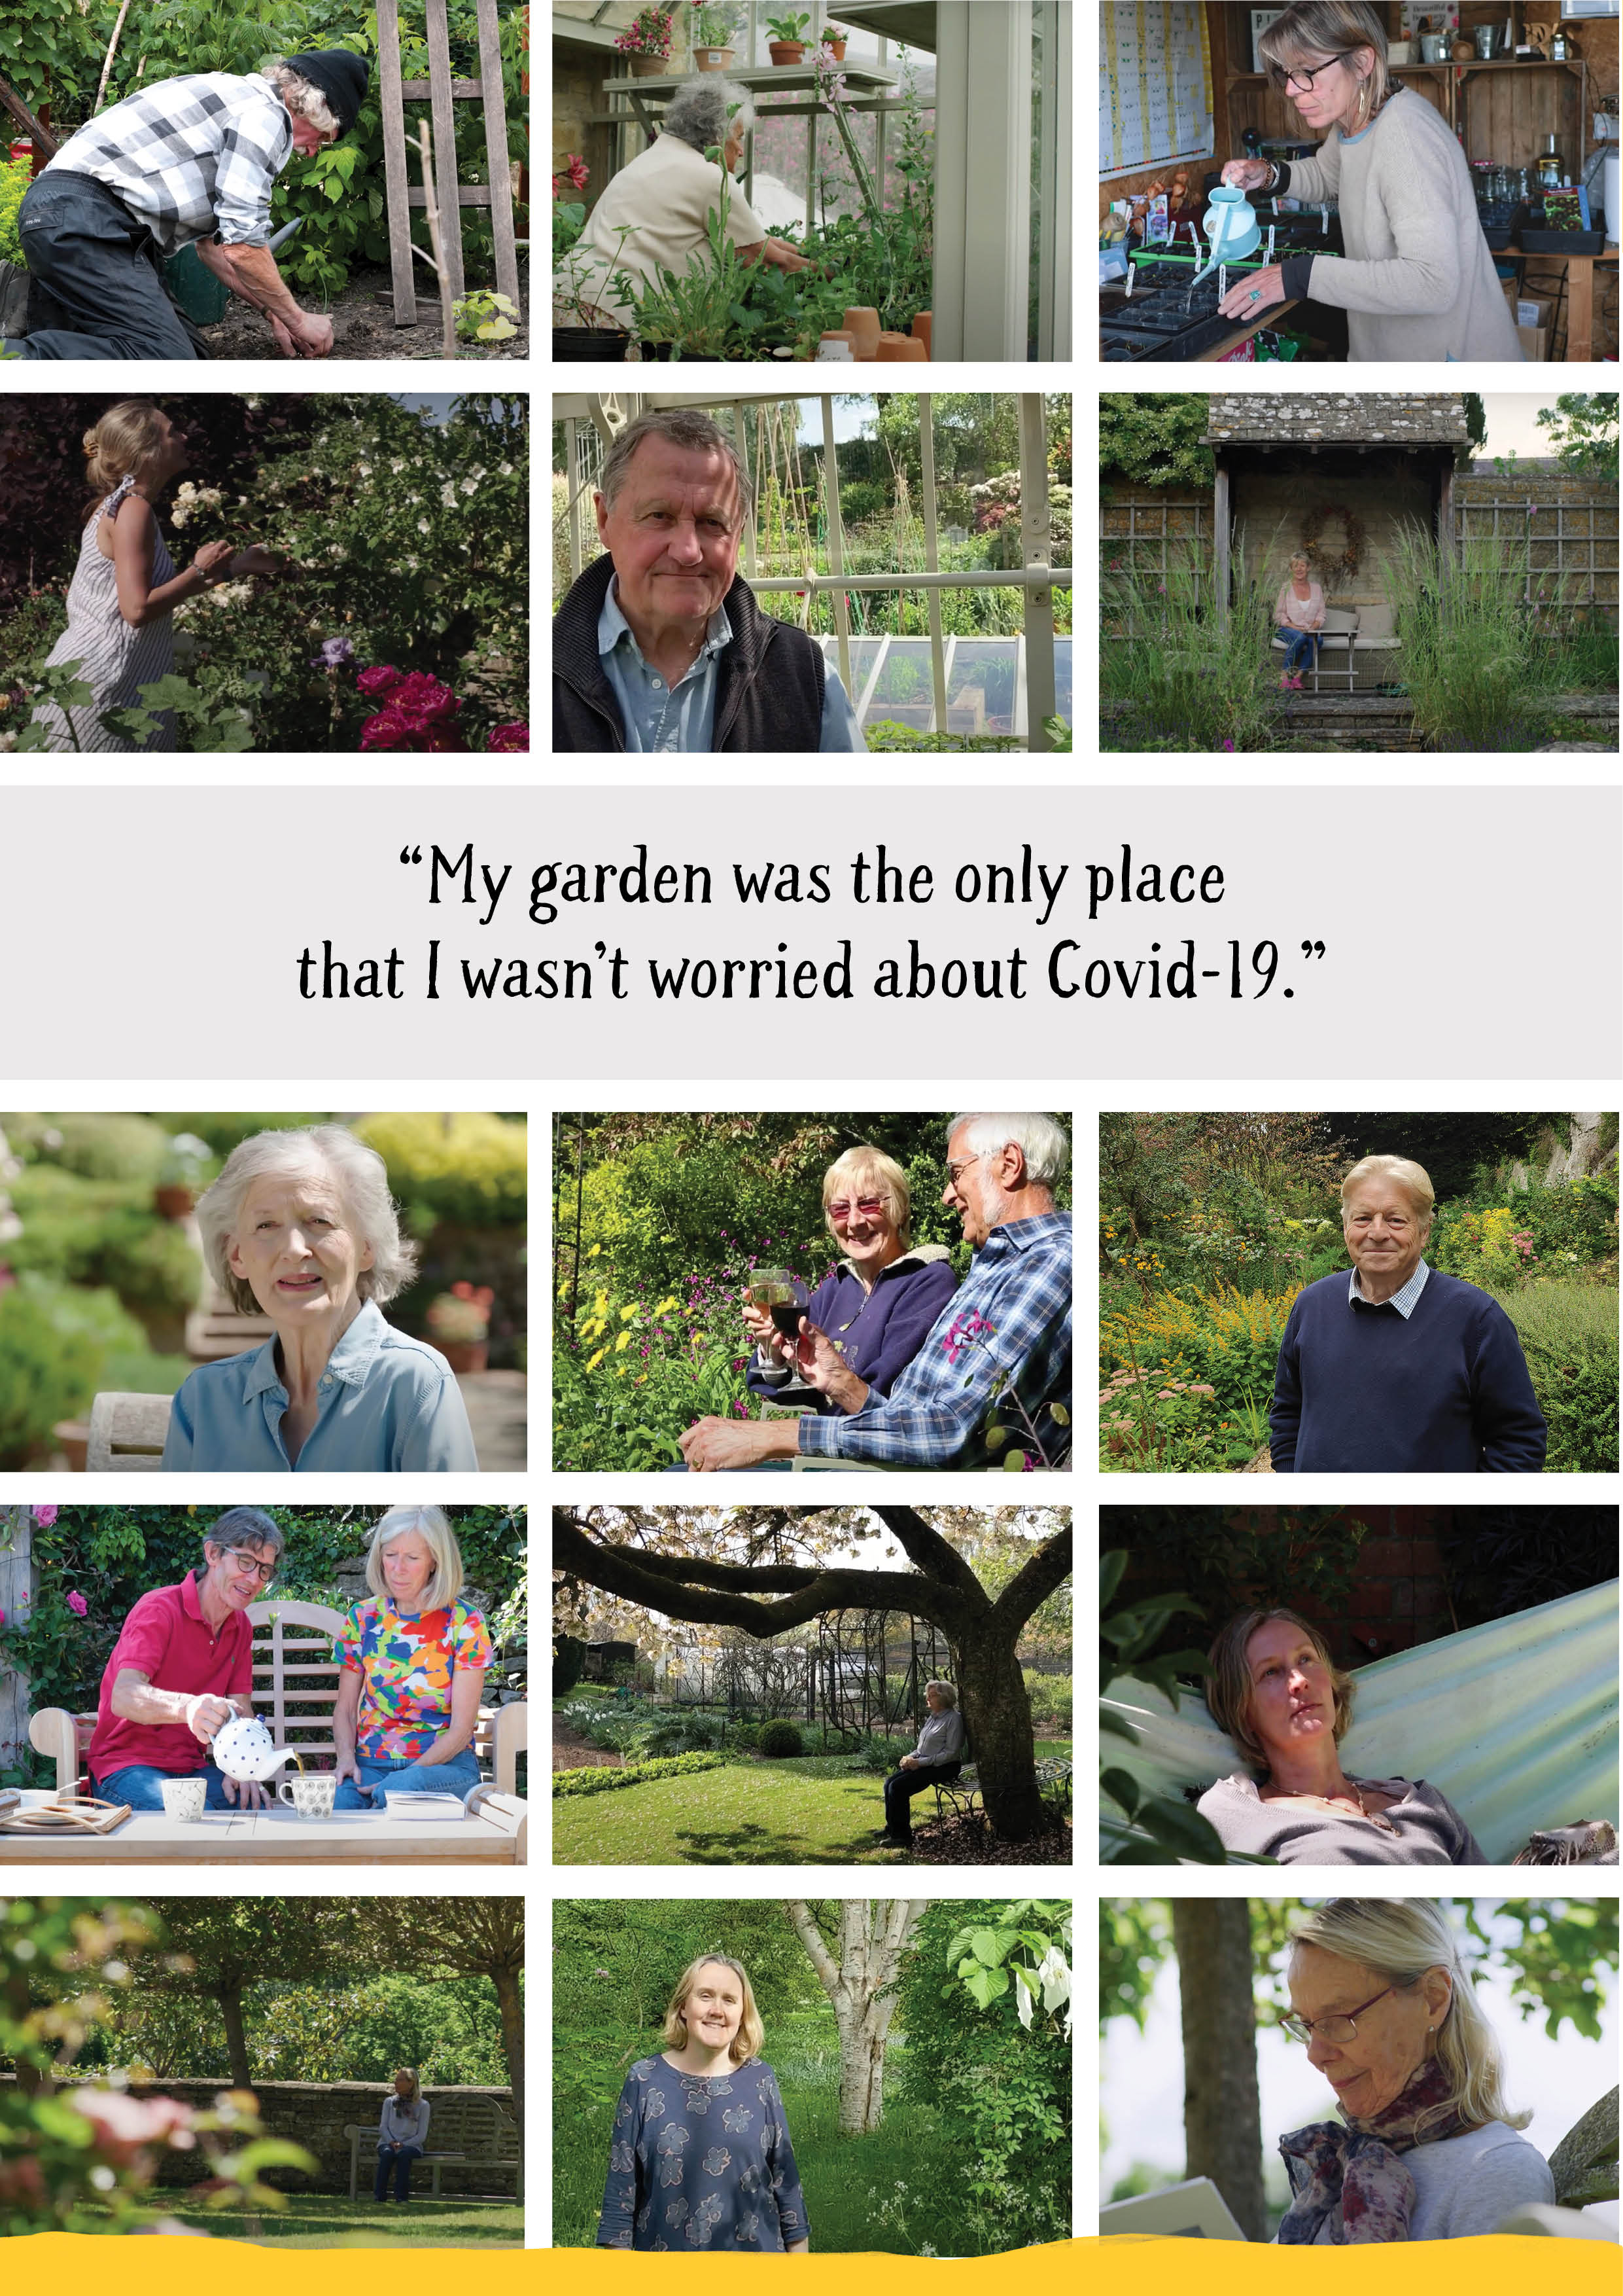
Gardens & Health reports
The Gardens and Health arena is an area of interest that has grown exponentially since the COVID-19 enforced lockdowns when our gardens and green spaces took on a new significance for our health and wellbeing.
Both the 2016 Kings Fund Report and our Gardens and Coronavirus 2020 Report highlight the key role that the National Garden Scheme has to play.
Notes:
With access to over 3,500 garden owners, 500+ volunteers and 50,000+ supporters, we are uniquely positioned to provide a strong voice in the Gardens & Health arena. It is an area of interest that has grown exponentially since the COVID-19 enforced lockdowns when our gardens and green spaces took on a new significance for our health and wellbeing.
Both the 2016 Kings Fund Report and our Gardens and Coronavirus 2020 Report highlight the key role that the National Garden Scheme has to play in this important subject area and have attracted much interest.

Slide 9
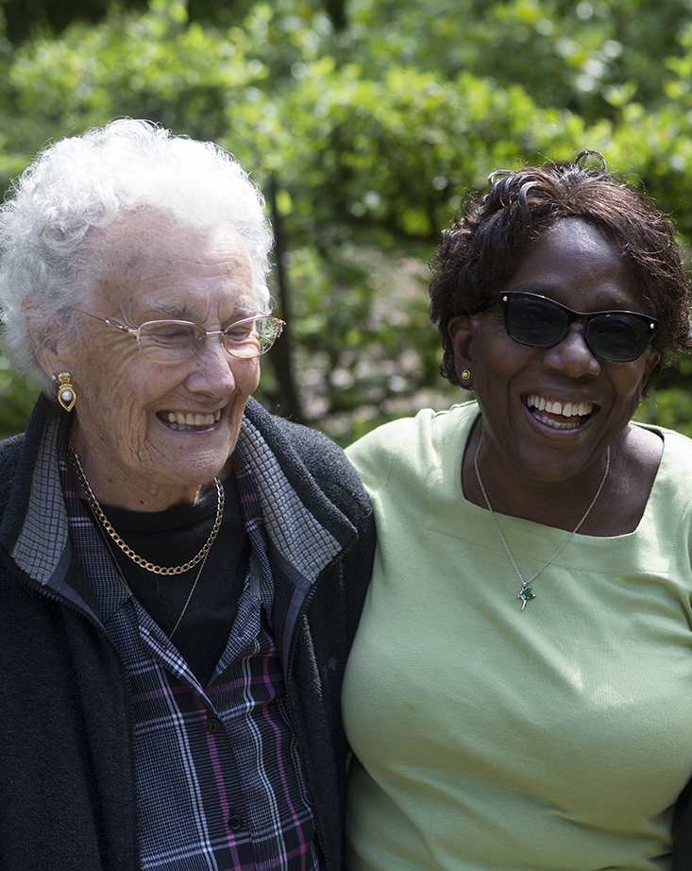
Gardens & Health visits
“The garden was beautiful. I could put my caring role aside and be with like-minded people. The whole experience left me feeling calm and peaceful and has done wonders for my mental health.”
Free garden visits to National Garden Scheme gardens for our beneficiary service-users and nursing and healthcare staff.
This programme works on a ‘match-making’ basis, identifying areas where there are groups of service-users who would benefit from a garden visit and matching them with a suitable garden.
Notes:
As part of our Gardens & Health programme we also facilitate free garden visits to National Garden Scheme gardens for our beneficiary service-users and nursing and healthcare staff.
This programme works on a ‘match-making’ basis, identifying areas where there are groups of service-users who would benefit from a garden visit and matching them with a suitable garden.
Despite the restrictions in place in 2019, we organised garden visits for 52 unpaid carers and 21 people in receipt of care.
Recognising the huge sense of wellbeing they provide, our beneficiaries are keen to arrange more garden visits in 2022.

Slide 10
Discover more at:
ngs.org.uk/gardens-and-health/

Slide 11
Your perfect garden awaits
ngs.org.uk

