Slide 1
Thank you for using the National Garden Scheme presentation template.
To be able to edit and use the presentation at your talks you will need to download it first.
To do this...
Click on file in the top left hand corner
Then click on download as
Then select download a copy
Once downloaded it will either just open automatically or be in your downloads folder
When you are in the presentation to edit it just select enable editing at the top of the page
From there you can save the presentation anywhere on your computer and delete this first slide

Slide 2

Beyond the garden gate
National Garden Scheme
Presented by: insert name and role

Slide 3
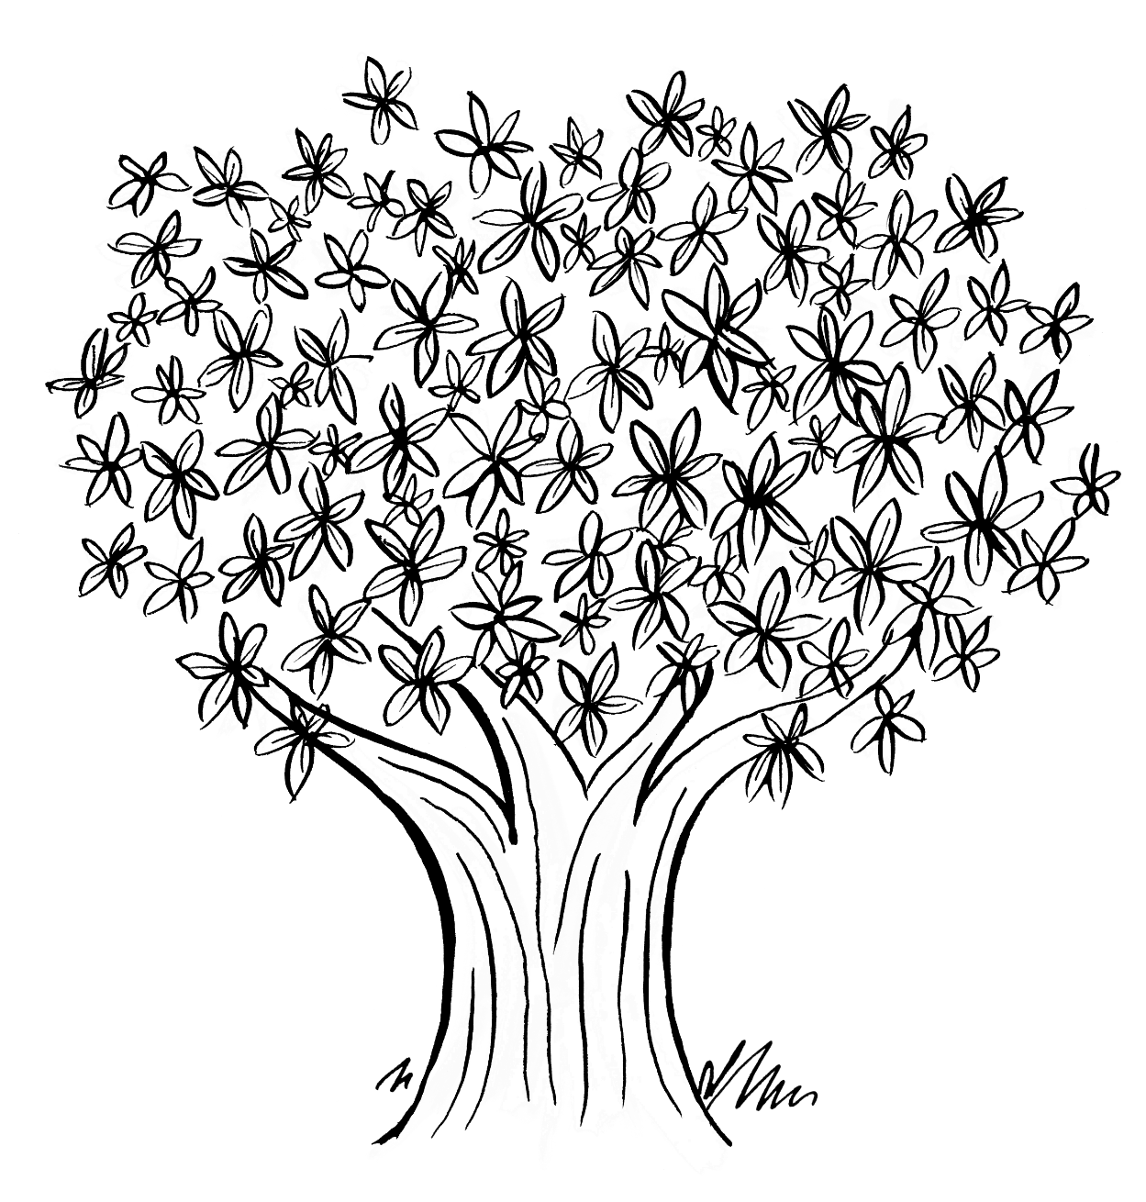
Since 1927…
We have
become the most significant charitable funder of nursing in the UK
donated over £77 million to nursing and health charities

Slide 4
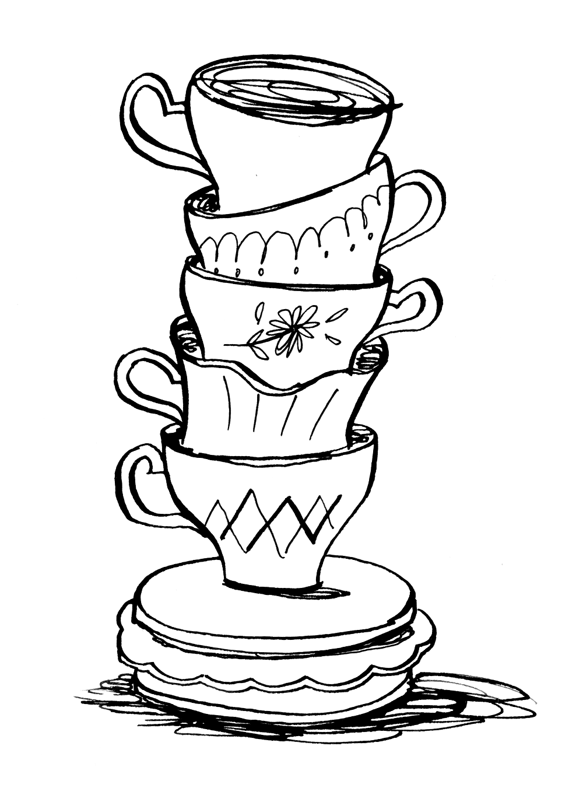
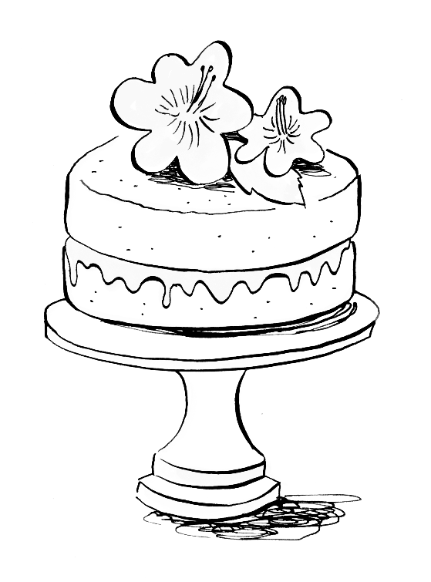
What we do
We..
discover the most remarkable gardens
help their owners open them up to the public
raise impressive amounts for charity though admissions, tea and cake!

Slide 5
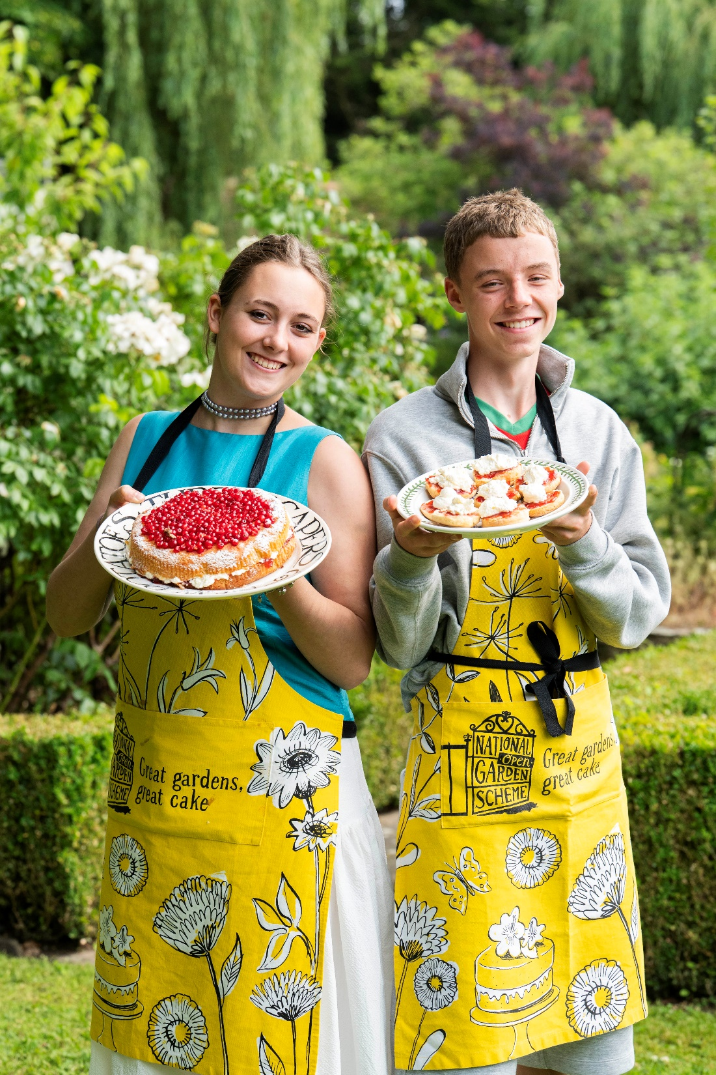
A bit of magic makes it possible
The generosity of...
over 3,200 gardeners
more than 600 volunteers
​generations of bakers and
tea makers
over 600,000 garden visitors

Slide 6
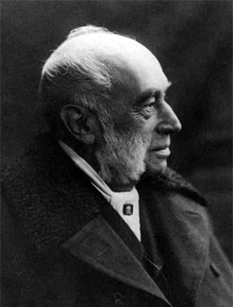
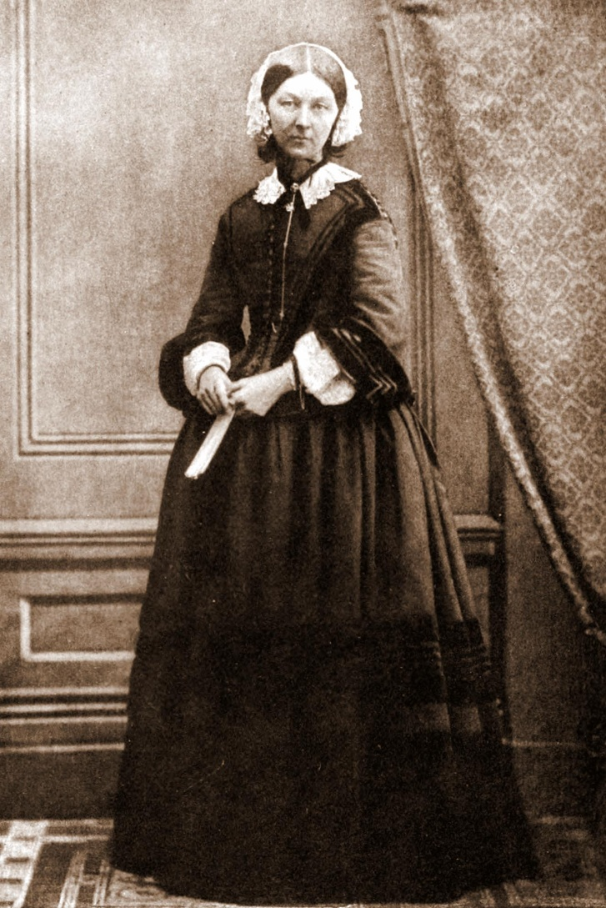
Our story begins in 1859
William Rathbone
Florence Nightingale

Slide 7
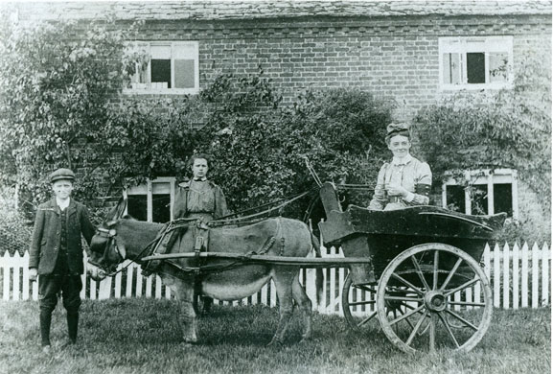
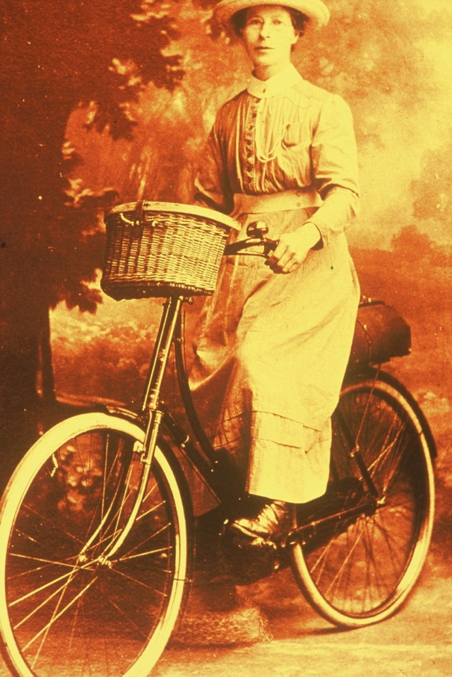
District nursing grew rapidly

Slide 8
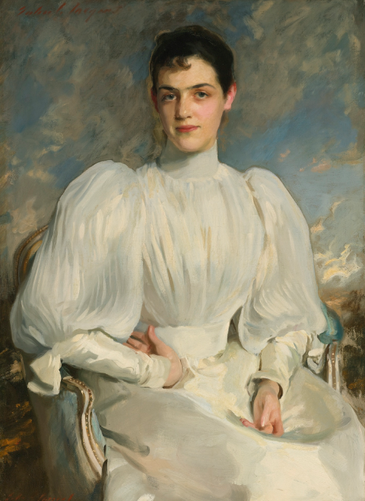
National Garden Scheme is founded
1926
Elsie Wagg suggests opening gardens to raise funds
1927
600 gardens open
one shilling a head
£8,191 raised

Slide 9
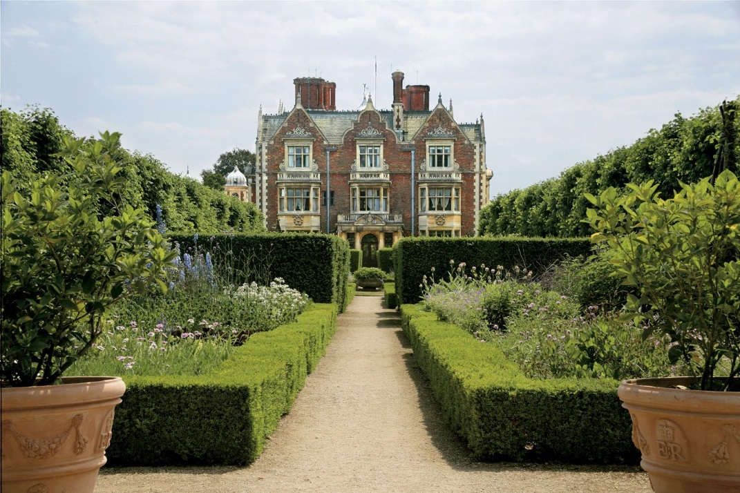
Sandringham, Norfolk

Slide 10
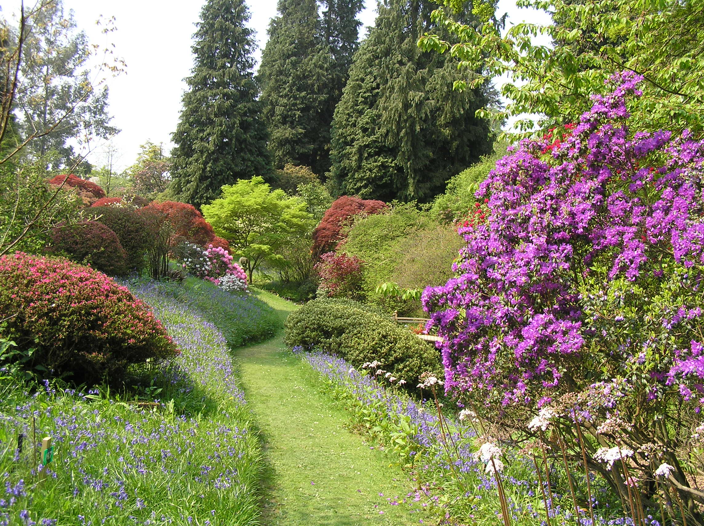
Ramster Gardens, Surrey

Slide 11
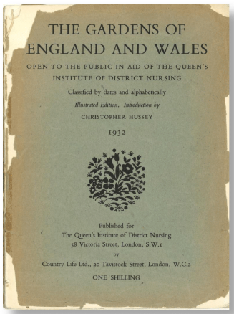
Our first guide
1932
published in Country Life
an illustrated list of 1079 gardens
cost one shilling

Slide 12
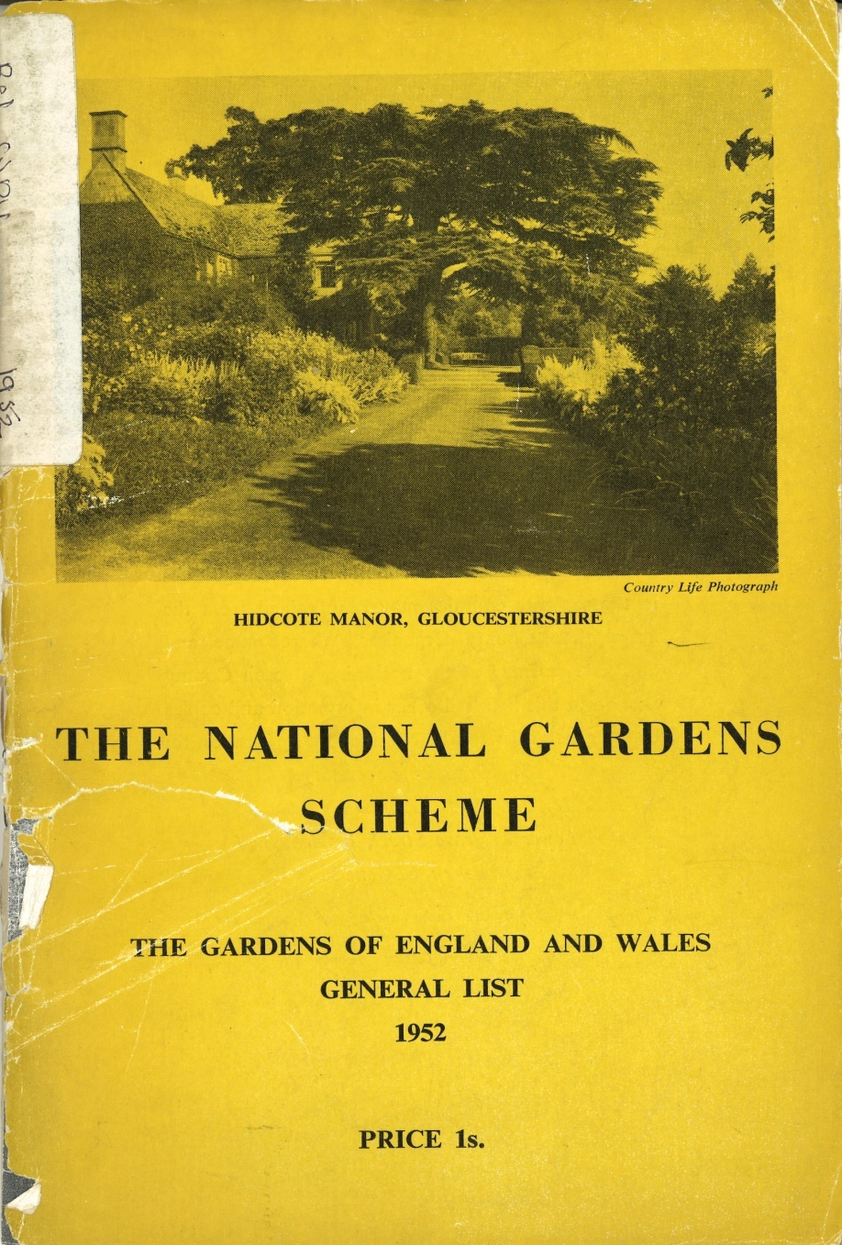
The war years
1939
Opening gardens as part of war effort
1948
NHS and local authorities take on home nursing service
1949
Our garden guide turns yellow - symbolising a mood of national regeneration

Slide 13

We become independent
1980
We become independent of QNI
The Queen mother becomes Royal Patron
1984
First donation to Macmillan nurses
1996
Five new nursing and health beneficiaries
2013
Parkinson's UK becomes guest charity and subsequently a permanent beneficiary.

Slide 14
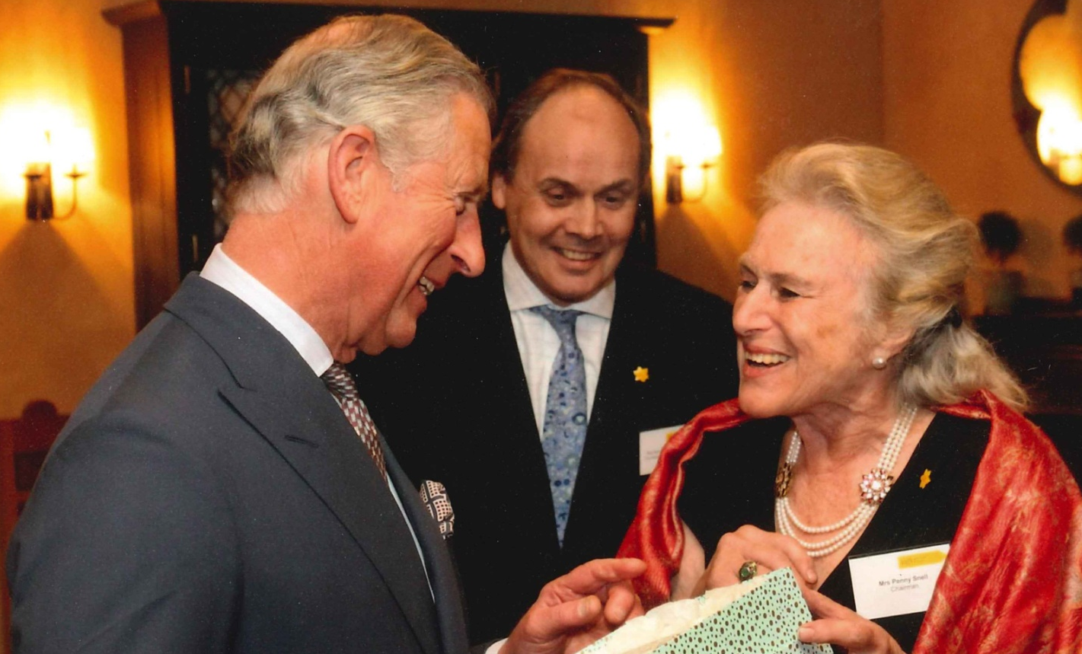
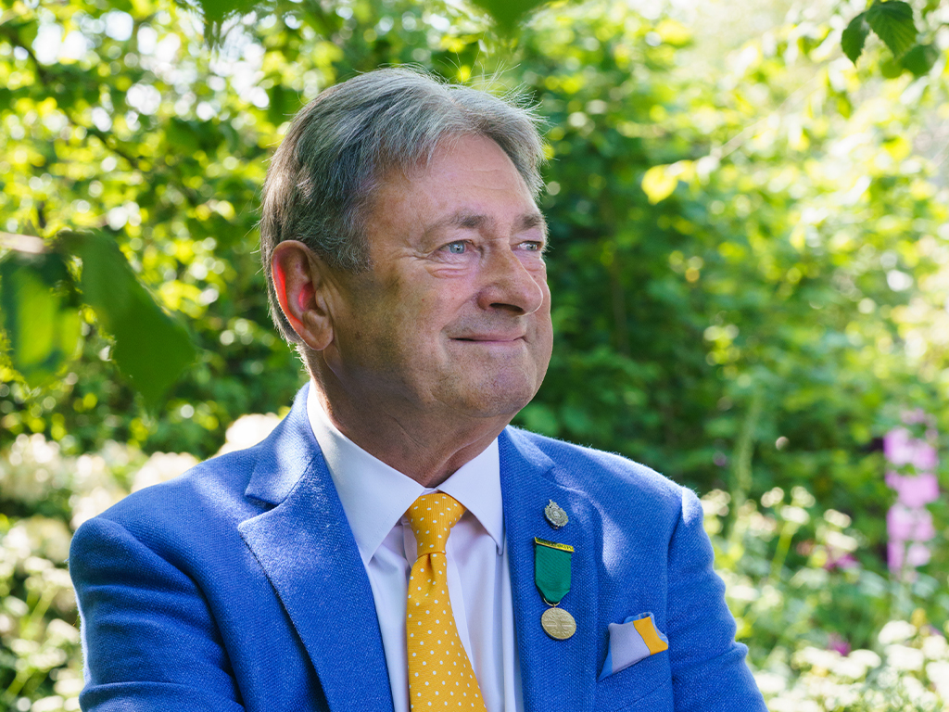
Royal patronage
2002
His Majesty King Charles III – Patron
2025
Alan Titchmarsh - President

Slide 15
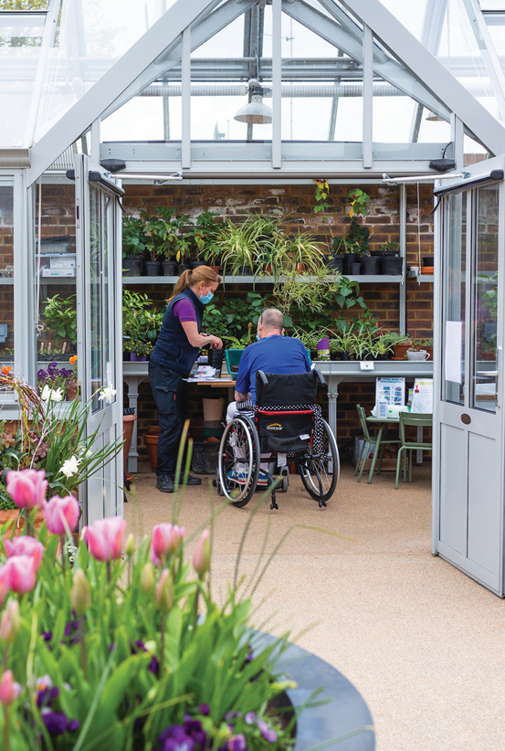
Gardens and Health
2016
King’s Fund report: Gardens and Health: Implications for Policy and Practice
Horatio’s Garden
2017
Gardens and health week launched
2019
Kings Fund report: Investing in Quality, the contribution of large charities to the future of health and care
2020
Report published: Gardens and Coronavirus – The importance of garden outdoor spaces during lockdown
2024
Report published: The wellbeing benefits of visiting National Garden Scheme gardens in winter

Slide 16
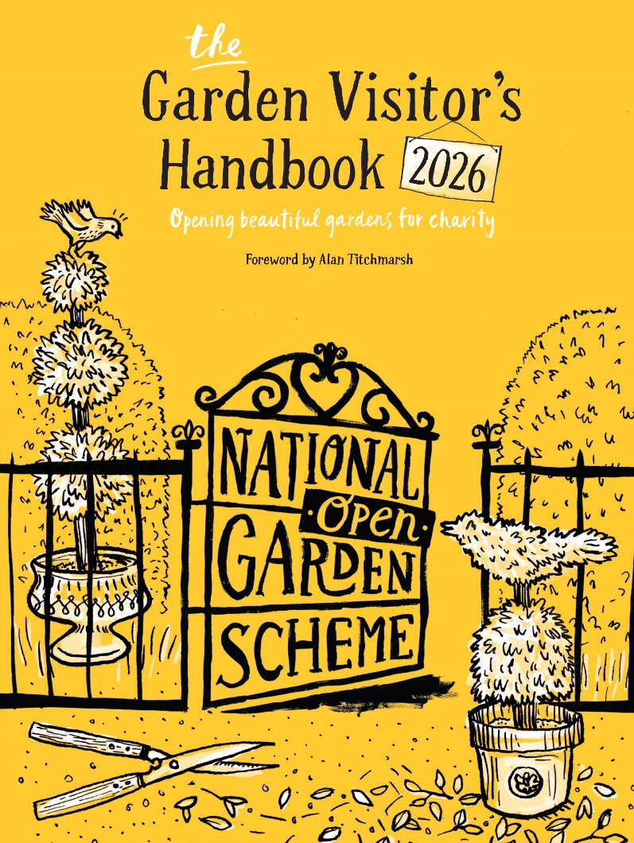
National Garden Scheme today
2026
Over 3,200 gardens open
Over 700 new and returning gardens
28 allotment groups
60 community gardens
14 hospice gardens
1,575 welcome dogs on leads
1,632 offer plants for sale

Slide 17
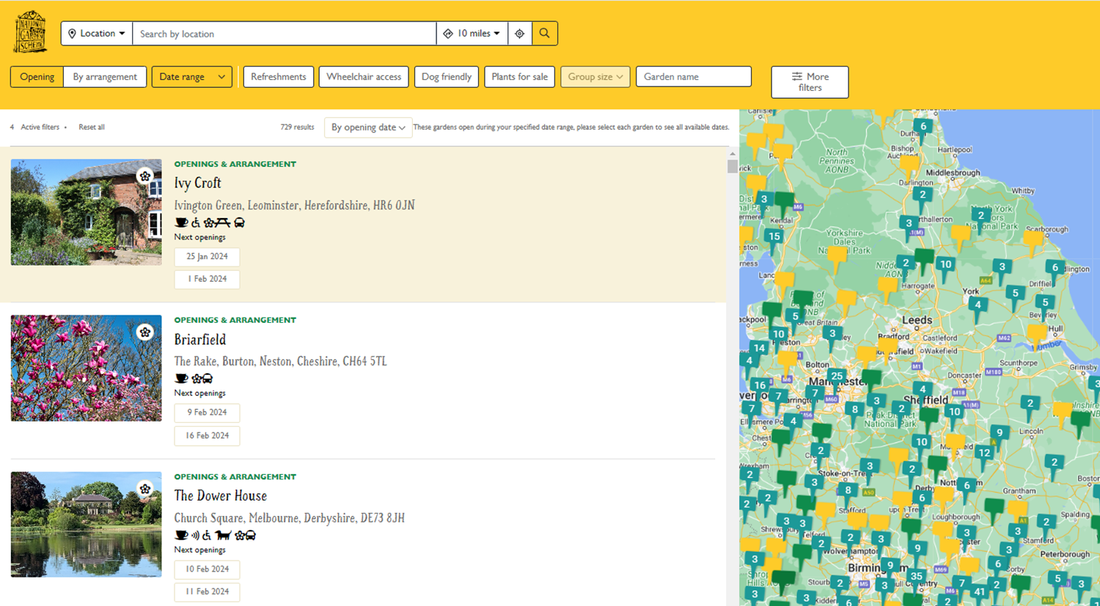
Find a garden

Slide 18

Our gardens through the seasons

Slide 19
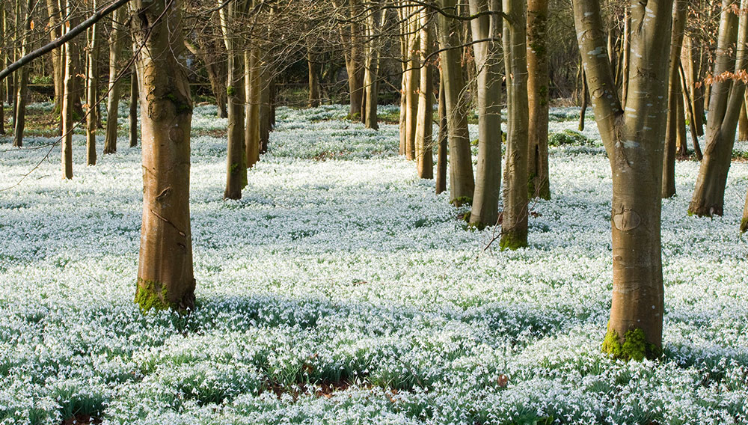

Winter
Welford Park, Berkshire

Slide 20
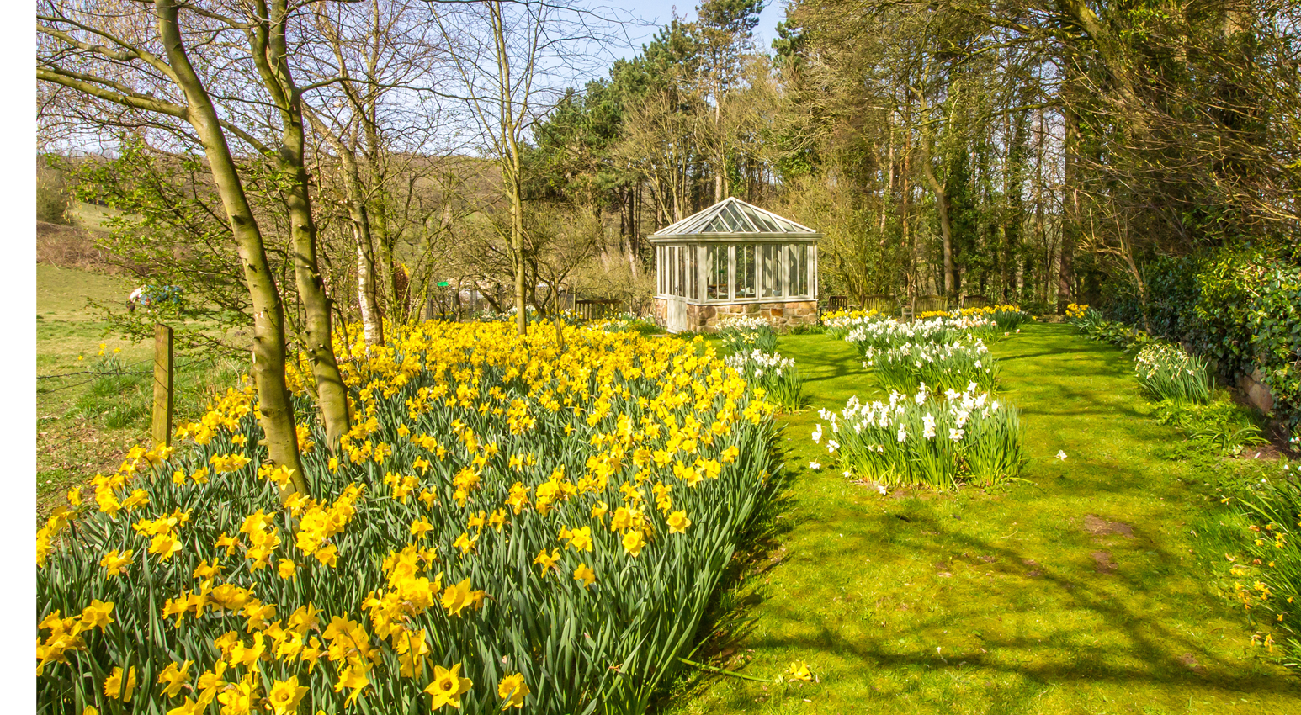
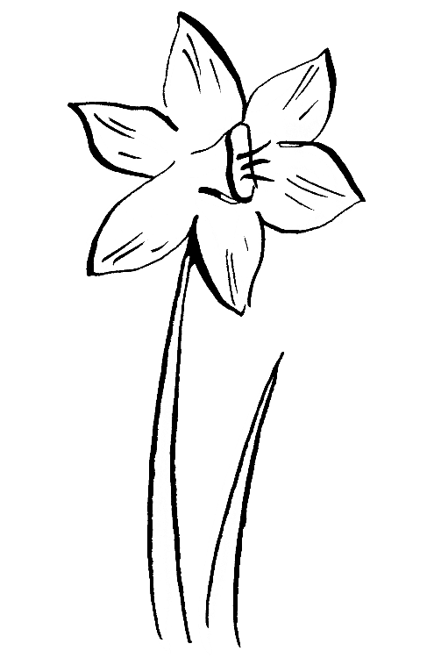
Spring
Chevin Brae, Derbyshire
© Amanda McConnell

Slide 21
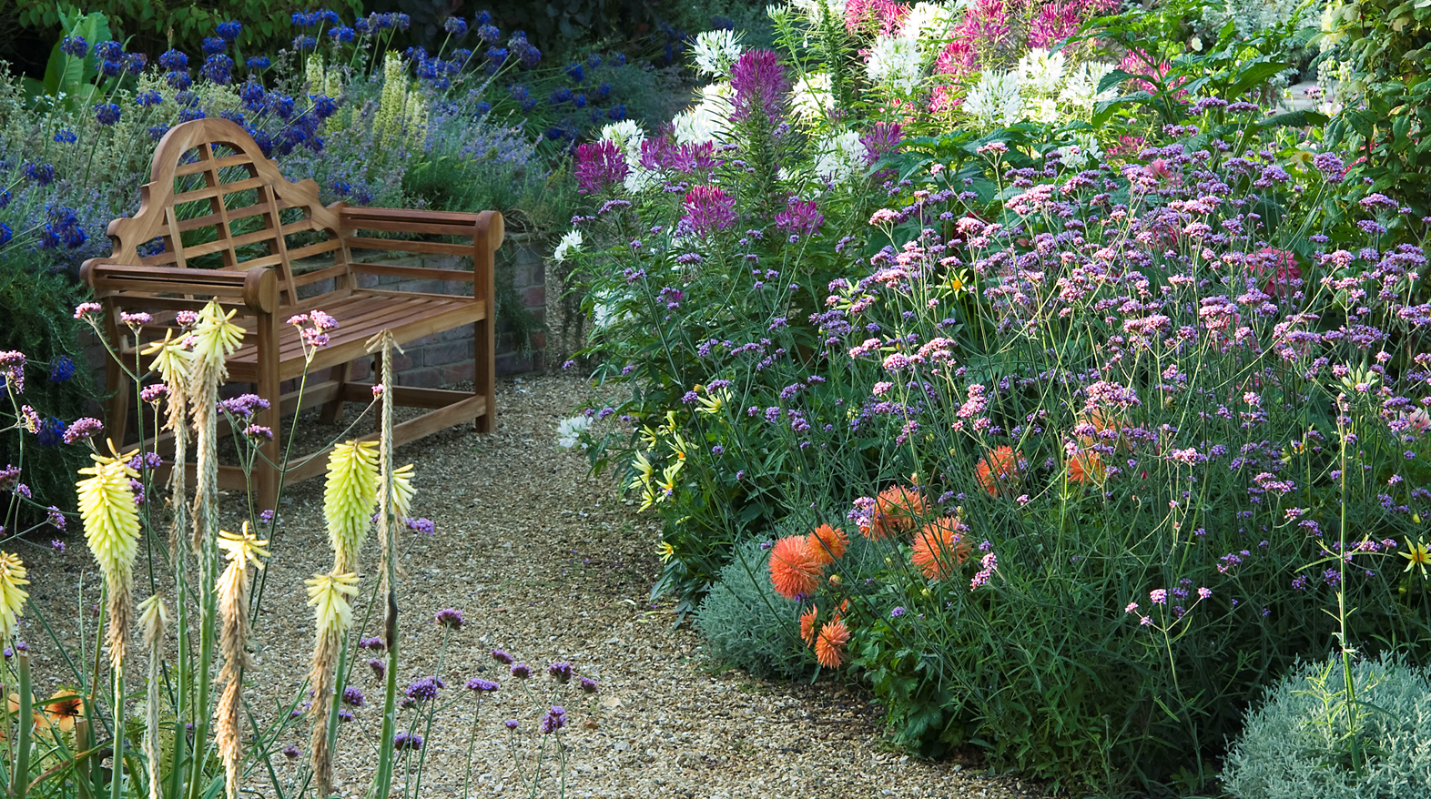

Summer
Crab Cottage, Isle of Wight
© Carol Drake

Slide 22
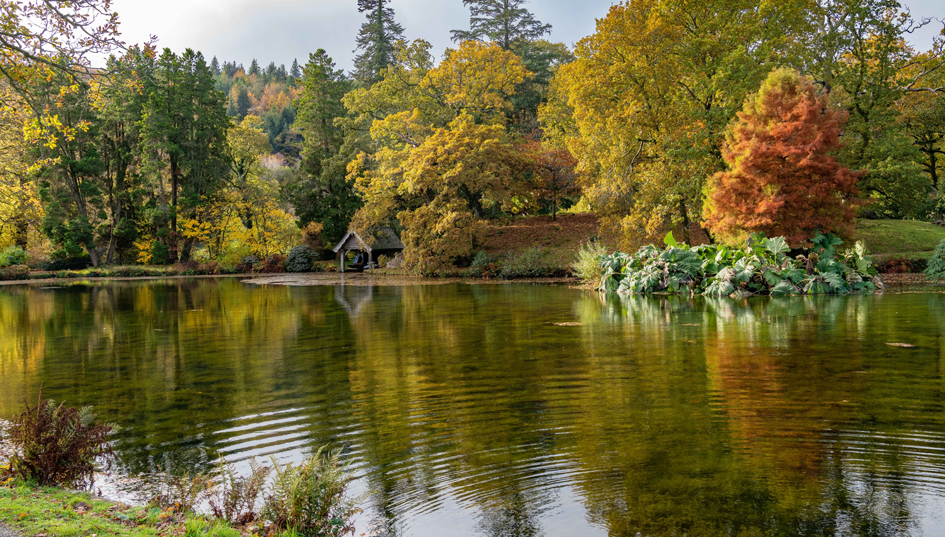

Autumn
Trebartha Estate, Cornwall
© Keith Tucker

Slide 23
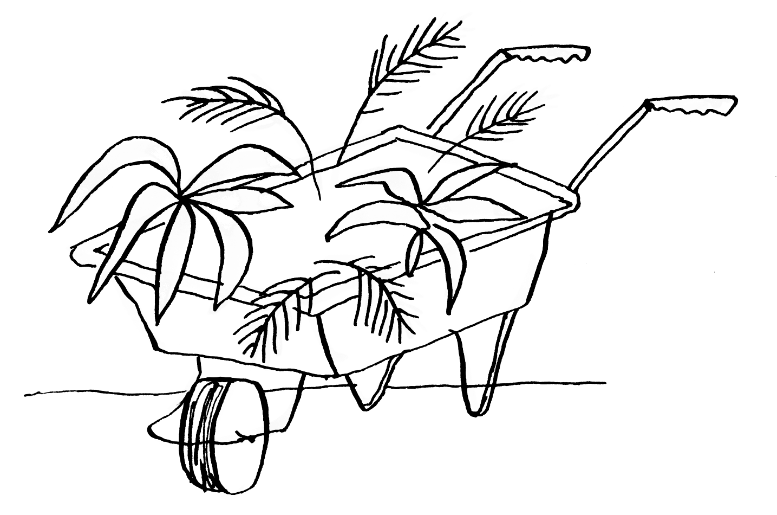
The diversity of our gardens

Slide 24
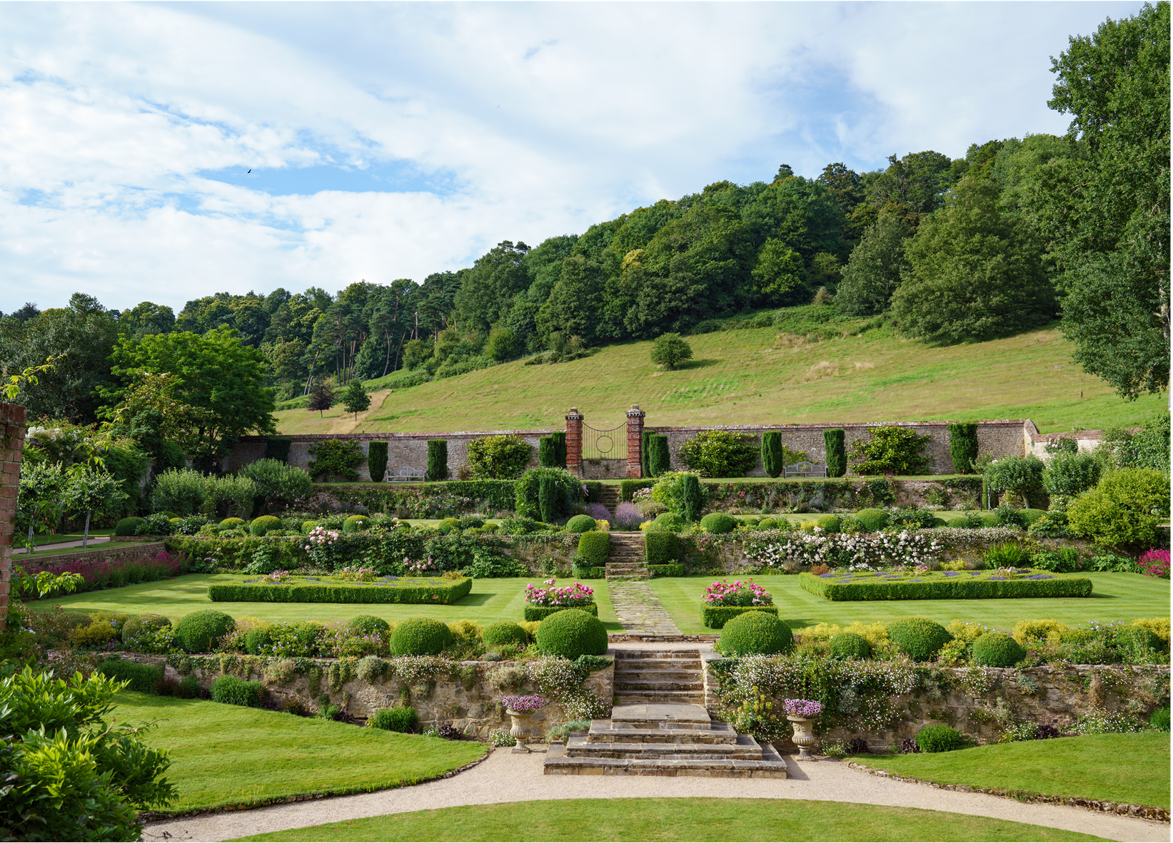
Country gardens – Chilworth Manor, Surrey
© Julie Skelton

Slide 25
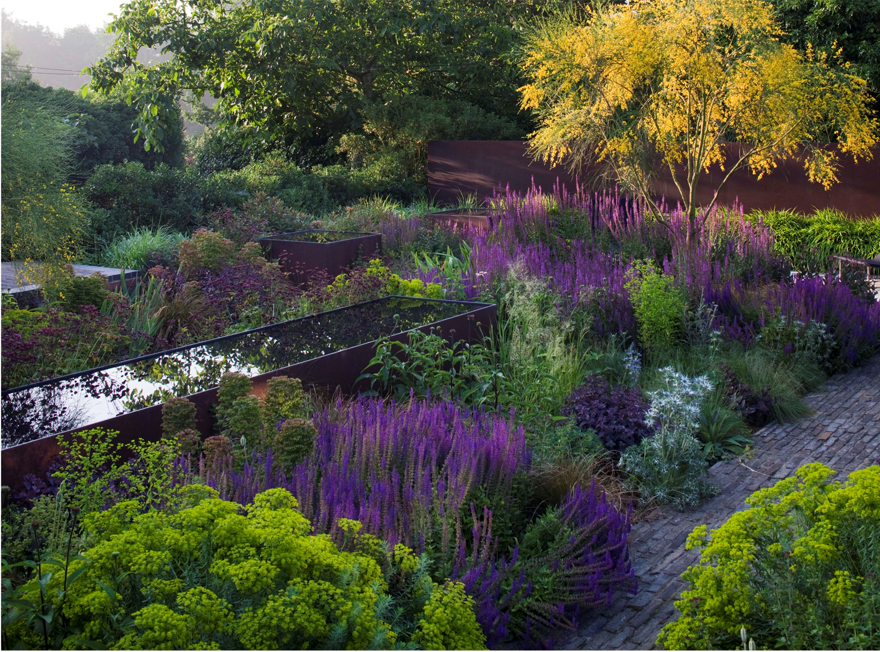
Serge Hill, Hertfordshire – designed by Tom Stuart-Smith

Slide 26
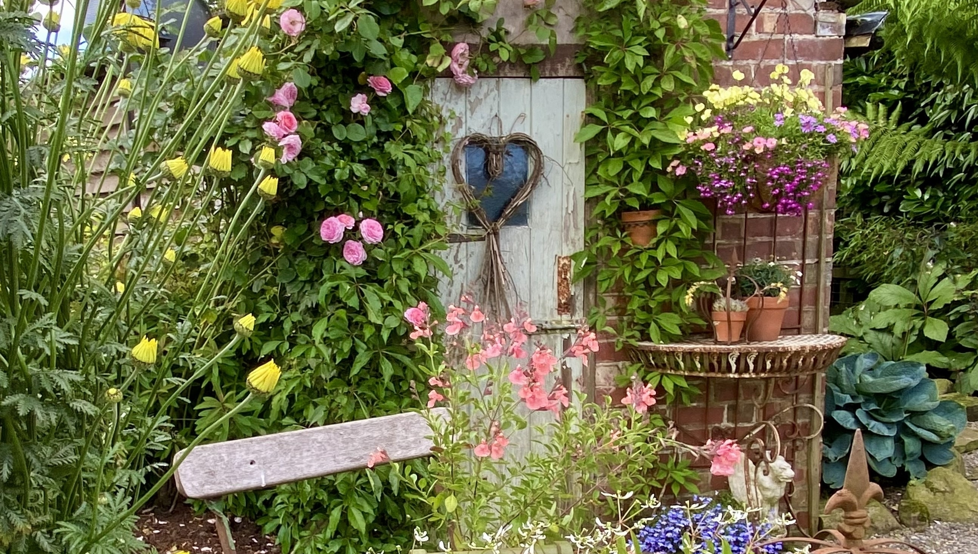
New gardens – Anderton Mill Cottage, Lancashire

Slide 27
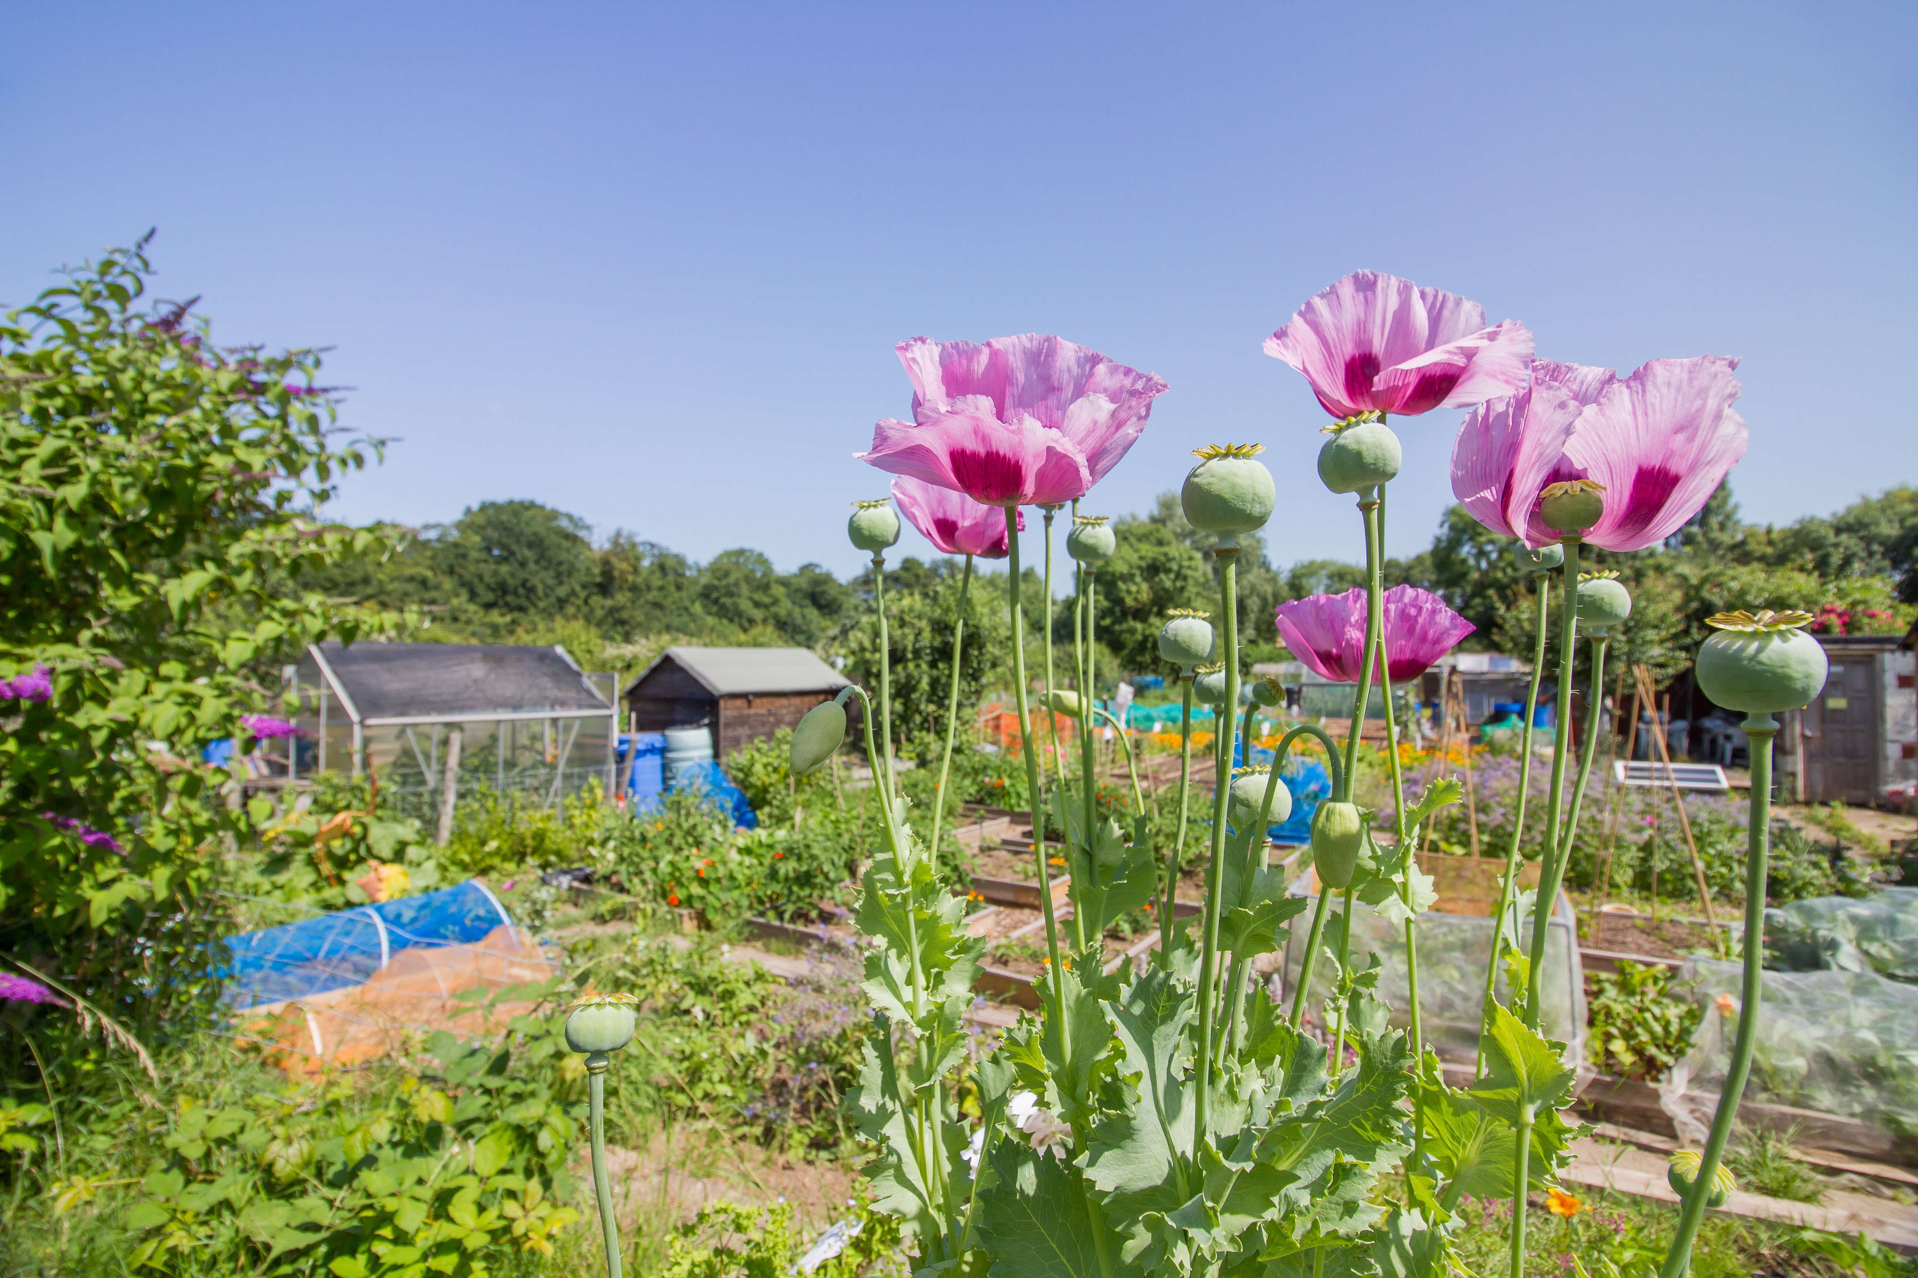
Allotment Gardens – Ashbourne Road and District Allotments, Derbyshire
© Amanda McConnell

Slide 28
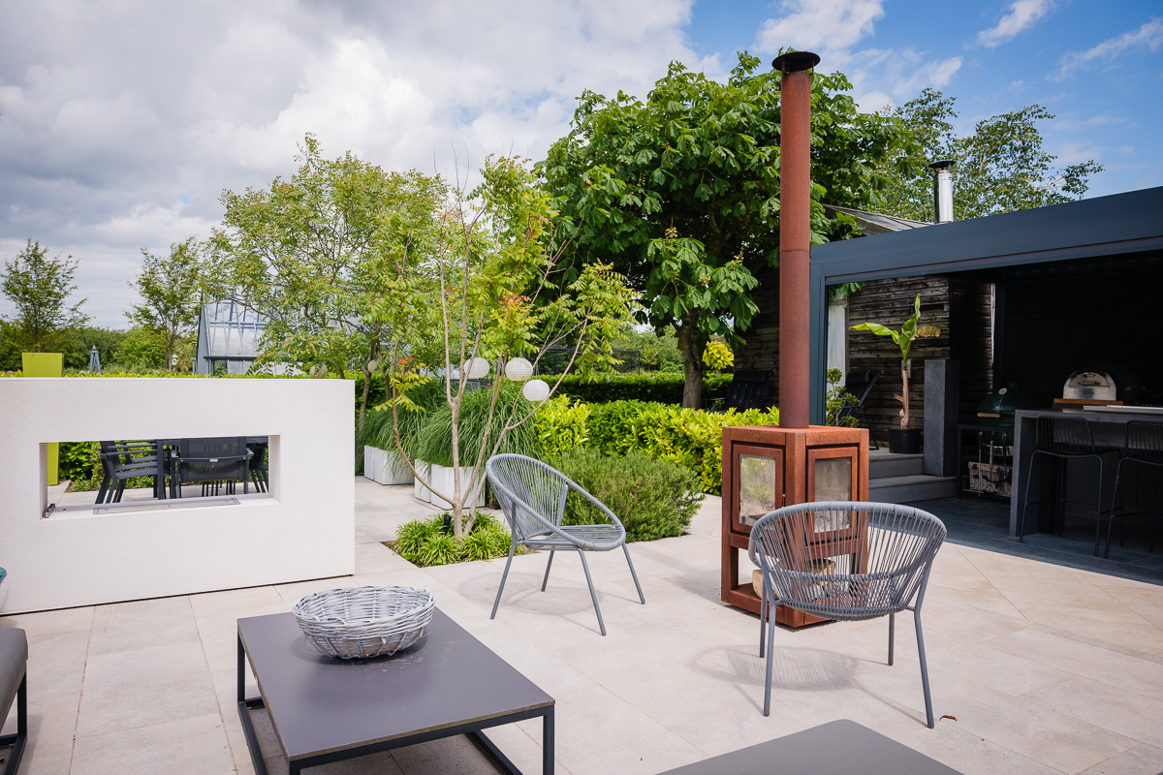
Contemporary Gardens – Green End Farm, Cambridgeshire

Slide 29
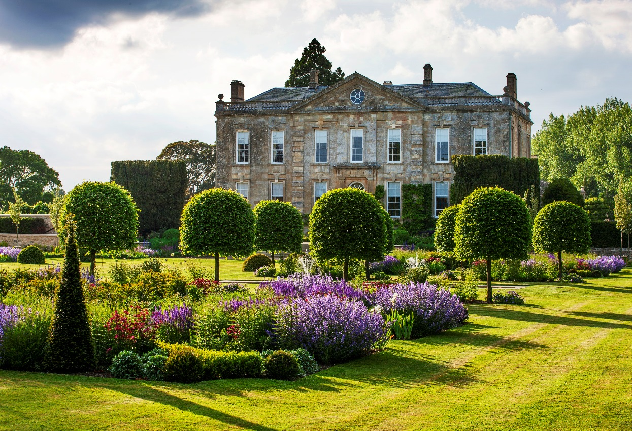
Ticketed gardens

Slide 30
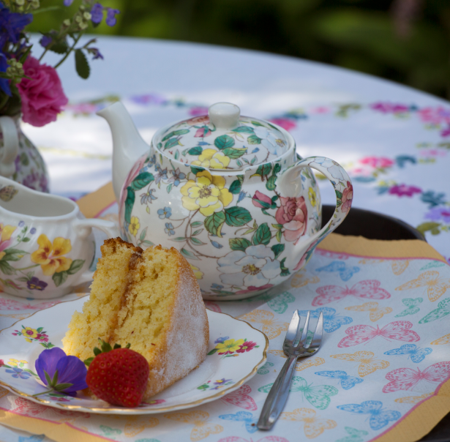
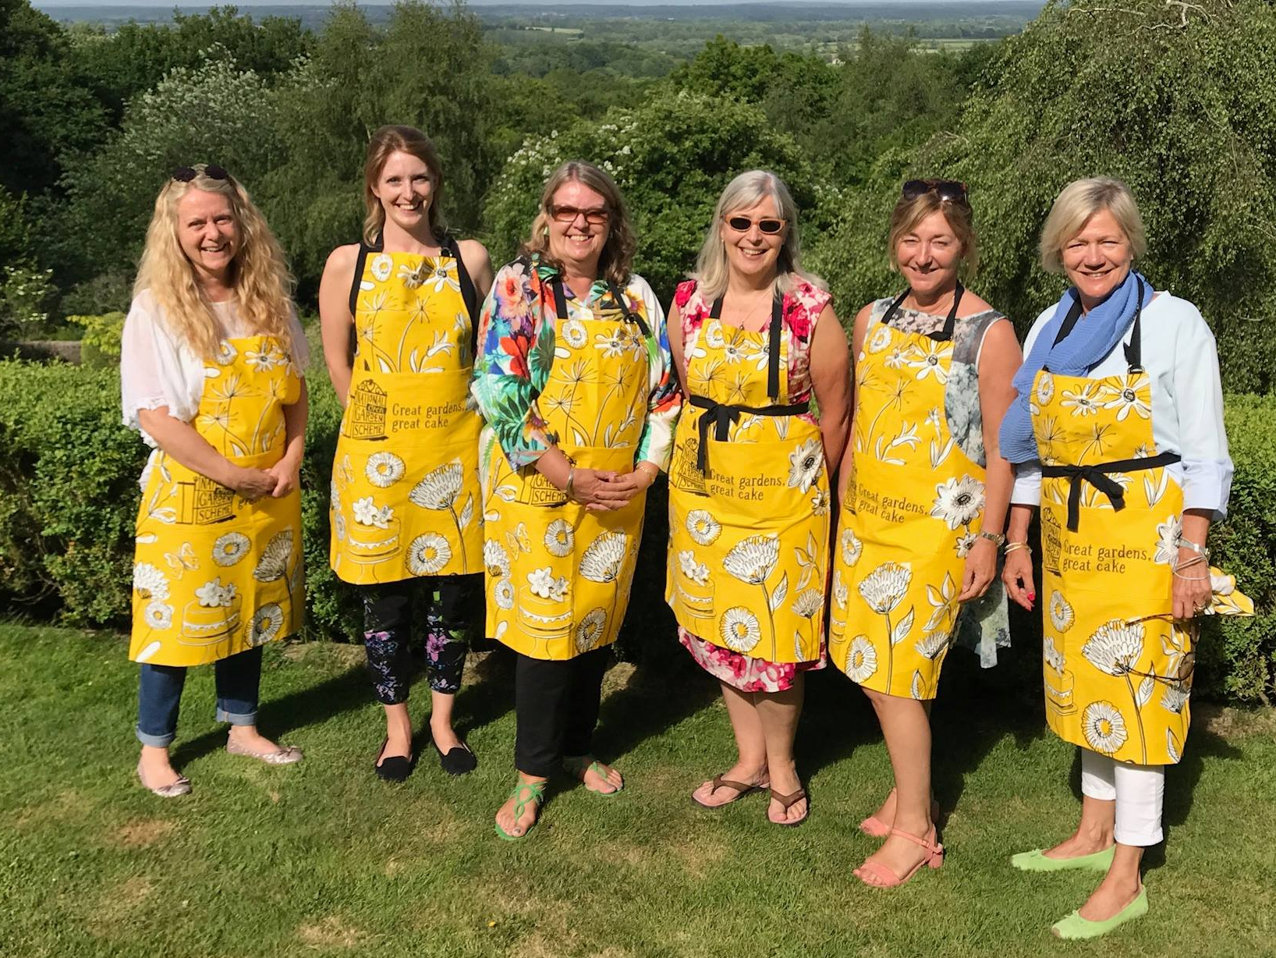
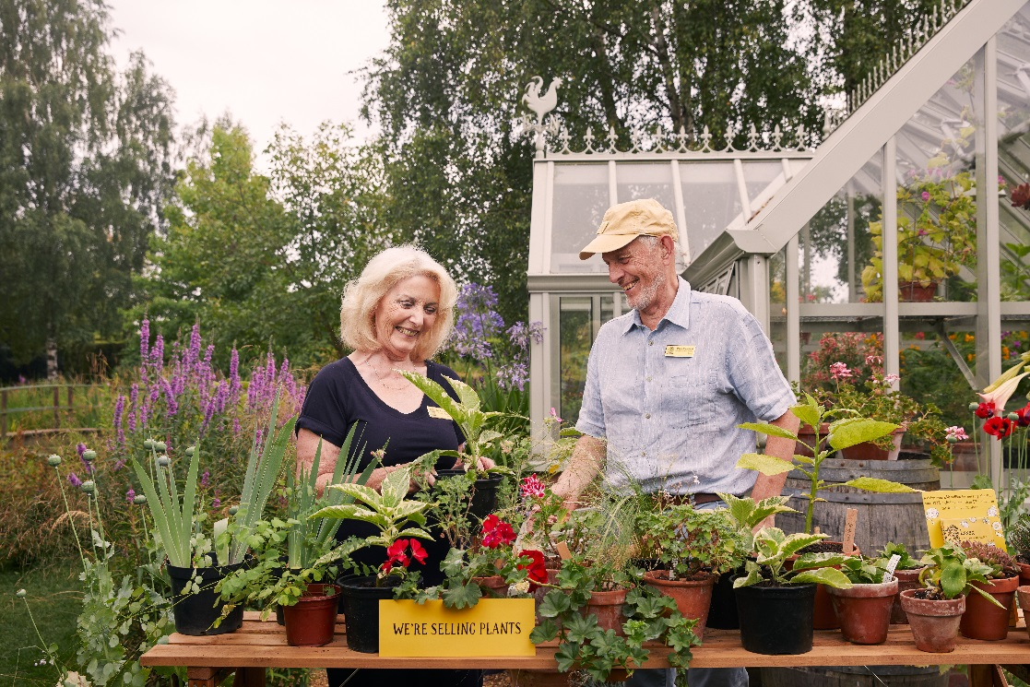
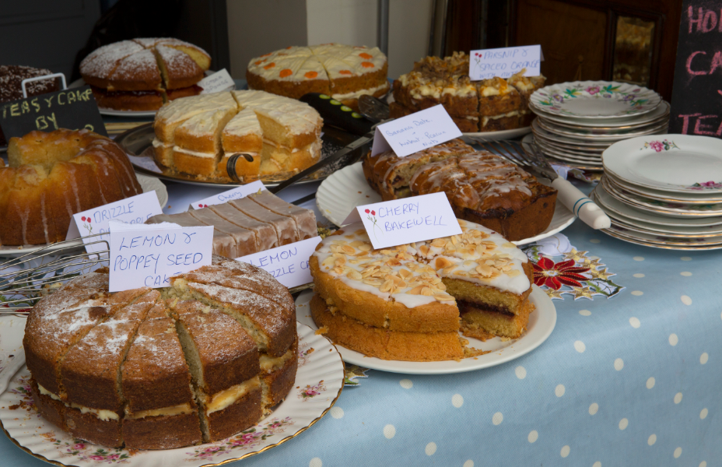
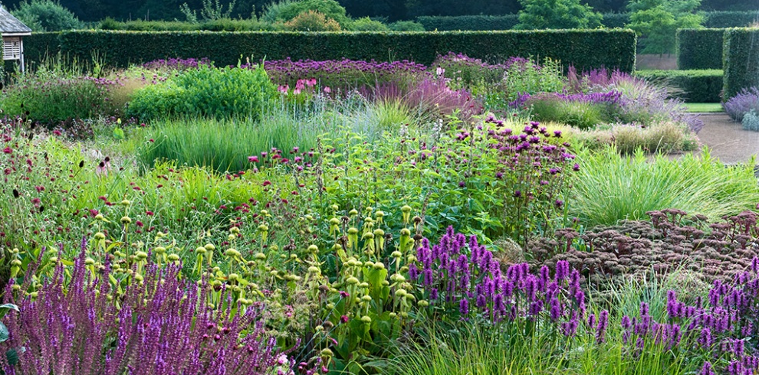
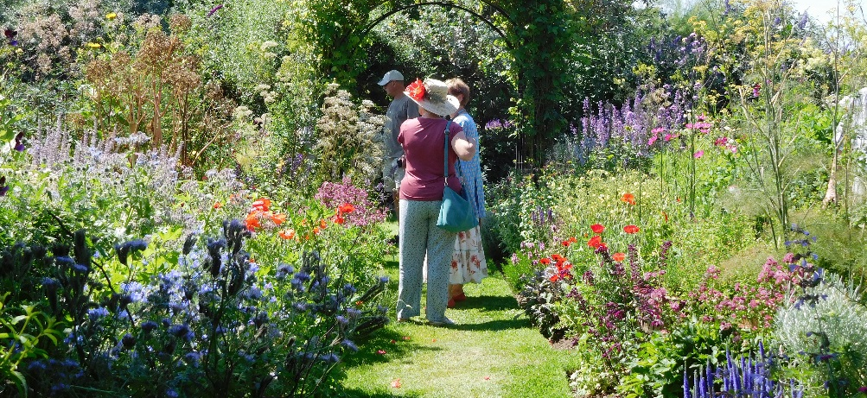
Our open days…
…great gardens, great cake, great causes!

Slide 31

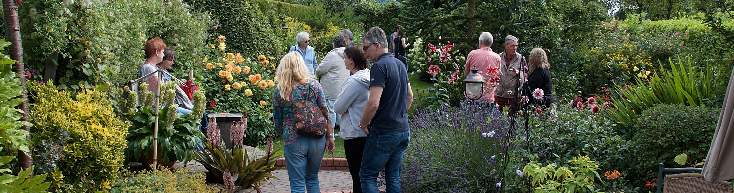
Arranging a group visit
At a time to suit you
Private tour of the garden
A personal and exclusive experience

Slide 32
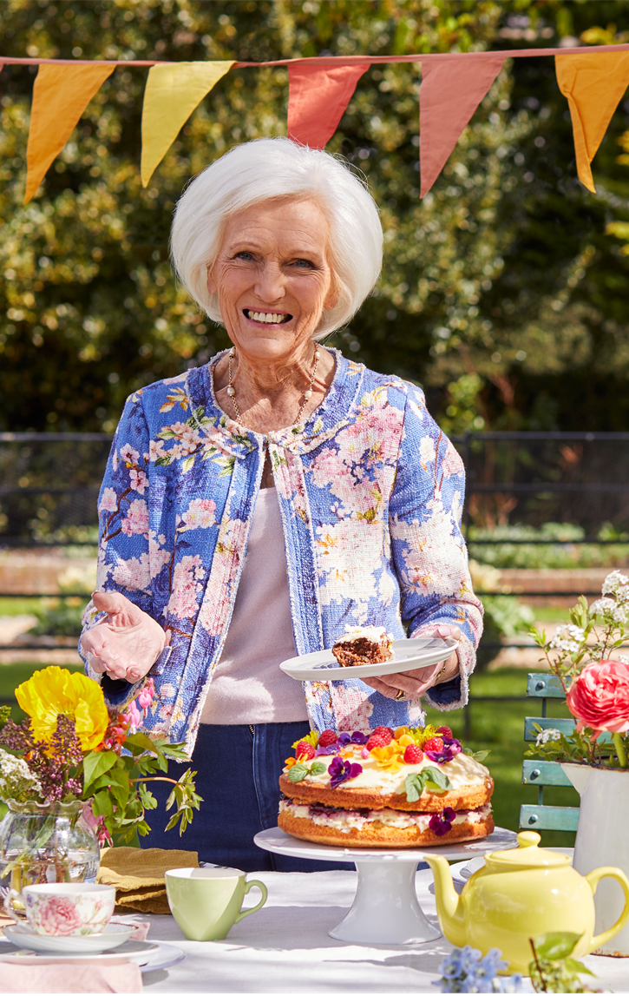
Gather friends and family for a garden get-together and join the Great British Garden Party
Show your support for the National Garden Scheme and help raise funds for vital nursing and health charities
Gather friends and family for an afternoon tea, barbecue, garden party or plant sale – the choice is yours
Raise funds through donations
Sign up: ngs.org.uk/gardenparty

Slide 33
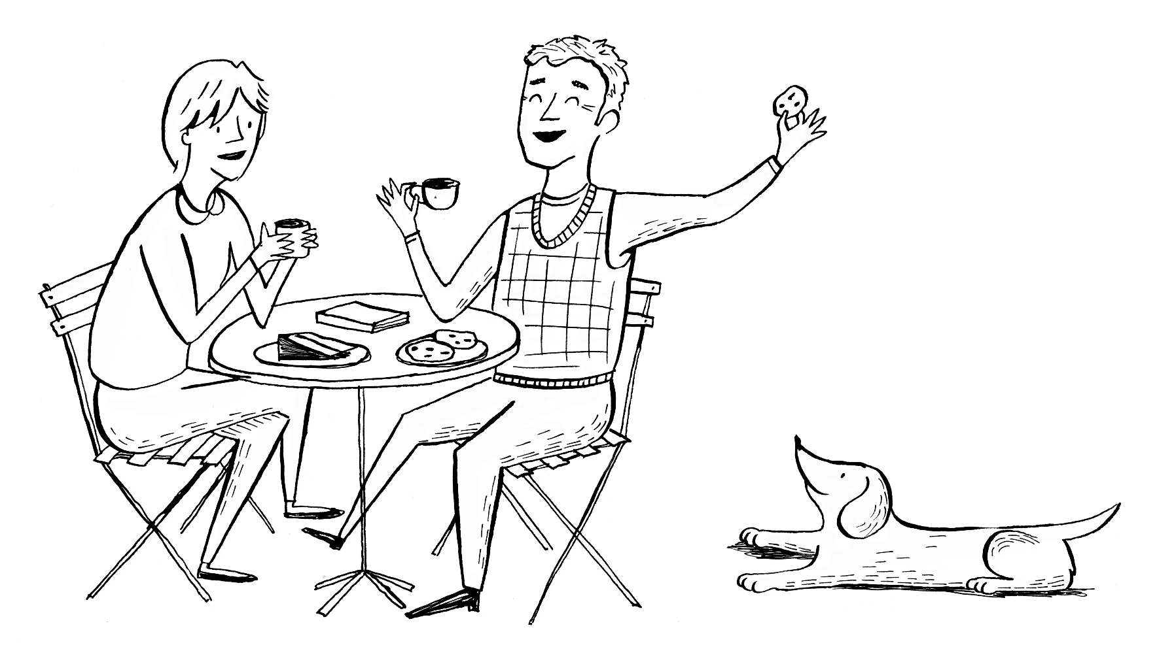
What a difference your visit makes

Slide 34

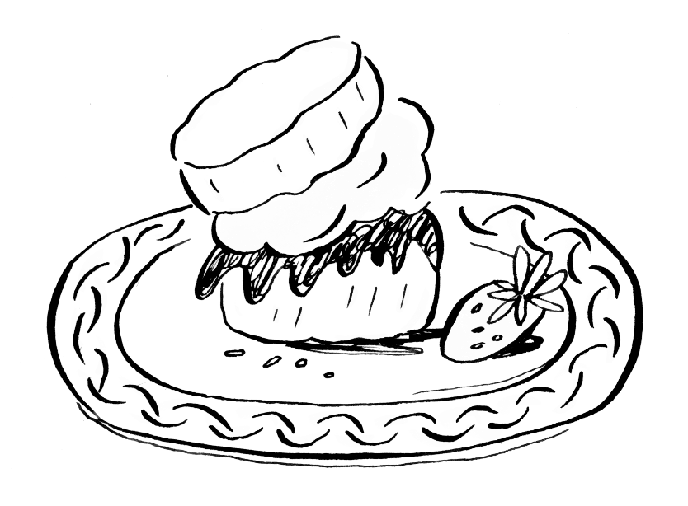
Your visits make a difference
£3.8 million donated in 2025
Over 80 pence donated for every £1 raised
at our garden openings

Slide 35
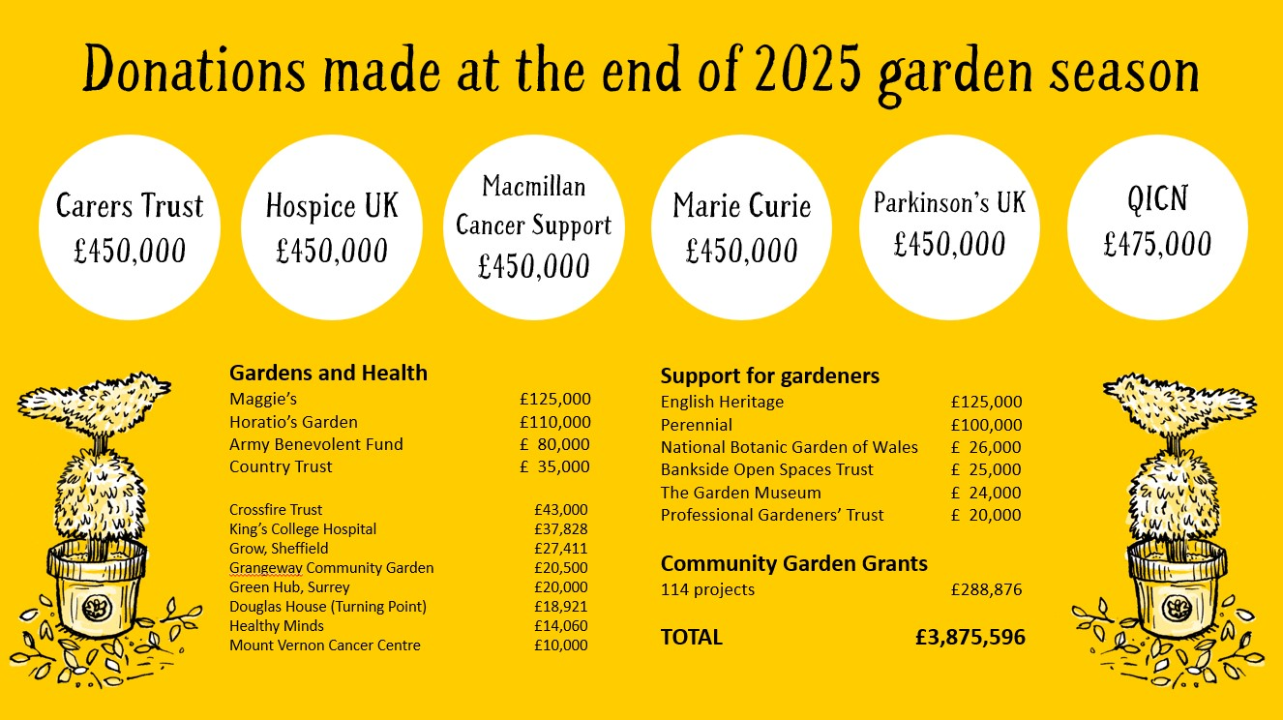

Slide 36


Nursing and health donations 2025
Marie Curie
£450,000
Macmillan Cancer Support
£450,000
Hospice UK
£450,000
The Queen’s Institute of Community Nursing
£475,000
Carers Trust
£450,000
Parkinson’s UK
£450,000

Slide 37

Gardens and health donations 2025
Maggie’s
£125,000
Horatio's Garden
£110,000
The Army Benevolent Fund
£80,000
The Country Trust
£35,000
Crossfire Trust, NI £43,000
King’s College Hospital £37,828
Grow, Sheffield £27,411
Grangeway Community Garden £20,500
Green Hub, Surrey £20,000
Douglas House (Turning Point) £18,921
Healthy Minds £14,060
Mount Vernon Cancer Centre £10,000

Slide 38
Donations in support of gardeners 2025
English Heritage
£125,000
Perennial
£100,000
National Botanic
Garden of Wales
£26,000
Bankside Open Spaces Trust
£25,000
Garden Museum
£24,000
Professional Gardeners’ Trust
£20,000
Support for community gardens 2025
£288,876

Slide 39
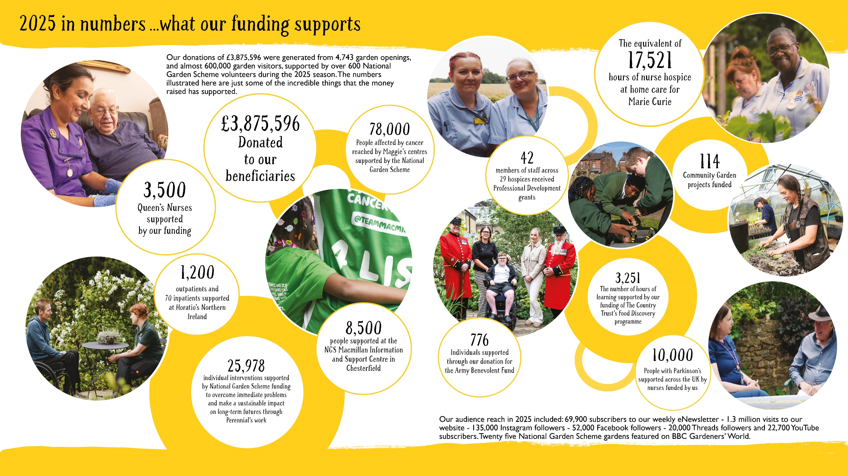

Slide 40
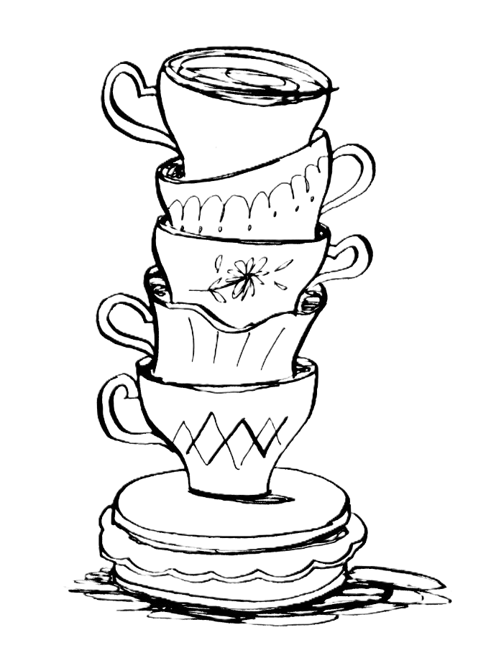

Celebrating 100 years
In 2027 the National Garden Scheme marks 100 years of great gardens, great cakes and great causes
We hope to open 100, 1927 gardens
Join us and open your garden too!

Slide 41
THANK YOU
ngs.org.uk

