Slide 1
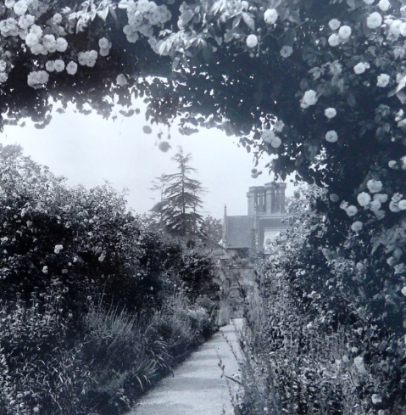
Origins of the National Garden Scheme (1927)
Supporting District Nursing through Garden Openings
Notes:
The National Garden Scheme began in 1927.
It was created to raise money for district nursing.
The idea linked gardening with charitable fundraising.
Previously gardens had been opened to the public but usually for a local charity or fete. This was the first time hundreds of gardens opened on a national scale to the general public.
This short presentation explains how it all started and why it was so successful.

Slide 2
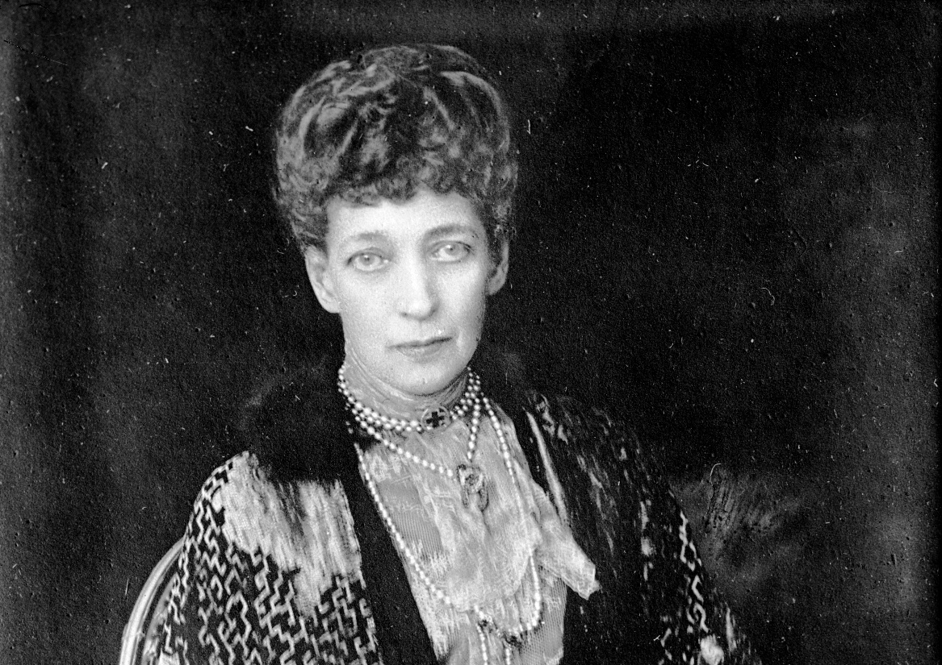
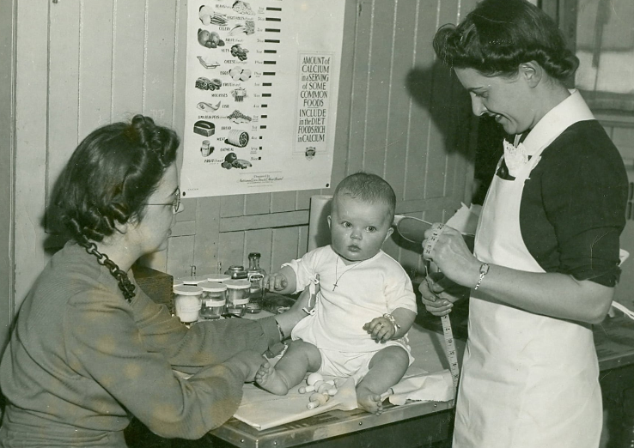
How it all started
Queen Alexandra died 1925
National Memorial Appeal launched in her name
With funds raised for district nursing
Notes:
When Queen Alexandra died in November 1925, a national appeal was set up in her memory.
The aim was to support the Queen’s Institute of District Nursing.
Queen Alexandra had been its Patron for 25 years
Donations to the appeal came from many sources across the country and the Empire.
However, fundraising soon faced difficulties.

Slide 3
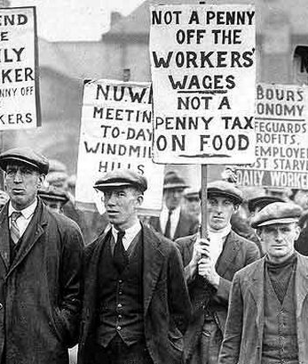
But a problem emerged
Fund raising slowed
after May 1926
General Strike disrupted progress
New ideas to raise money were needed
Notes:
The General Strike of May 1926 affected fundraising efforts.
Progress towards the memorial fund slowed down as donations dried up and fund-raising events were postponed or cancelled.
The organisers of the Memorial Appeal realised they needed a new and practical way to raise money.
This created an opportunity for a different approach.

Slide 4
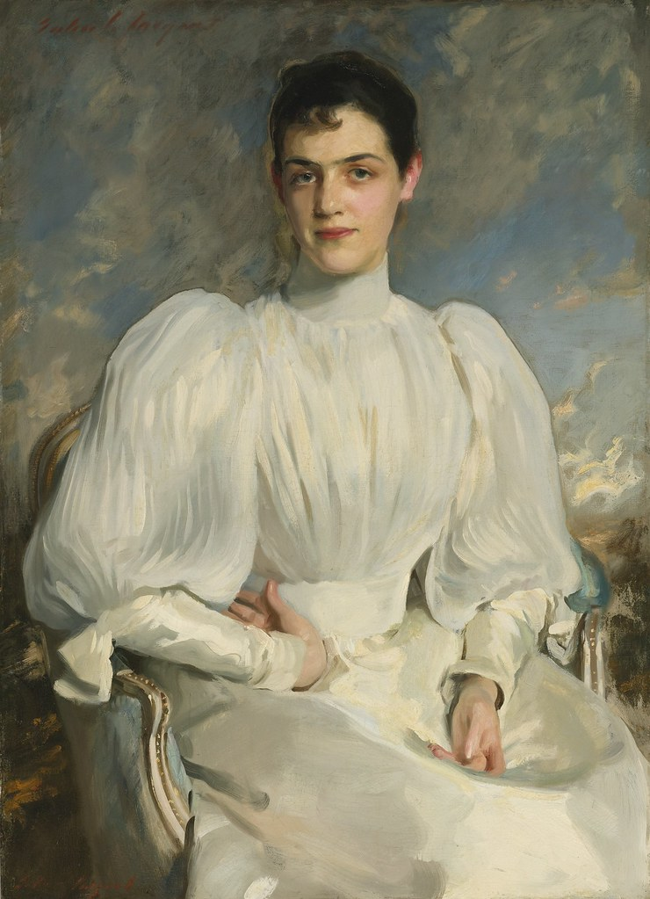
Elsie Wagg’s idea
Her letter written
7 October 1926
She proposed a
‘Garden Week’ to raise money for the appeal
Visitors pay one shilling
Notes:
It was at this point, Elsie Wagg wrote a letter to the organisers of the Memorial appeal suggesting a new and rather bold idea - opening private gardens to the public.
Visitors would pay a small entrance fee of one shilling.
Elsie was already involved in nursing charities, including the Queens Institute of district nursing and was also a lover of gardens.
Her idea to open gardens to raise money was simple, but it offered a completely new way to raise funds.

Slide 5
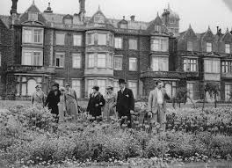
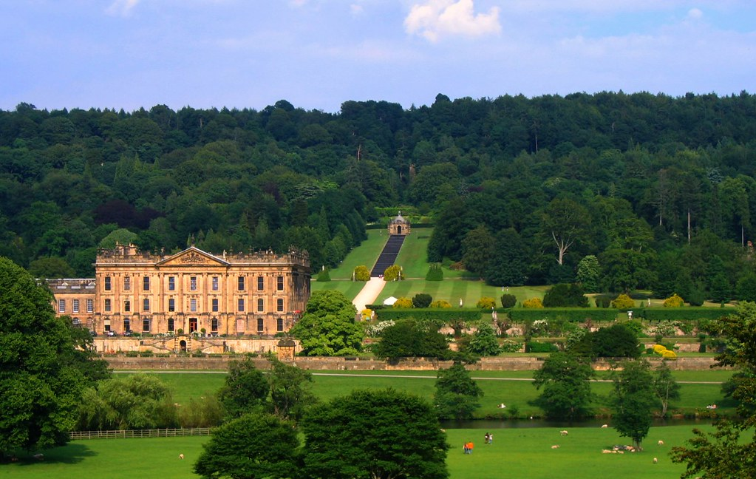
From idea to reality
Women’s National Committee formed
Open gardens organised in just 7 months
Hundreds of
gardens opened
Blenheim,
opened in 1927
Notes:
Elsie Wagg’s idea was quickly taken up by the Memorial appeal and unanimously approved.
A Women’s National Committee led the work with Lady Georgiana Mure as the Chairman and Millicent Stobart as her closest ally.
Garden owners across England and Wales were recruited – often by personal invitation and recommendations.
Many well-known gardens and country house estates agreed to take part, including King George’s gardens at Sandringham and Chatsworth owned by the Duke of Devonshire, shown here.
Most of the gardens surrounded stately homes, halls, castles and manor houses.
The first garden openings began in May 1927
It was so successful the garden openings were extended until the end of September.

Slide 6
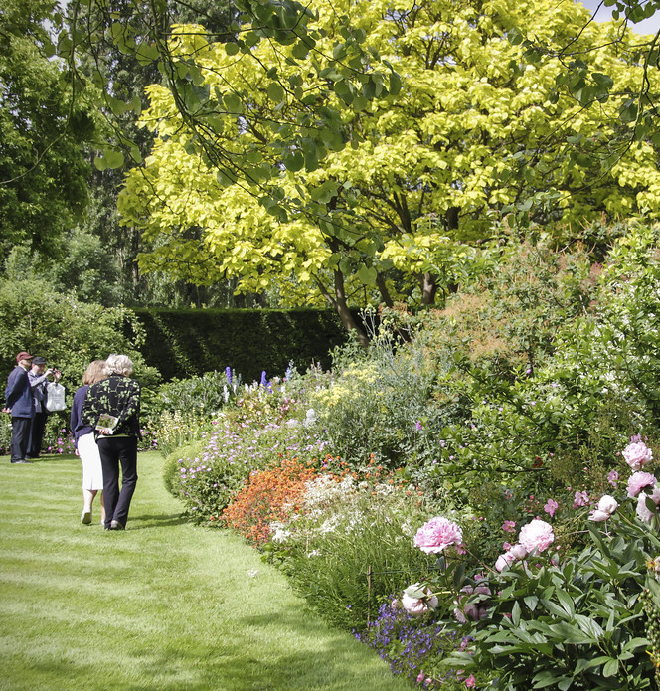
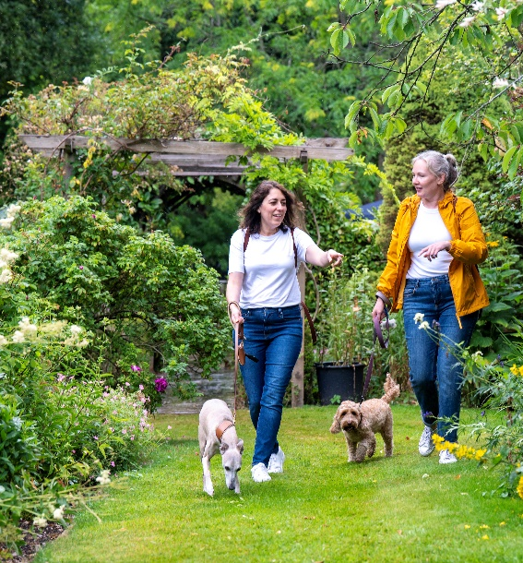
Success in 1927
609 gardens opened
200,000 visitors
£8,191 raised
(about £450,000 today)
Notes:
The first year was a major success.
Large numbers of visitors attended the gardens.
The money raised made a significant contribution to district nursing.
The scheme proved so popular that is became a permanent annual event, which continues today as the National Garden Scheme

