Slide 1
Notes to all Counties
This presentation is designed to last about 50mins (when featuring 10 local founding gardens)
The slide about 2027 will be completed nearer the time
There are some optional slides after the final blank slide. These are mainly for use with presentations near the county border. You may wish to add some slides of your own, perhaps to promote nearby forthcoming garden openings.
It goes without saying, please feel free to adapt this presentation to suit the needs of your County. But please retain all credits/references.
Notes:
Presentation created by Graham O’Connell , Assistant County Organiser, Herefordshire. If you have any questions or need any help please do feel free to email graham.oconnell22@gmail.com And if you have any additional material or slides that may be useful to others please contact Graham or email Vicky at vicky@ngs.org.uk

Slide 2
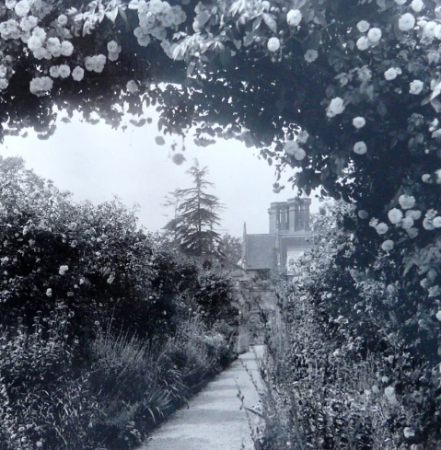
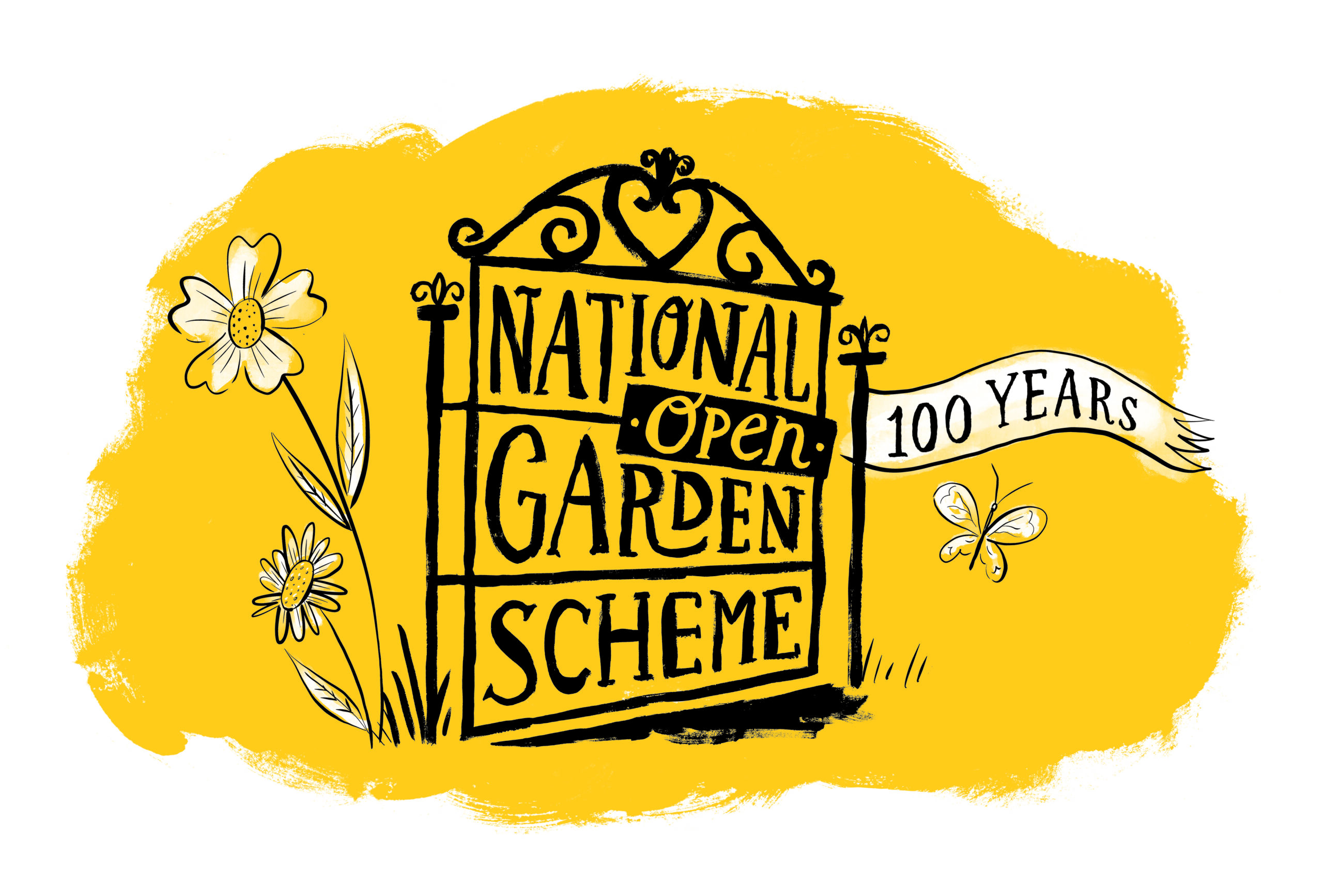
Origins of the
National Garden Scheme (1927)
Supporting District Nursing through Garden Openings
Graham & Angela O’Connell
Assistant County Organisers Herefordshire
Notes:
The National Garden Scheme began in 1927. It was created to raise money for district nursing. The idea linked gardening with charitable fundraising. Previously a few gardens had been opened to the public but usually for a local charity or fete. This was the first time hundreds of gardens opened on a national scale to the general public.
This presentation explains how it all started and why it was so successful.
Image: NGS

Slide 3
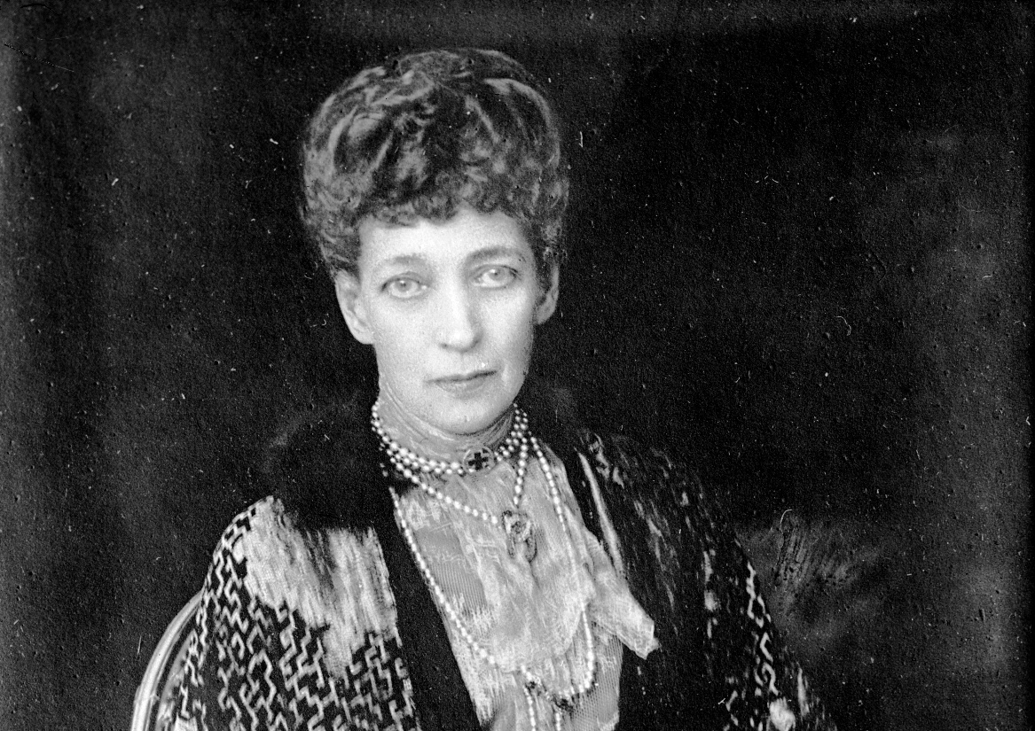
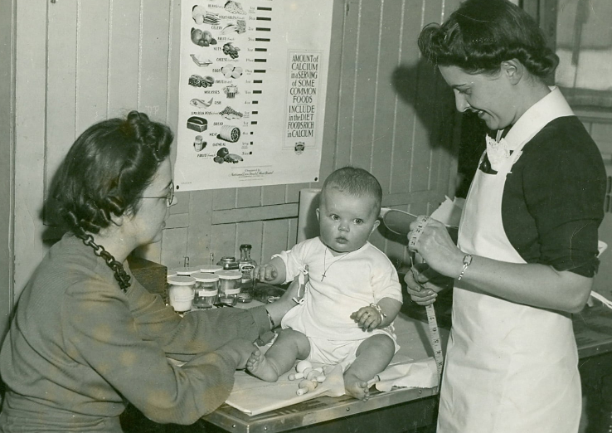
How it all started
Queen Alexandra died 1925
National Memorial Appeal launched in her name
With funds raised for district nursing
© QICN
Notes:
Queen Alexandra, the widow of Edward VII, died in November 1925. Her son, George V, was King and she as Queen Mother lived at Sandringham. Upon her death a national appeal was set up in her memory. The aim was to support the Queen’s Institute of District Nursing. Queen Alexandra had been its Patron for 25 years.
Donations to the appeal came from many sources across the country and the Empire. However, fundraising soon faced difficulties…
Images sourced via Clare Waters / NGS. Queen Alexandra: Wikimedia Commons (Library of Congress). District Nursing: Source unknown.

Slide 4
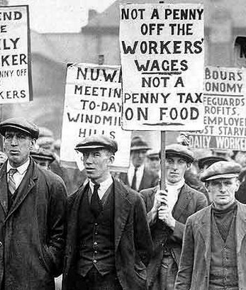
But a problem emerged
Fund raising slowed
after May 1926
General Strike disrupted progress
New ideas to raise money were needed
Notes:
The General Strike of May 1926 affected fundraising efforts. Progress towards the memorial fund slowed down as donations dried up and fund-raising events were postponed or cancelled.
The organisers of the Memorial Appeal realised they needed a new and practical way to raise money. This created an opportunity for a different approach.
Image sourced via Clare Waters / NGS. Discovering the 1920s: Creative Commons

Slide 5
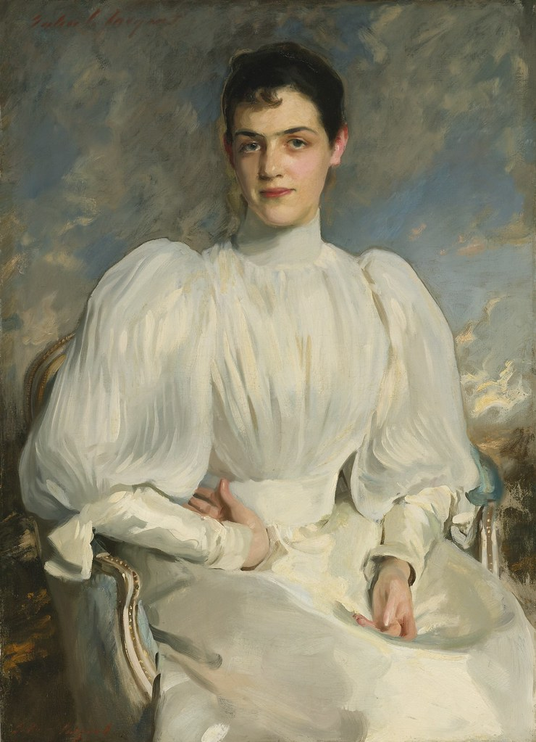
Elsie Wagg’s idea
Her letter written
7 October 1926
She proposed a
‘Garden Week’ to raise money for the appeal
Visitors pay one shilling
Credit: Doug Eng Images
Notes:
It was at this point, Elsie Wagg wrote a letter to the organisers of the Memorial appeal suggesting a new and rather bold idea - opening private gardens to the public. Visitors would pay a small entrance fee of one shilling.
Elsie was already involved in nursing charities, including the Queens Institute of district nursing and was also a lover of gardens. Her idea to open gardens to raise money was simple, but it offered a completely new way to raise funds.
Some individual gardens already opened for charity, especially for local hospitals. In her letter Elsie writes ‘…Leonardslee is open about four times a year, and huge char-a-banc parties come over from Brighton…’
But the idea of a widespread, national openings was still a bold and innovative step.
Note: The John Singer Sargent portrait was painted in 1893 when Elsie was 17. She was 50 in 1926. Credit: Doug Eng Images. The portrait now resides in the USA.
See separate notes for more on Elsie Wagg or visit https://en.wikipedia.org/wiki/Elsie_Wagg

Slide 6
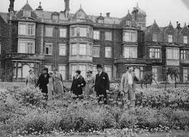
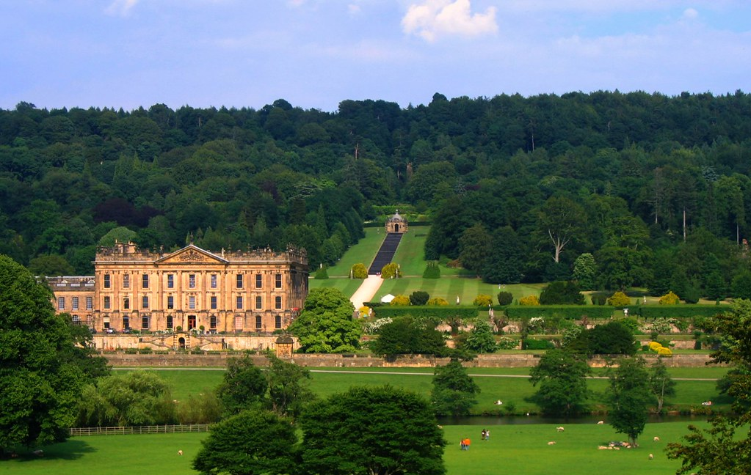
From idea to reality
Women’s National Committee formed
Open gardens organised in just 7 months
Hundreds of
gardens agreed to open
Blenheim,
opened in 1927
Notes:
Elsie Wagg’s idea was quickly taken up by the Memorial appeal and unanimously approved. A Women’s National Committee led the work with Lady Georgiana Mure as the Chairman and Millicent Stobart as her closest ally.
Garden owners across England and Wales were recruited – often by personal invitation and recommendations. Many well-known gardens and country house estates agreed to take part, including King George’s gardens at Sandringham and Chatsworth owned by the Duke of Devonshire, shown here.
Most of the gardens surrounded stately homes, halls, castles and manor houses. The first garden openings began in May 1927. The original plan was to run for a fortnight from Whit Monday 30th May, a Bank Holiday, to Saturday 11th June inclusive. It was so successful the garden openings were extended until the end of September.
Images sourced via Clare Waters / NGS

Slide 7
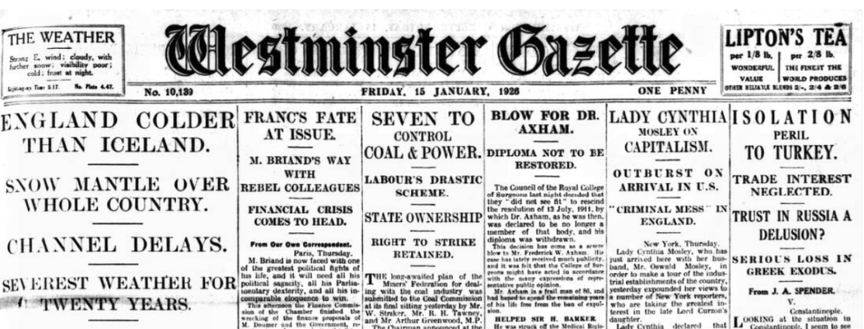
One estate owner told the Westminster Gazette that he would like to invite visitors to see his grounds…
‘But you feel that they do not appreciate your kindness. […] They must walk into the most private parts; they pick your flowers, throw stones at the ducks, peer in at the windows to see the family at lunch, ask the maids for hot water for their tea-pots and then, […] go away calling for the gardeners to clear away their litter of paper, food tins, and beer bottles.’
Notes:
Not everyone was keen on the idea. Though as it turns out the reality was very different and the feedback about visitors was very good.
Cutting: Westminster Gazette, Endole, out of Copyright.

Slide 8
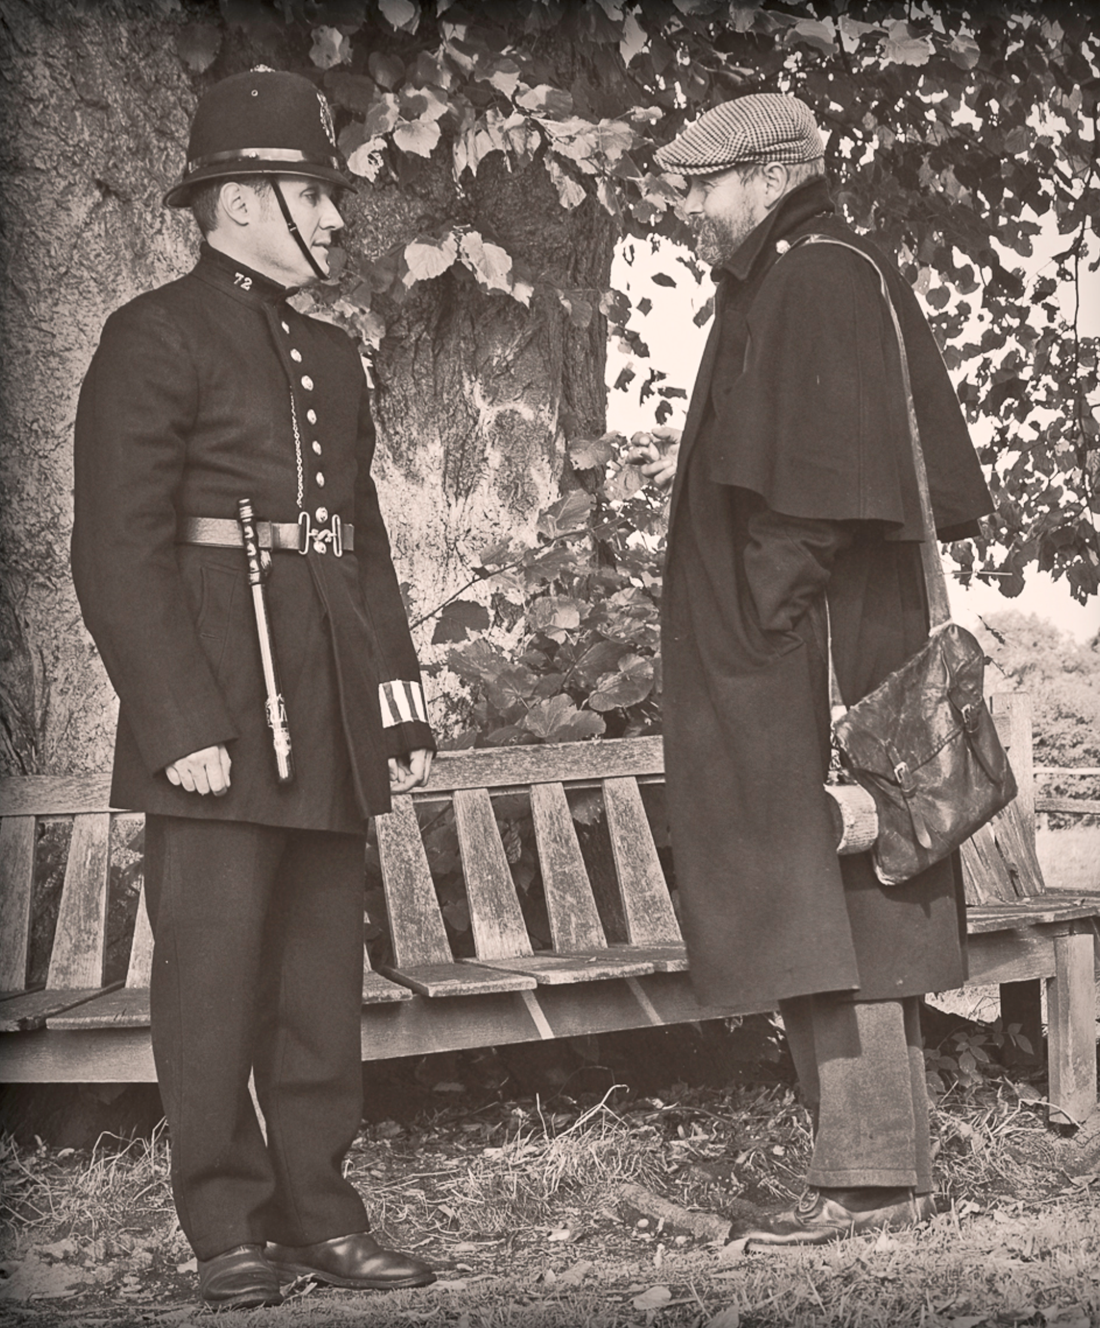
The Committee offered police protection if garden owners wanted it. Most were not worried.
But a few took up the offer.
Vicary Gibbs of Aldenham House, near Elstree requested four!
Notes:
One of the main concerns the Women’s National Committee was at pains to manage was garden owner’s worries over potential damage to their property, particularly given the general press reporting of trespass, damage and litter around this period. Indeed, a decision was taken in November 1926 by the Committee to offer police protection if garden owners wanted it. Most were not worried but a few took up the offer. Aldenham House, near Elstree and the home of Vicary Gibbs, requested four.
In the event, no damage was recorded and by the end of June the Women’s National Committee noted that ‘Owners reported that they were very pleased with the behaviour of visitors, and that great care had been taken of the gardens, and everything left in good order.’
Image: Creative Commons Attribution-Share Alike. Note: this policeman image is technically pre-1920s but is broadly indicative of a country/garden scene

Slide 9
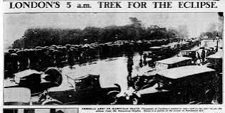
Also in 1927
1927 saw an unusually miserable summer; June was cold and grey, August brought weeks of heavy rain, floods, and thunder
29th June saw a ‘spectacular’ total solar eclipse but thick clouds and poor weather blocked the view for most
The "cottage garden" aesthetic was highly popular, blending structured formality (like fine lawns, clipped hedges and brick pathways) with exuberant, overflowing borders
Chelsea Flower Show extended from 3 to 4 days
Notes:
This extract from an editorial in a Cornish newspaper commented:
‘On each occasion when one or other of our famous Cornish gardens was open to the public it rained heavily, or was so cold and dull that probably not a tenth of the number of people, who would ordinarily have been delighted to pay the small sum charged […] were prepared to risk the weather.’
But the popularity of gardening was on the rise and poor weather was not going to deter those wanting a glimpse behind an upper class garden gate. Or better still a Royal garden.
Photo Creative Commons

Slide 10
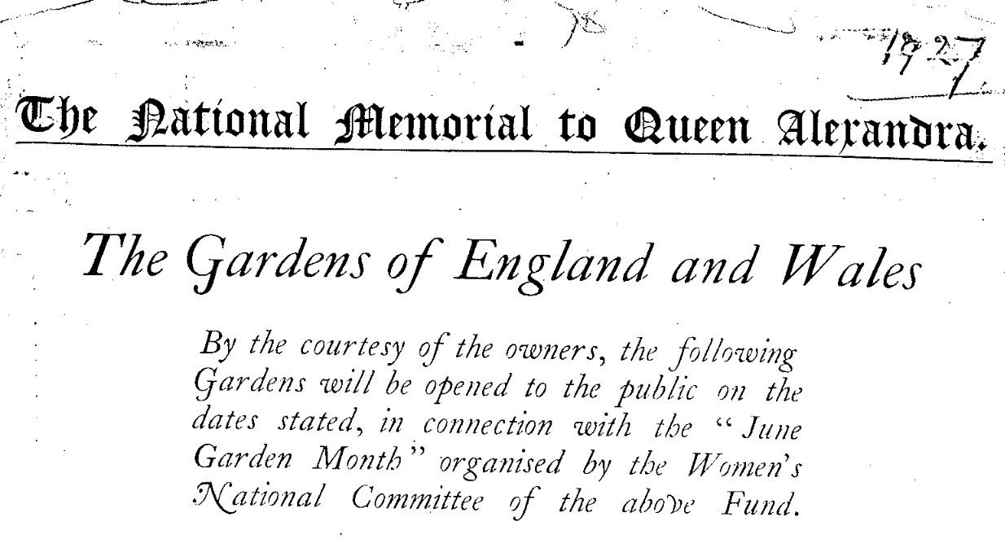
Credit: The Times
Notes:
A National list of gardens open during June was published in The Times. Many local newspapers also published a list.
Of particular note was Queen Alexandra’s former home, Sandringham
Image: NGS

Slide 11
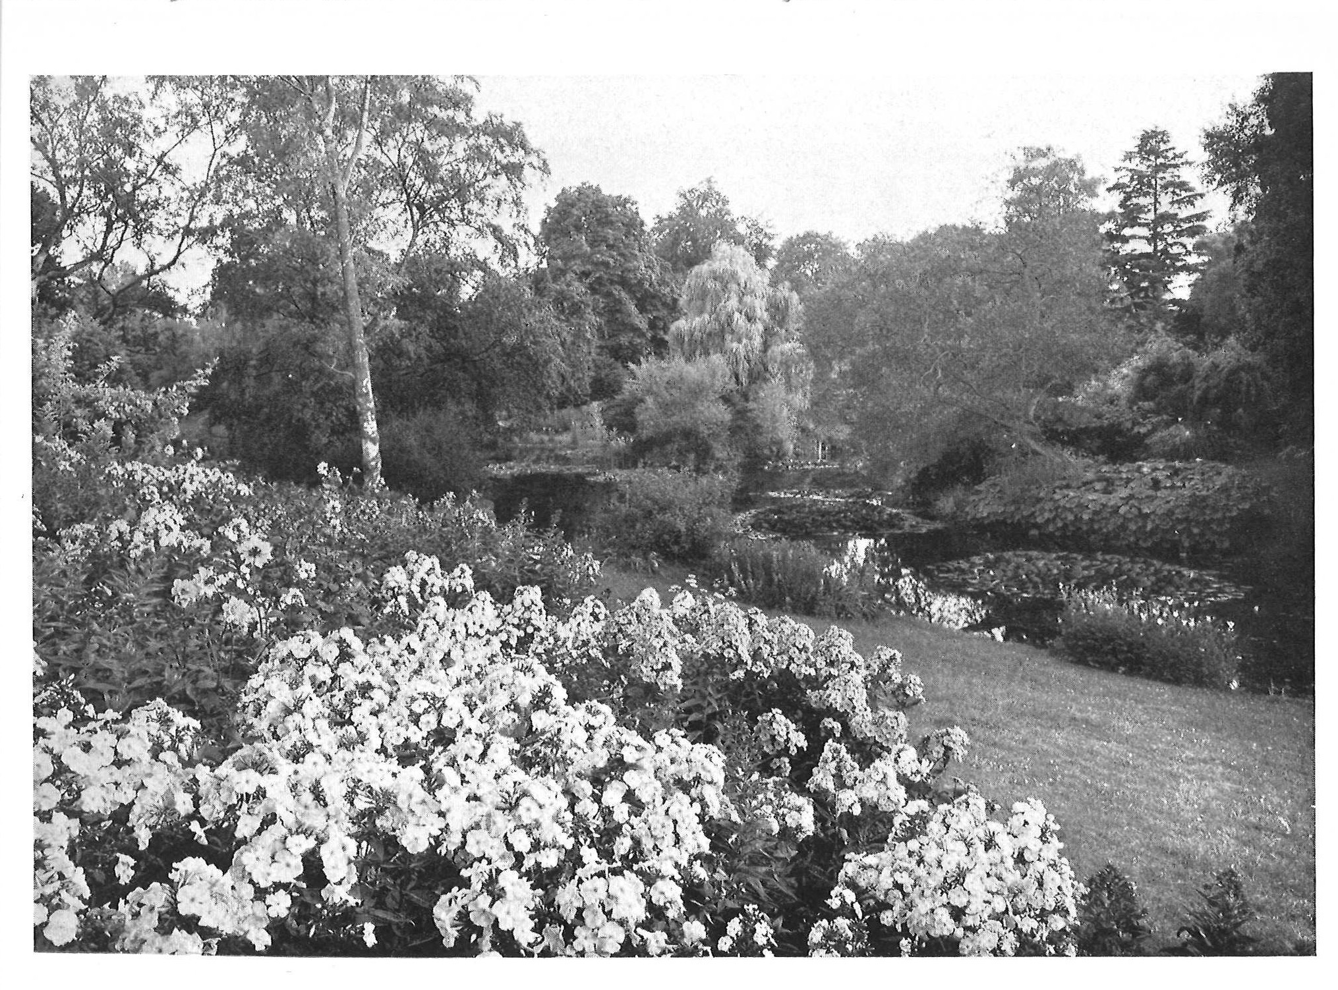
Sandringham, Norfolk
Notes:
Sandringham had been Queen Alexandra’s home for the last few years of her life and purportedly her favourite residence. It may be that her son, the King, liked the idea of opening Sandringham for this reason.
After some delay it was agreed that Sandringham could open after all, for two days a week from 1 May to 30 September with admission of 6d. and half of the net proceeds to the Memorial fund and the other half to local charities. This was far more than the single day’s opening the Women’s National Committee had asked for..
King George V’s agreement to open Sandringham looks to have had a positive effect. Of the 1927 open gardens, half were owned by members of the aristocracy, peers, senior clergy or armed services personnel, including nine of the highest hereditary peers
Image Credit: NGS

Slide 12
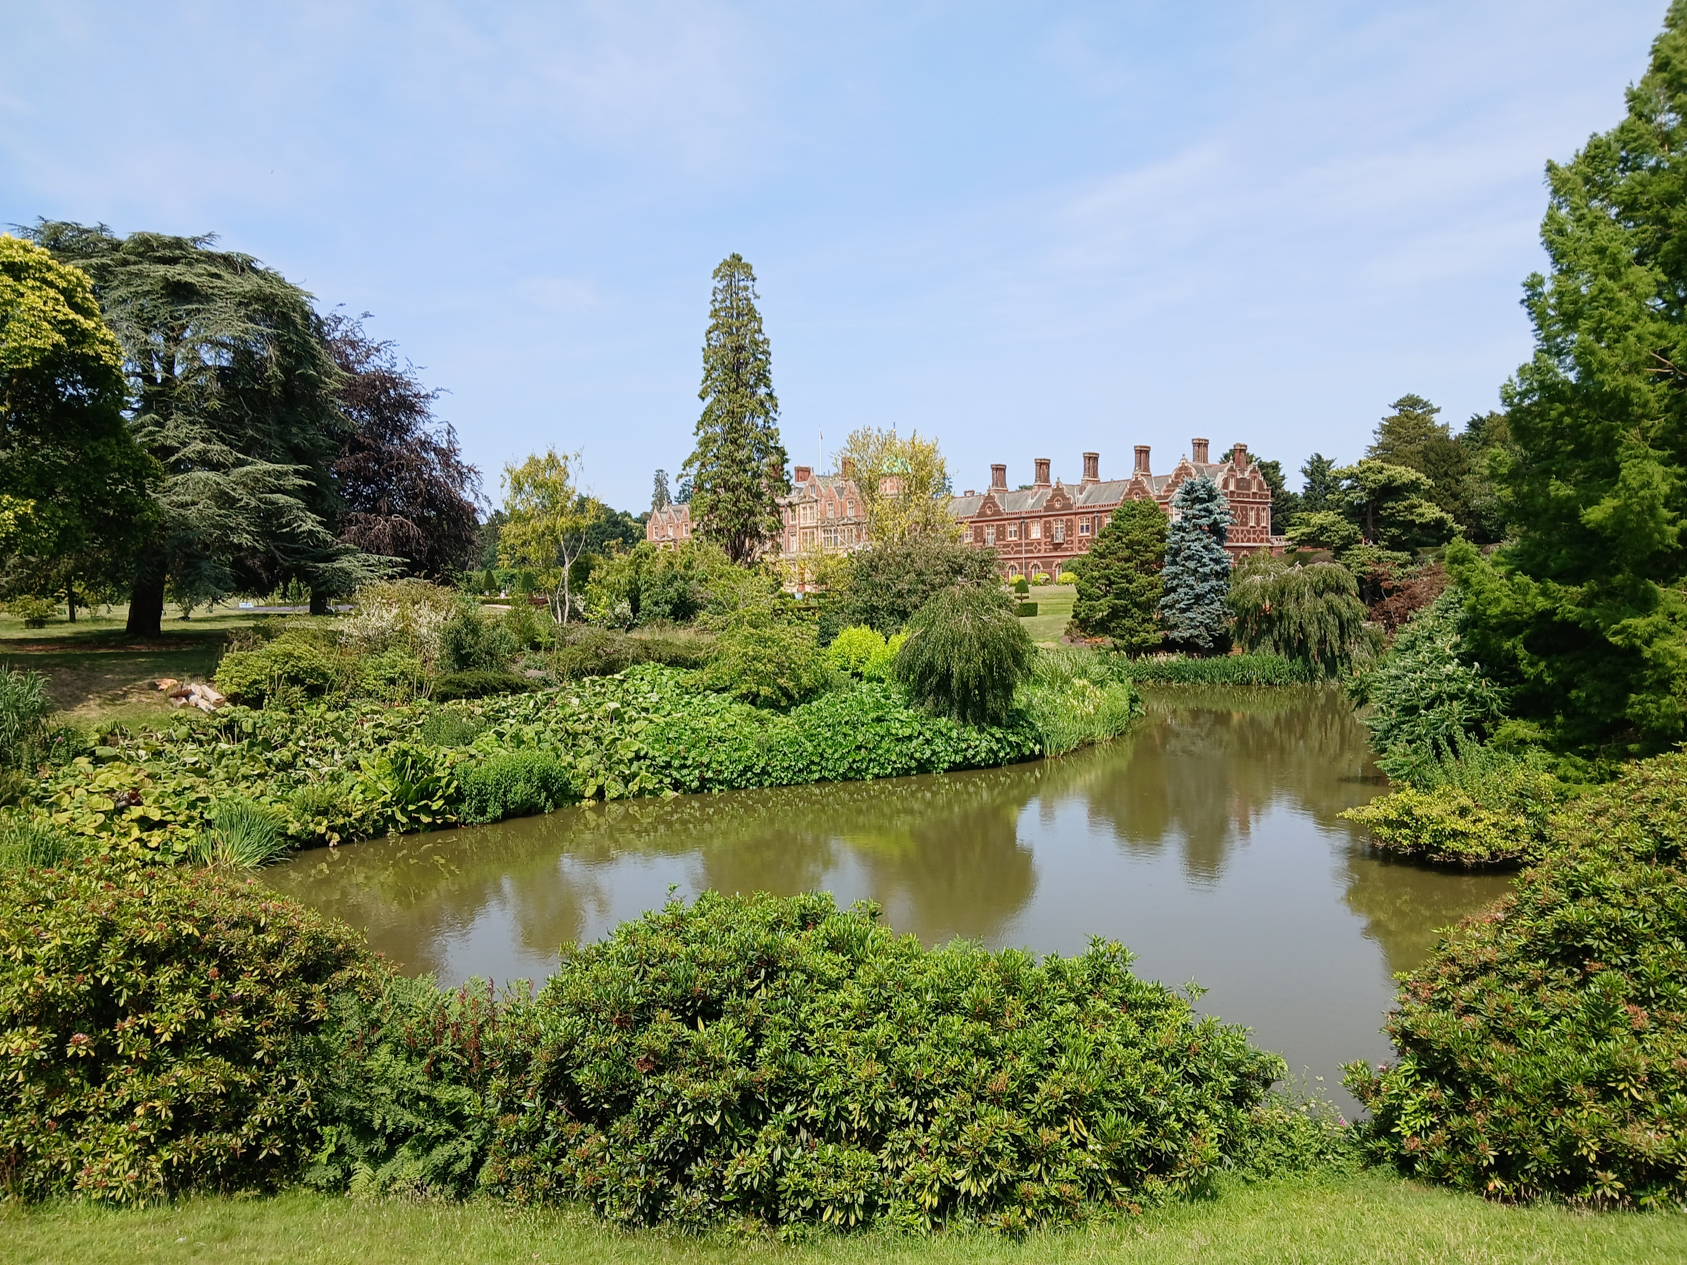
Sandringham Today
Notes:
The royal gardens at Sandringham were understandably one of the biggest draws and were open for forty-four days - every Wednesday and Thursday each week for 6d. entrance fee, from 1 May to 30 September inclusive. In June, The Times wrote a long article on the gardens giving them further publicity. In October, the Sandringham Estate Office confirmed that 41,920 visitors to the grounds over 44 openings had raised £1,051 17s. 2d. which, after expenses, the Queen Alexandra Memorial received £500 and local nursing charities about the same.
Sandringham still opens for us today and remains a big draw.
Sandringham today. Photo: Graham O’Connell; taken June 2026. Available for use by anyone for the NGS

Slide 13
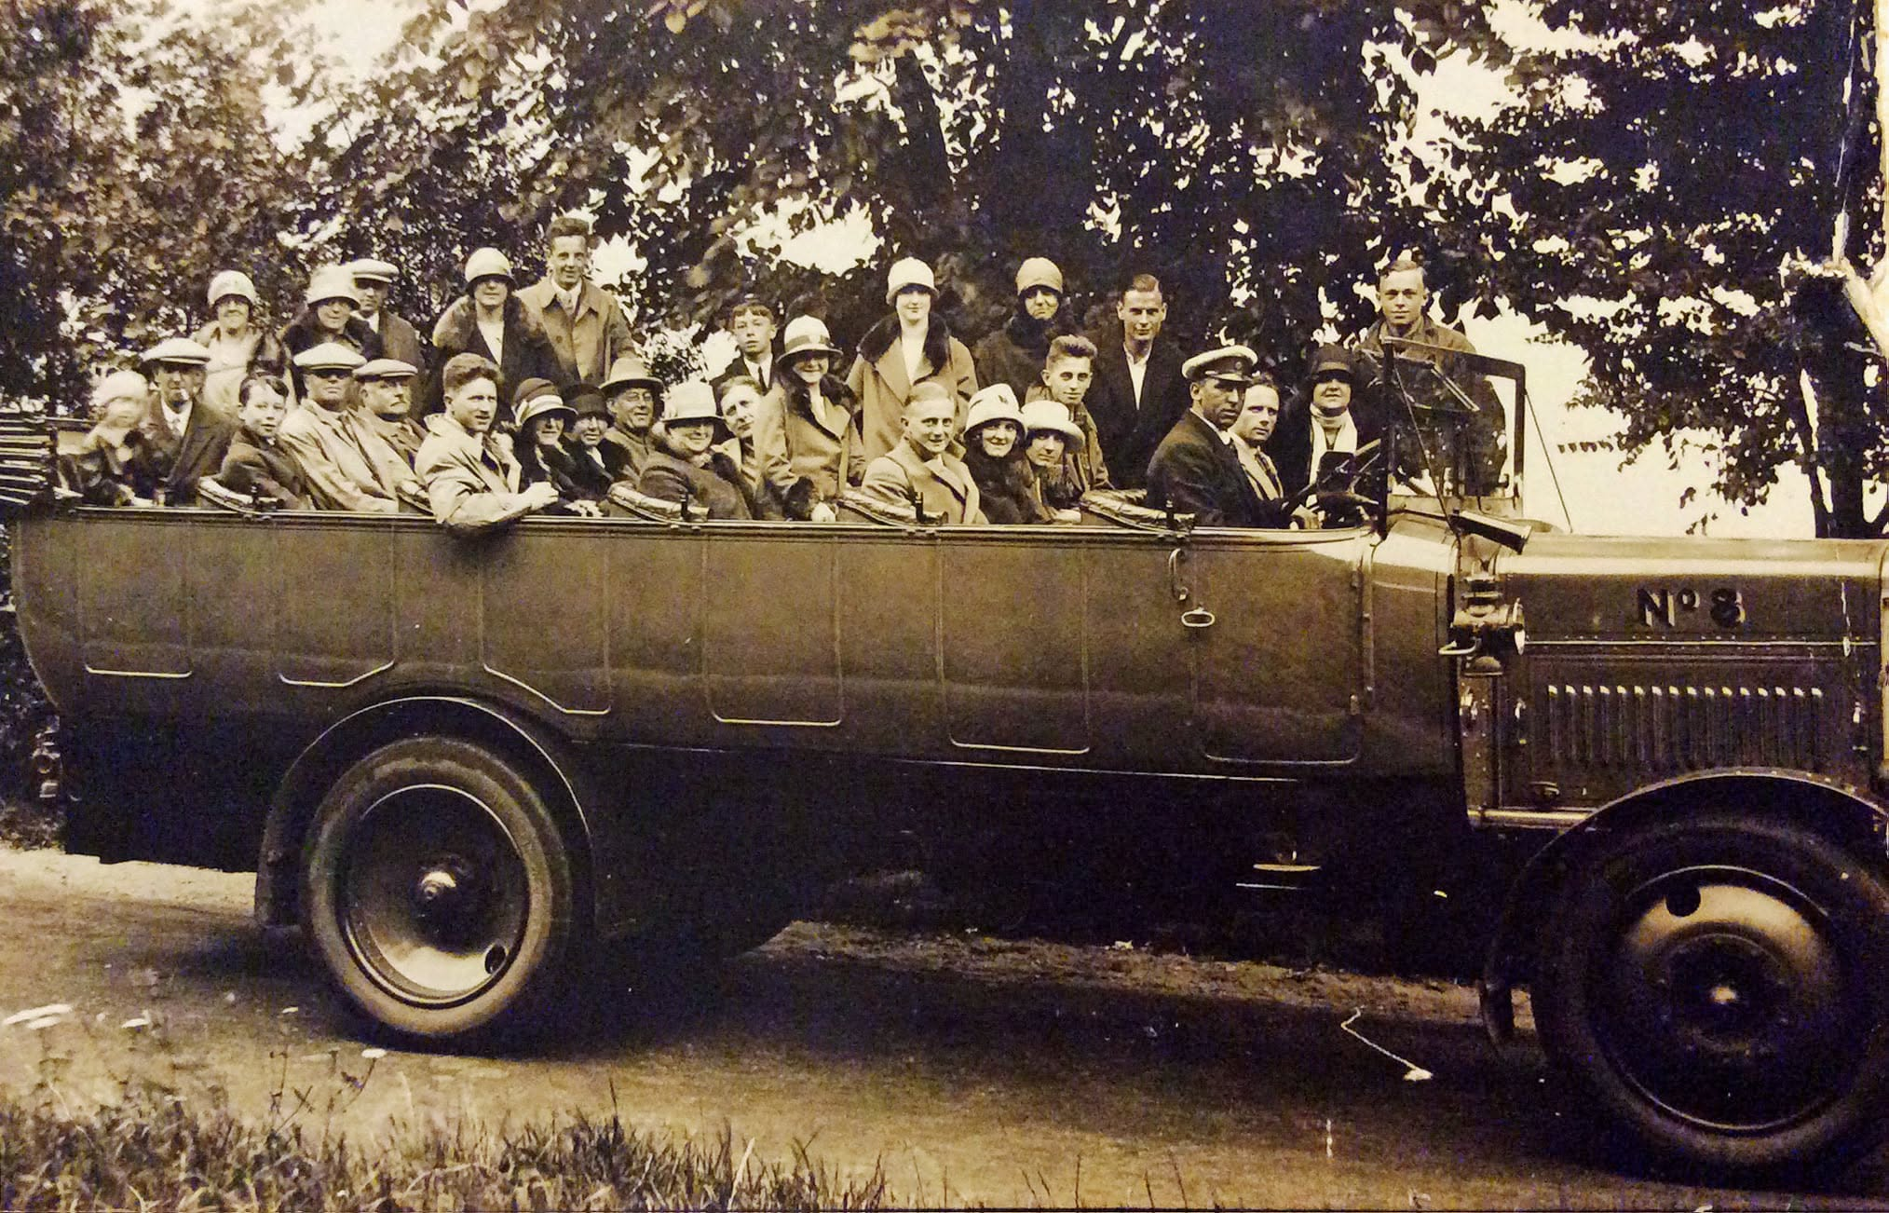
Photo: Olney History Hub
Notes:
A Charabanc. Following the work by the Women’s National Committee, a number of rail excursions were organised. But relatively few charabanc trips were organised to see the open gardens and the annoyance of the Women’s National Committee can be heard in this quote given to the newspapers in June 1927:
‘It would appear that the owners of public motor charabancs do not seem to have fully realised the advantage of running vehicles to the gardens in their areas. “Where road transport has been available," one official said, “the results have been very good, indeed, and if only the 1,500 motor coach owners that we circularised will help where they can do so profitably, the movement is certain to be a great success.’
Visitors arrived at the gardens by all manners of transport, some on foot or bicycle, but often the gardens were deep in the countryside requiring some form of motorised transport. When Elsie Wagg inherited her car in 1919, there were only two hundred and fifty thousand cars on the road. By 1927 there were 1.2m. Whilst there were only 2-3,000 motor vehicles in Herefordshire at this time, motorbikes were becoming more popular.
Photo courtesy of Mike Neale, Olney History Society accessed by Olney History Hub.

Slide 14
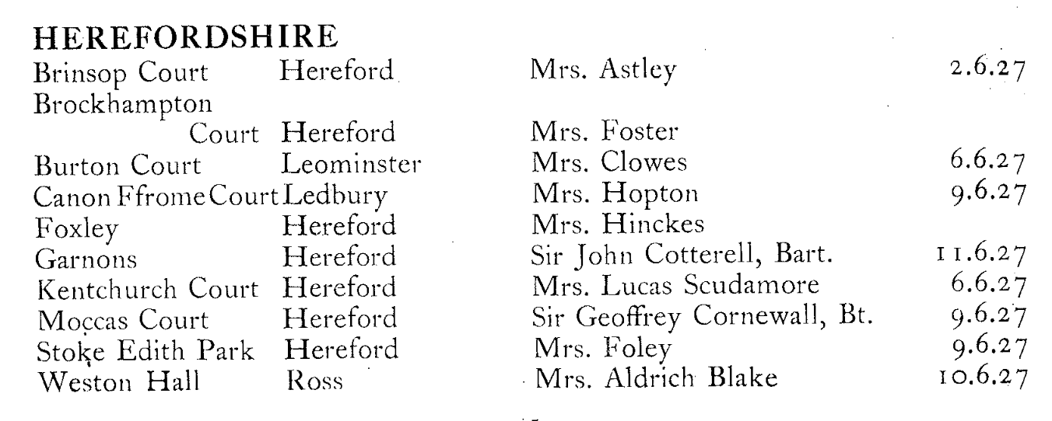
Notes:
Herefordshire list of the ten 1927 gardens.
2nd June was a Thursday, 6th a Monday, 9th a Thursday, 10th a Friday. Only Garnons opened at the weekend, even then not a Sunday. Why was that? An explanation will come later!
Some gardens subsequently offered to open again later in the summer:
Brinsop Court on 18 August - Burton Court - on 14 July - Kenchurch - on 7 July, 18 August
Moccas Court - on 7 July, 4 August - Weston Hall - on 14 July
And another garden, Eywood, near Titley, west of Leominster, opened on 20 July. Sadly the house was demolished in 1954
Image: NGS

Slide 15
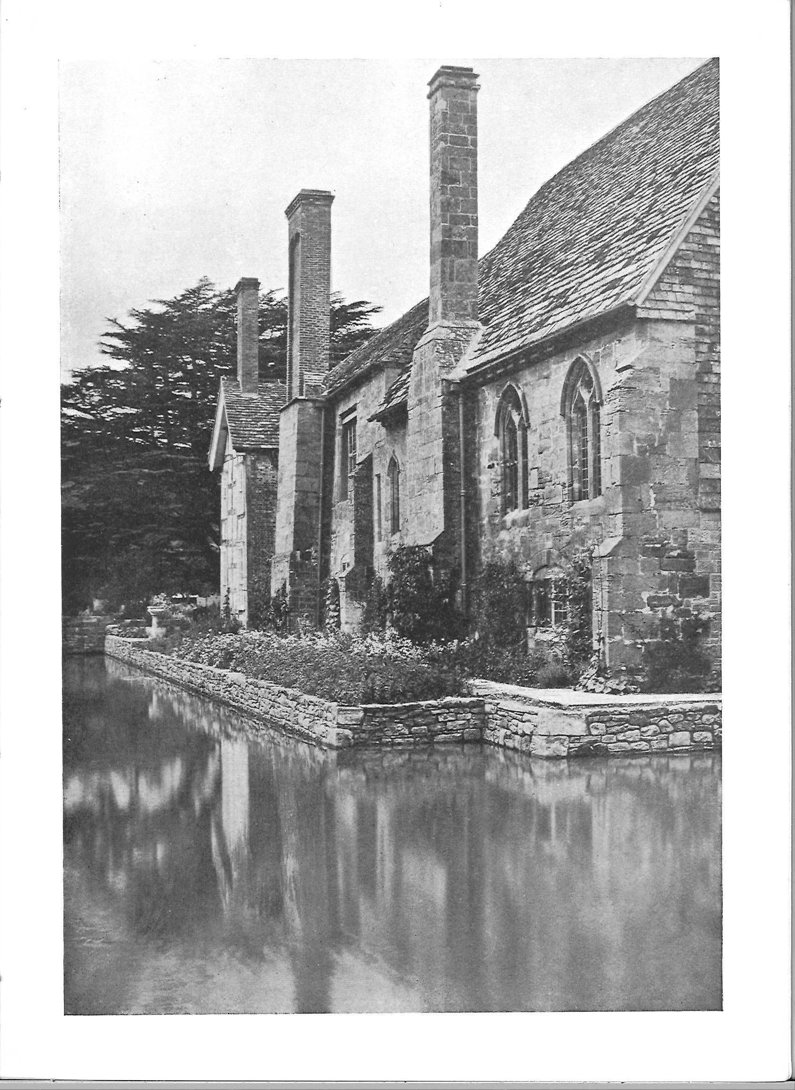
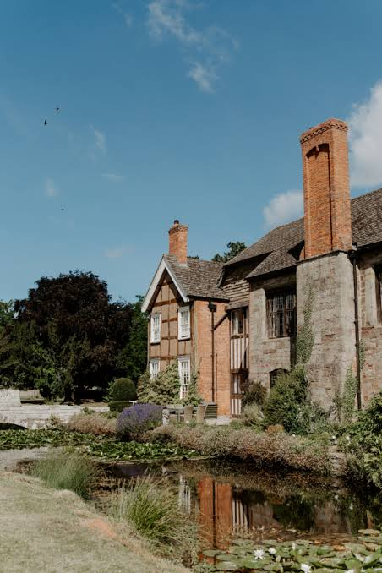
Brinsop Court
Photo: Love My Dress
Notes:
Brinsop Court
Just off Tillington Common, this Grade 1-listed 14th-century moated manor offered a perfect blend of history and natural beauty. Today it is a wedding and events venue but retains
Its expansive 800-acre estate, featuring ancient woodlands, rolling hills, and sweeping fields that stretch as far as the eye can see.
Image Credit: NGS and Love My Dress

Slide 16
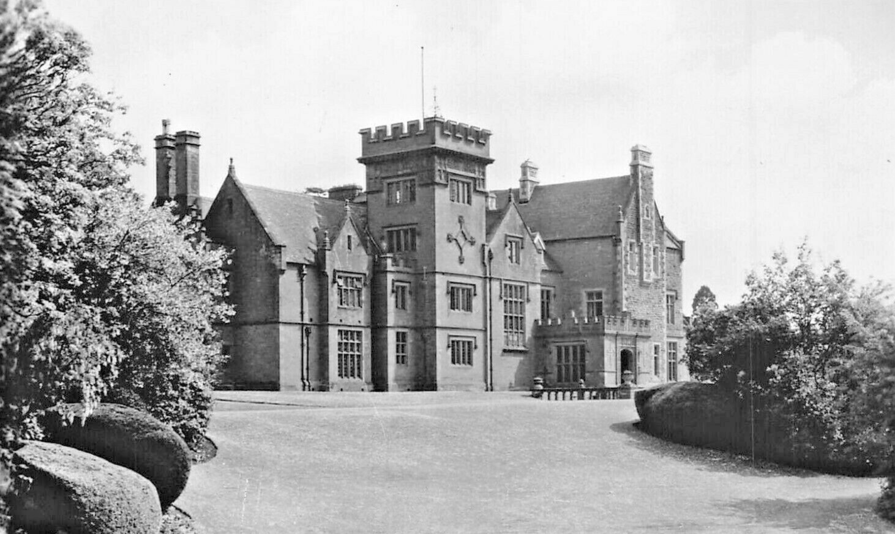
Brockhampton Court
Notes:
Brockhampton is half way between Ross and Hereford just off the back road, B4224
In the 1885, Brockhampton Court, Herefordshire, was purchased by Ebenezer D. Jordan of Boston, USA. The property was dramatically altered into a beautiful home by Mr Ebenezer as a wedding gift to his daughter, Alice Madeline Foster. After her marriage to Colonel Arthur Wellesley Foster, Alice became the driving force behind intricate changes, ensuring no expense was spared. The gardens were described as ‘delightfully positioned amidst peaceful countryside’.
Brockhampton Court was handed down through the family until it was eventually sold and in the 1940s was turned into a hotel with function rooms, 26 bedrooms and an attached riding school. In 1949 it was put up for auction, and currently it is a nursing home.
Viewcard Image: Herefordshire Past (via Herefordshire Archives)

Slide 17
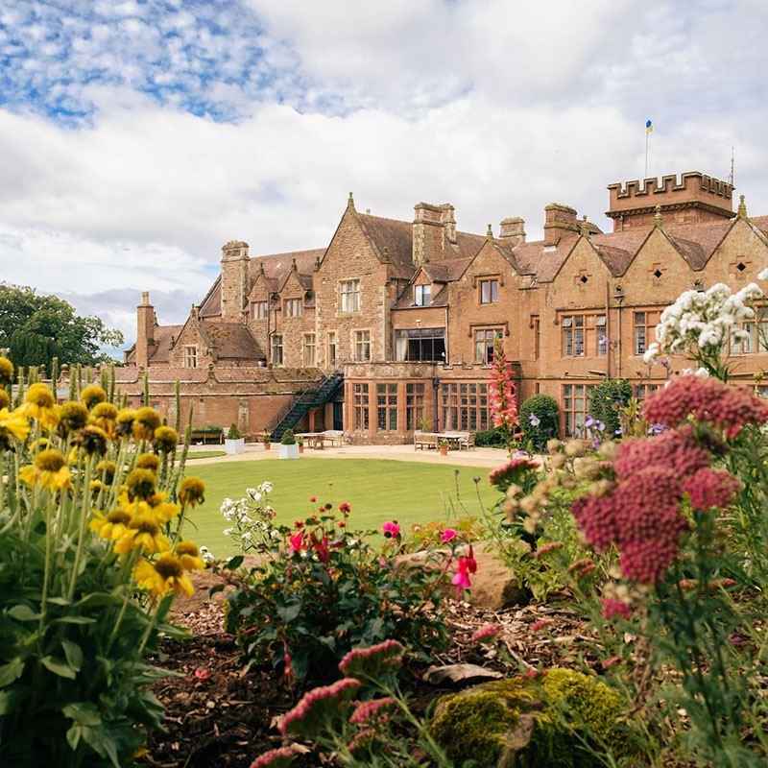
Brockhampton Court today, now a nursing home
Photo Courtesy of SpringCare
Notes:
It still has 10 acres of beautifully landscaped gardens but is sadly not open to the public.
Photo: Courtesy of SpringCare

Slide 18
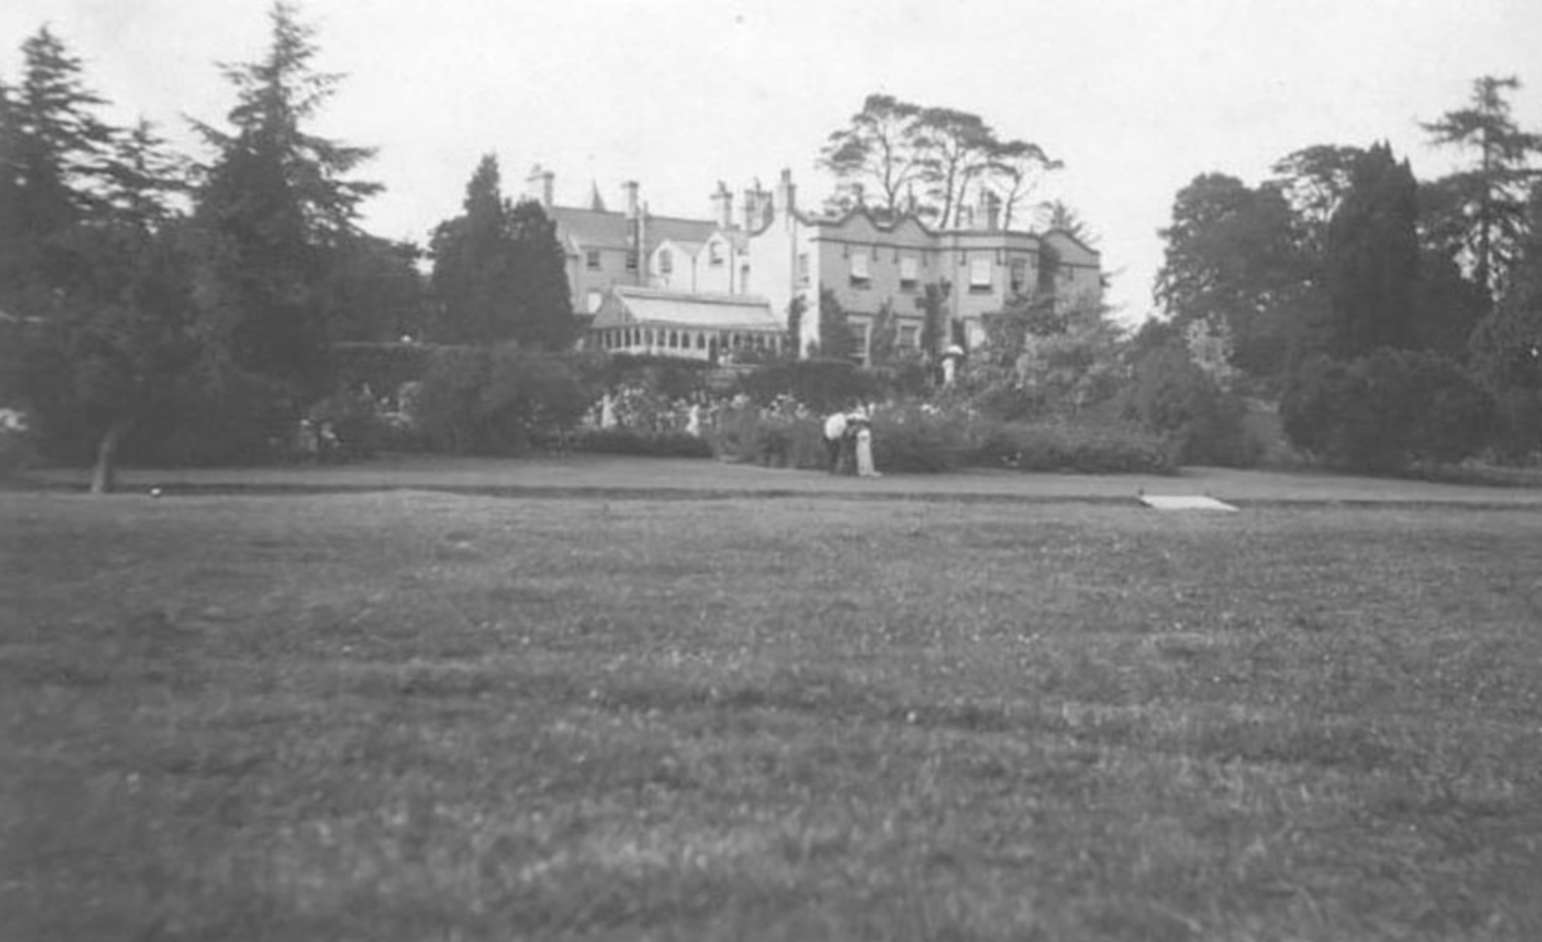
Burton Court
Notes:
Burton Court (near Eardisland, SW of Leominster)
Spanning 19 acres of the broader estate, the traditional gardens feature classic plantings like lavender, delphiniums, and geraniums.
Image: Courtesy of Burton Court

Slide 19
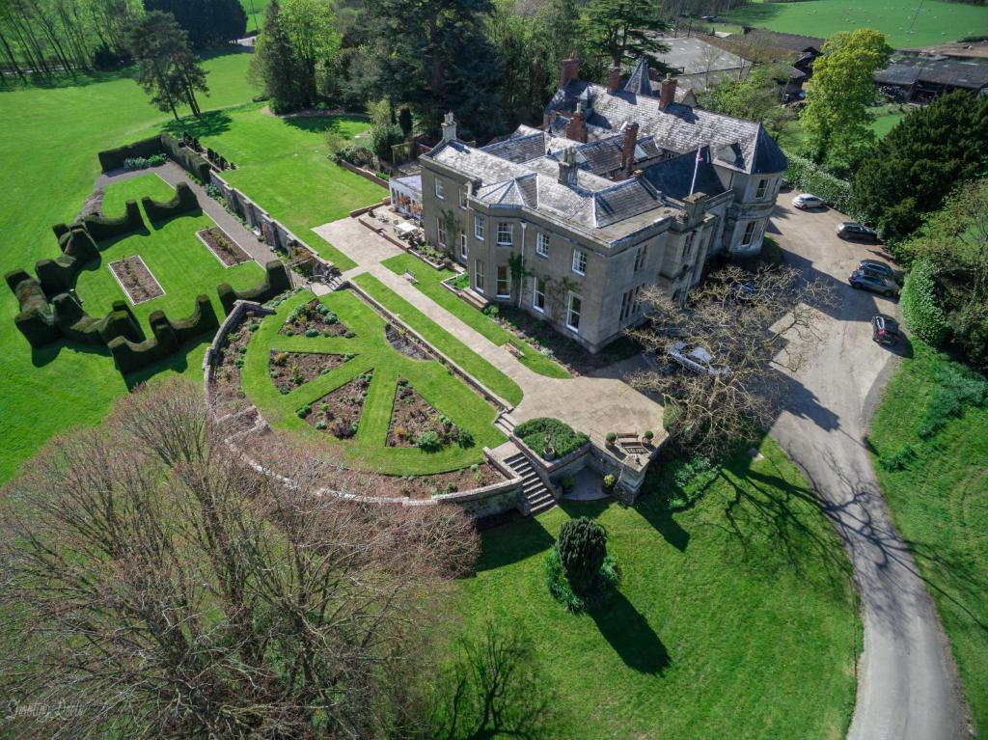
Burton Court Today
Notes:
The Simpson family have been conducting guided tours around their home since the 1960s. The newest addition to the tour these days is the large archaeological dig. This has provided considerable interest, as it is believed to be the remains of a Norman Castle inside the grounds. The discoveries on the mound have reshaped the house tours as the finds tie in in with the various occupants that have lived at Burton Court over the centuries. They now amount to the largest medieval pottery find in Herefordshire. Open only under Historic Houses.
Described as a Manor house with medieval, Regency, Victorian and Edwardian architecture, at the heart of the Black and White Village Trail. Exhibitions include costumes, militaria, natural history and ship models. ‘Hugely enjoyable’ (Simon Jenkins).
Photo: Historic Houses

Slide 20
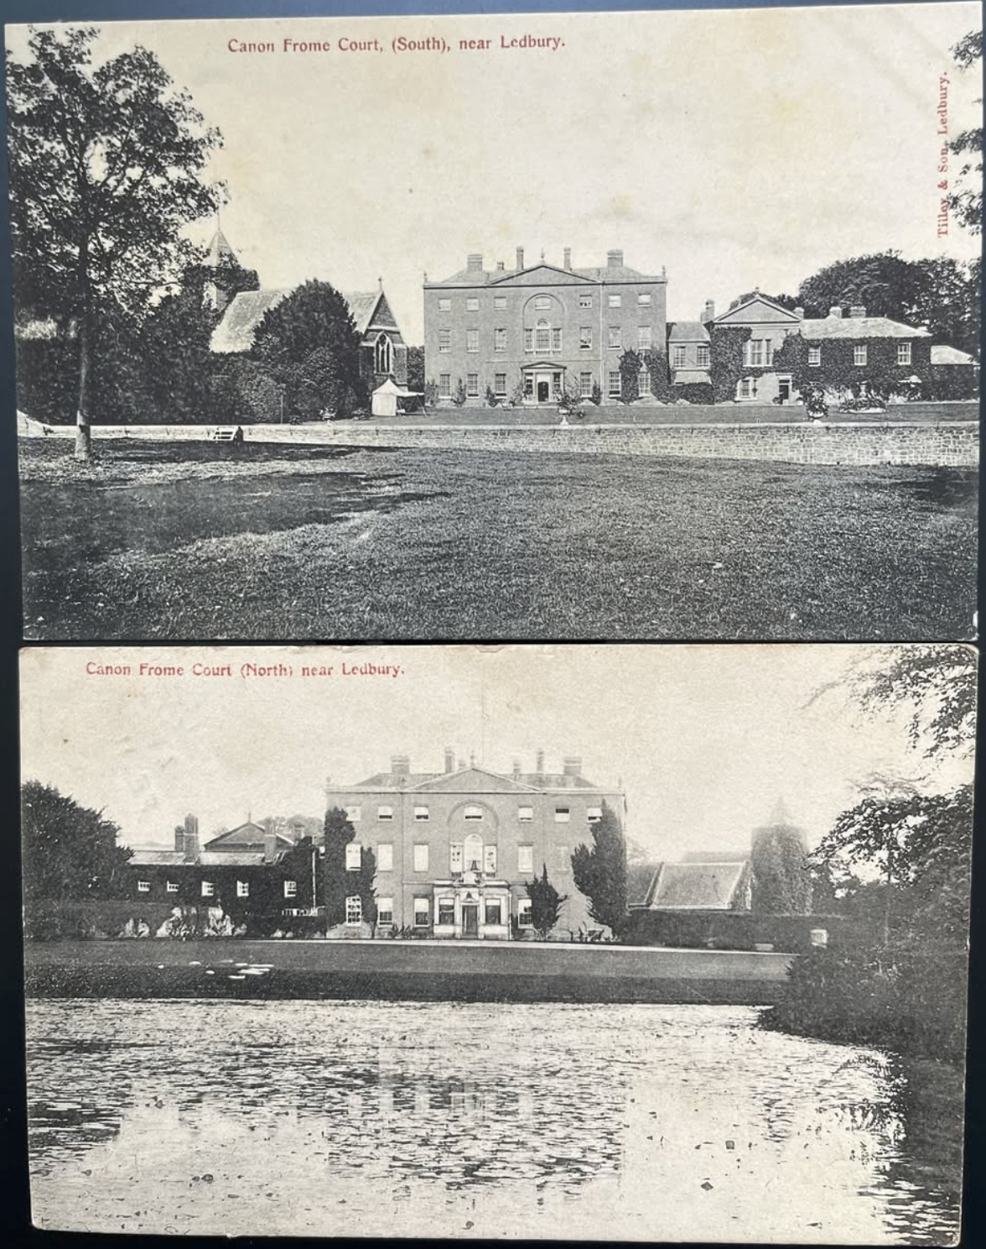
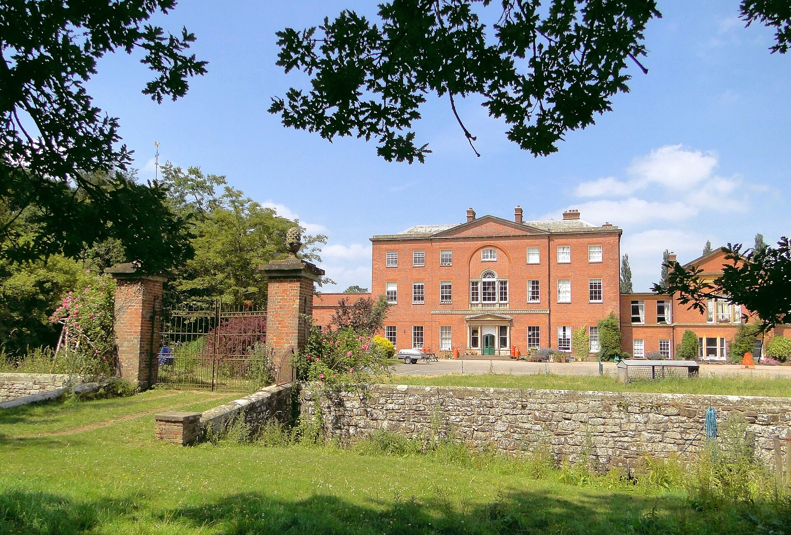
Canon Frome Court
Open again for the Centenary
Notes:
Canon Frome Court (east of Hereford)
Grade 11 listed in 1952, a large red brick country house. Originally a 16th century moated house. It was the Hopton family home for 300 years. The house and land was bought by Hereford County Council in 1957 (State secondary school). 1978 bought by the Windflower Housing Association, It now forms a co-housing community. The walled garden is a wonderful example for lovers of fruit and veg.
Tilley Postcard Images: Thanks to David Smith, Old Ledbury Group
Modern photo: Wikimedia Commons

Slide 21
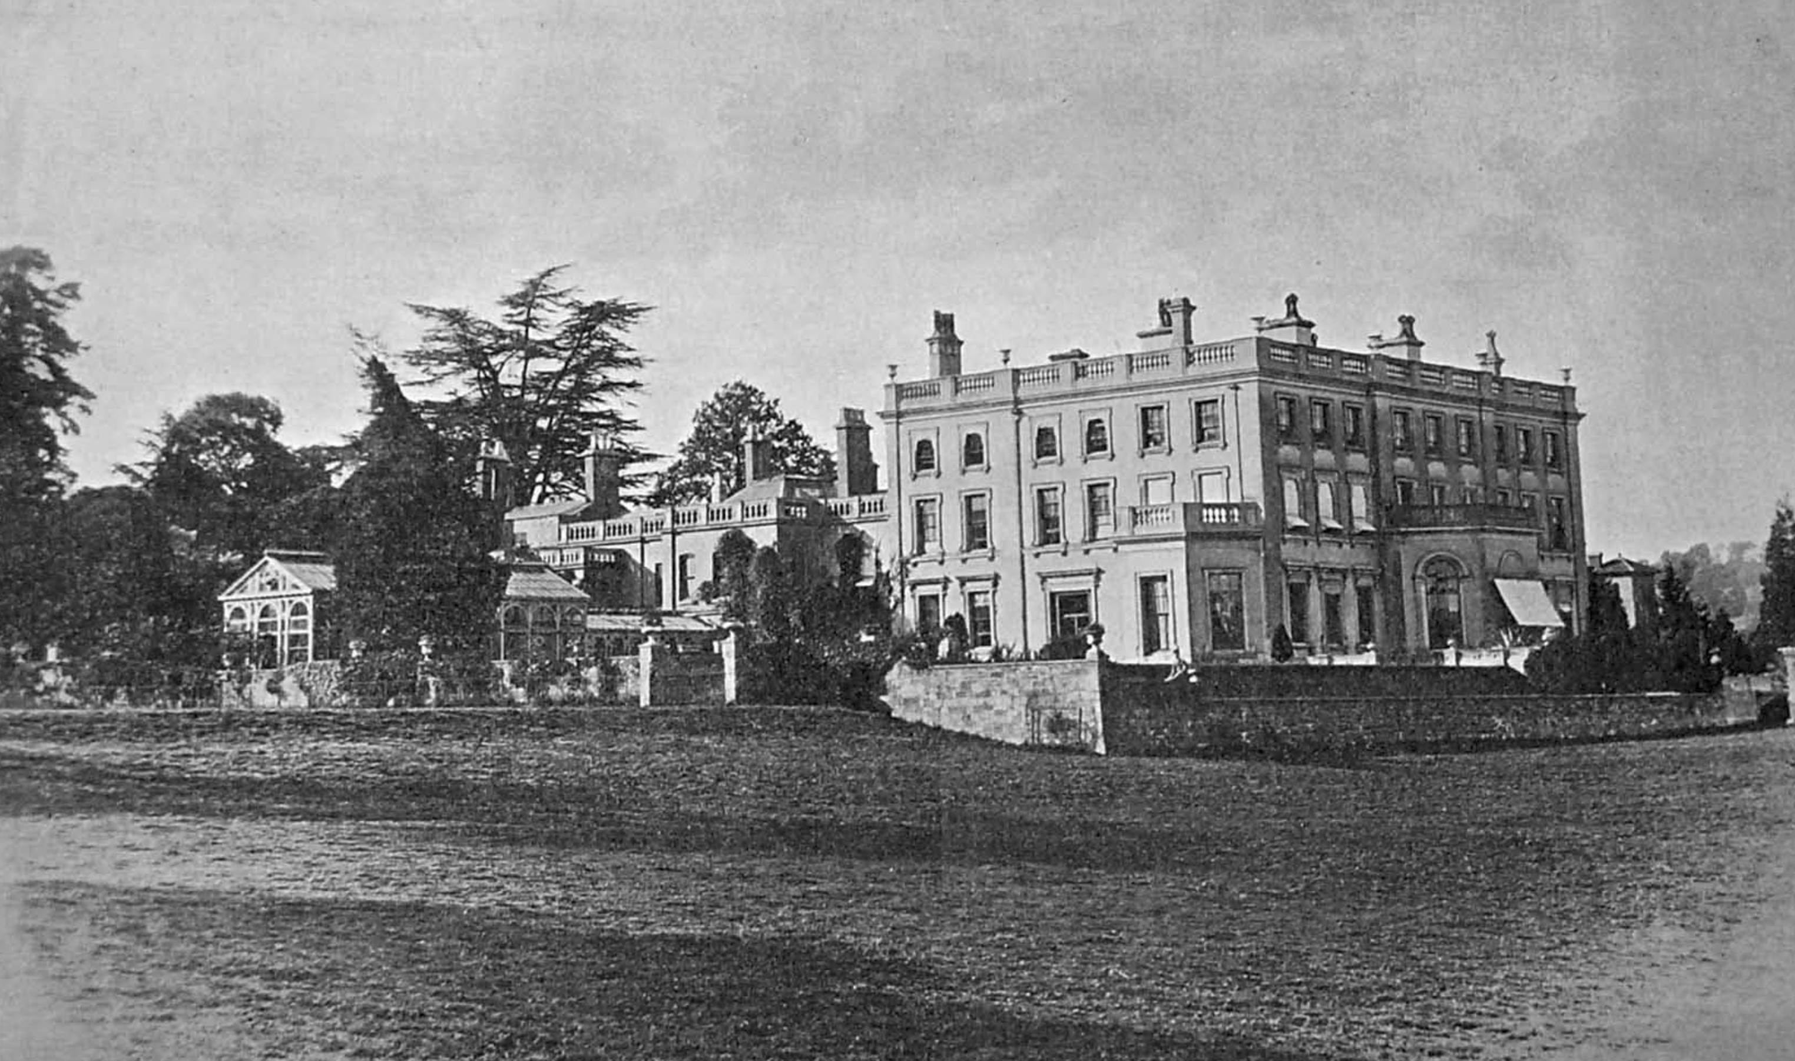
Foxley Manor
Notes:
Foxley Manor (NW of Hereford near Mansel Lacy)
The Foxley estate was described in late Victorian era as in a "high state of cultivation", the mansion as commanding "some beautiful views over the vale of Hereford, the distance being formed by various hills retiring in perspective, and the foreground by rich masses of wood". Renowned as the historic home of Sir Uvedale Price, a pioneer of the "Picturesque" aesthetic movement in landscape design. The house itself contained apartments which were mostly "elegantly fitted up, and decorated with a good collection of painting by the first masters”. It was requisitioned in WW2 as a camp for Canadian forces. After the War the camp became a centre for the Polish Resettlement Corps and their families
The dilapidated mansion was demolished in 1948
Image: thanks to Bartonsham History Society

Slide 22
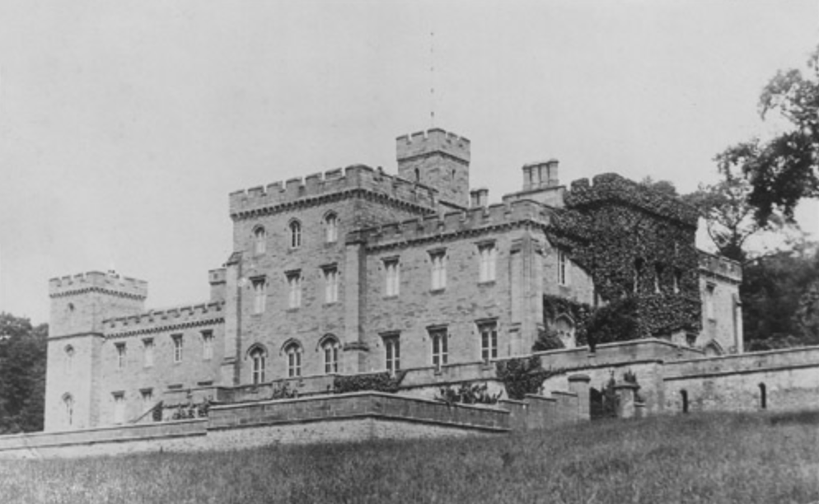
Garnons
Notes:
Garnons is 6m west of Hereford, near Byford.
Garnons is an historic 2,500-acre estate tied to the Geers and Cotterell families for centuries. It featured a landscape park designed by renowned landscape architect Humphry Repton in 1794. The grounds included an 18th-century brick-walled kitchen garden and majestic ancient trees,
Richard Cotterell was 14 years old when the health of his mother – ‘a smart all-round cricketer and fine fisherwoman’ – went into precipitous, terminal decline in February 1922.19 ‘It is sincerely hoped that her ladyship’s death will not have the effect… of accelerating the departure of the family from Garnons, which Sir John has broadly hinted at lately, owing to the post-war taxation that is bearing so heavily on all landowners.’ The fear of the local newspaper was not borne out but the estate did lose some longstanding residents later that year when the 4th baronet decided to disperse entirely his renowned herd of Hereford cattle.
The Cotterells’ eventually divorced in 1958, the culmination of turbulent period which saw the 5th baronet taking some momentous decisions in the face of stark post-war exigencies. With many country house owners now opting to either sell up or tear down, the choice at Garnons was partial demolition. ‘Sir Richard Cotterell is having a large part of his 50-room house reduced to a “more handy size,” said his butler’ to an enquiring Daily Express.
Part demolished in late 1950s. A ‘cut-down’ Grade 2 manor still remains
Image Credit: Lost Heritage

Slide 23
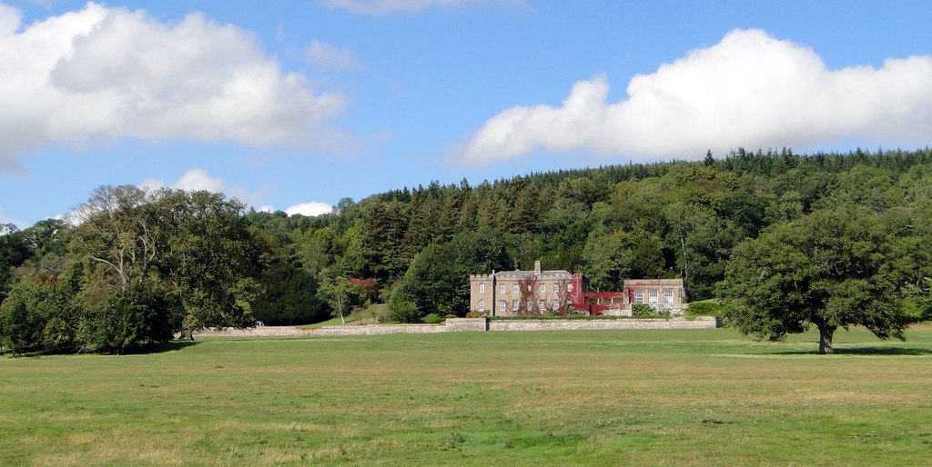
Garnons Today
Notes:
Garnons occasionally host charity plant fairs today so some access is possible.
Photo: Philip Pankhurst licensed for reuse under Creative Commons

Slide 24
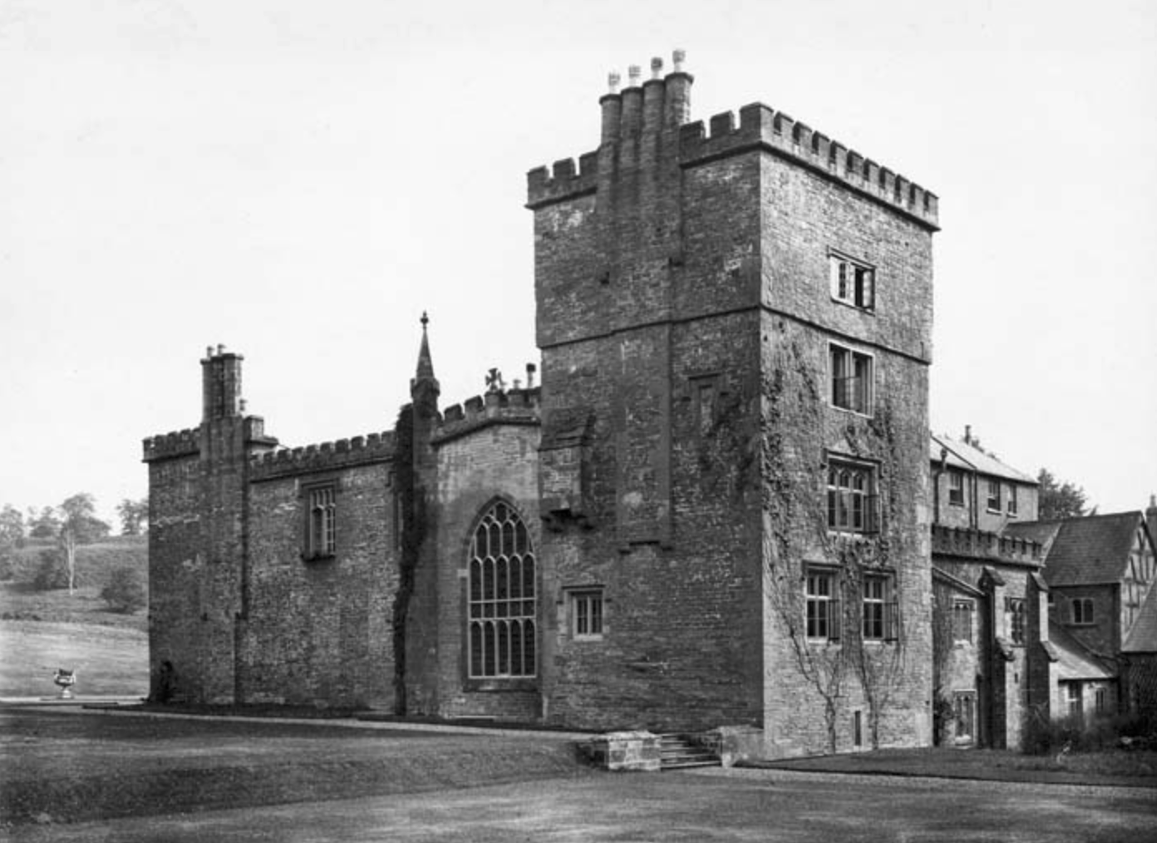
Kentchurch Court
Notes:
Kentchurch is 13m SW of Hereford near Welsh border. . See separate background notes including info on the Scudamores
Image Credit: Historic England

Slide 25
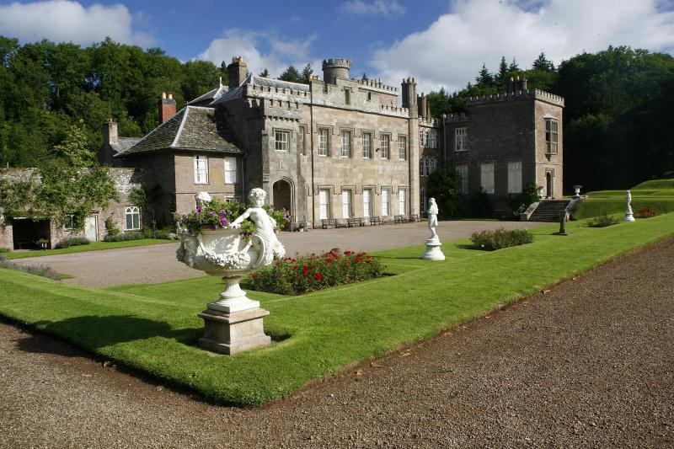
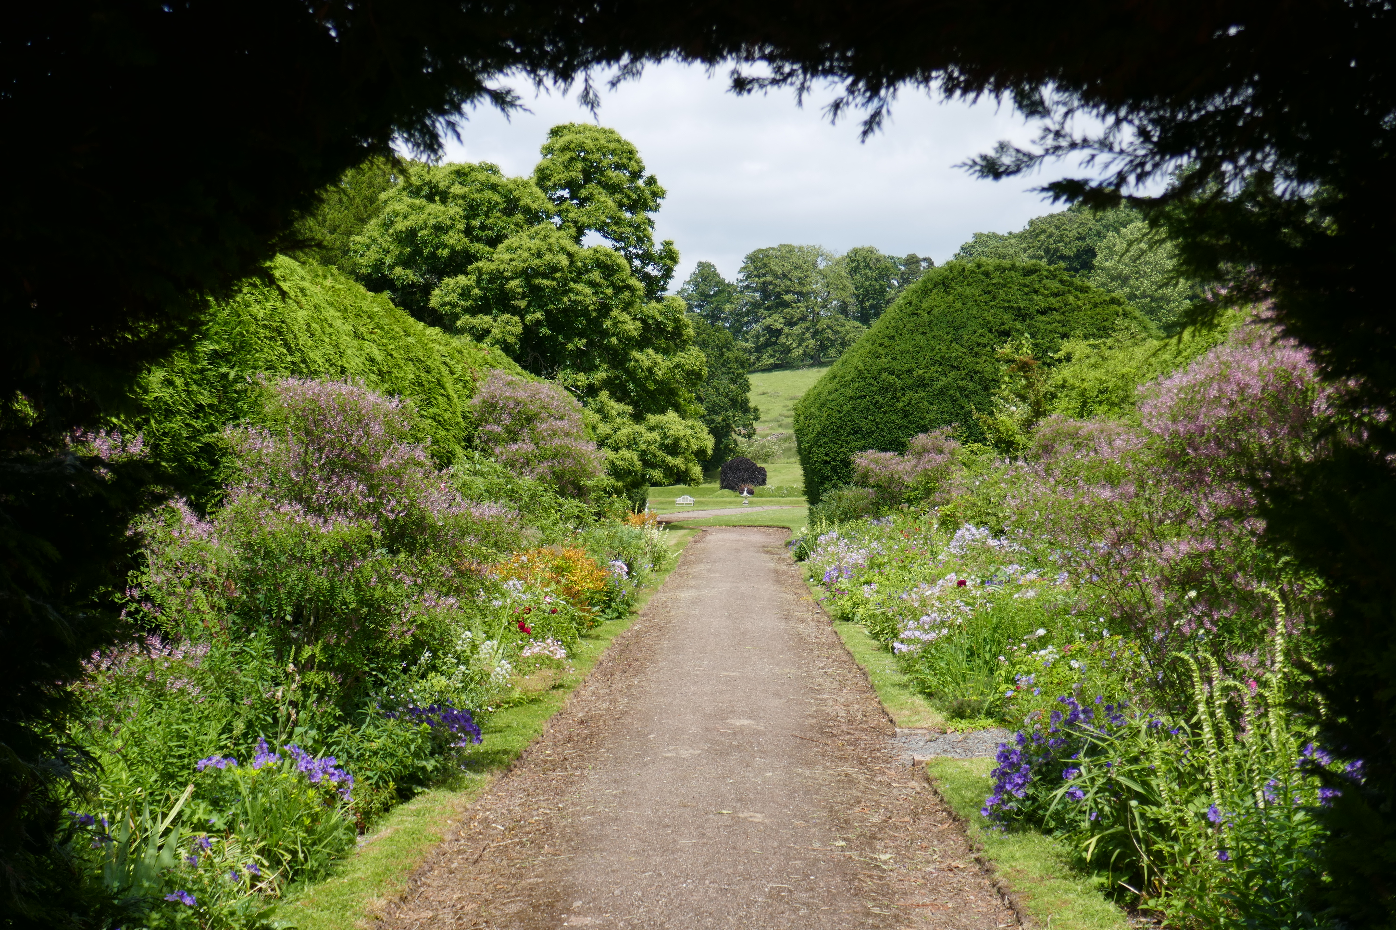
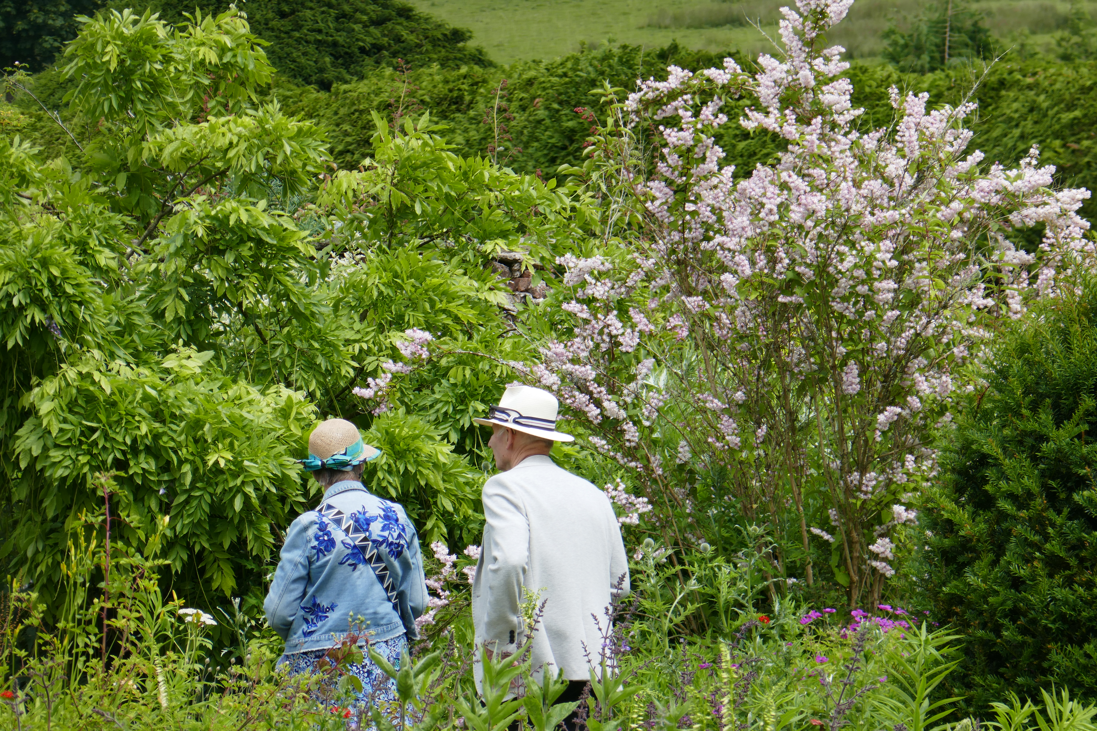
Kentchurch Court
Open for the Centenary
Notes:
Give opening details and brief description.
Photos: Graham O’Connell and NGS

Slide 26
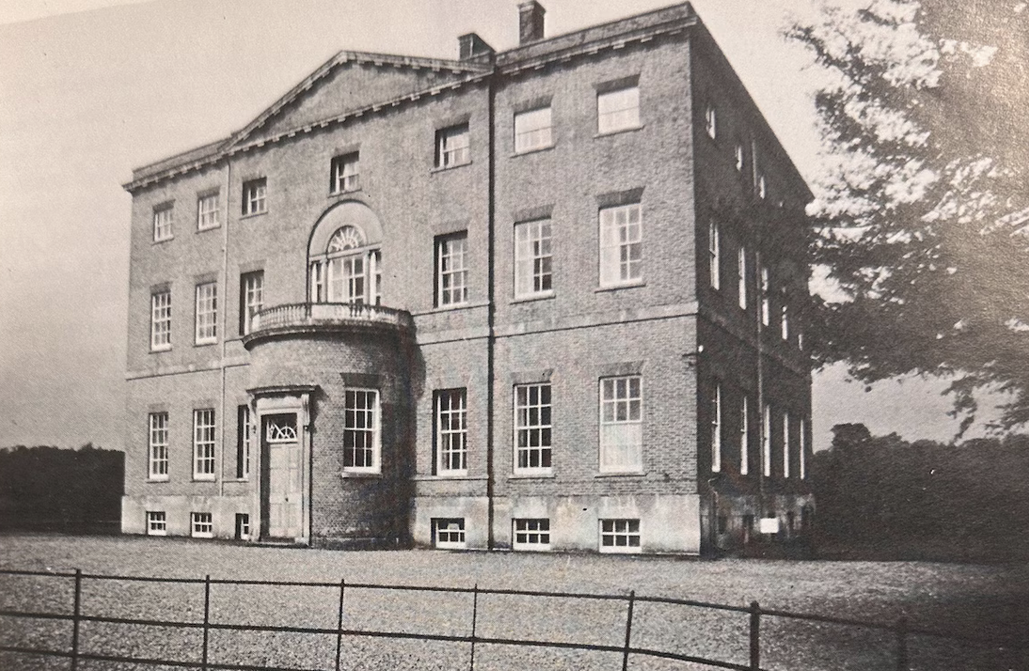
Moccas Court
Notes:
Moccas Court, Dorstone (14m W of Hereford)
About 15ha around the house and including the Home Farm and kitchen garden are enclosed within a ha-ha, the line of which is continued to the north of the house by a chain of three small fishponds. The walks, and possibly terraces, are believed to derive, at least in part, from suggestions made by Humphry Repton circa 1794.
After death of Sir William Cornewall, the 7th Baronet in 1962, the estate passed to the Chester-Master family who owned the house until 2014. It was then sold to Linda Bennett, founder of the fashion house L.K.Bennett.
Image Credit: A History of Herefordshire; publisher: Phillimore

Slide 27
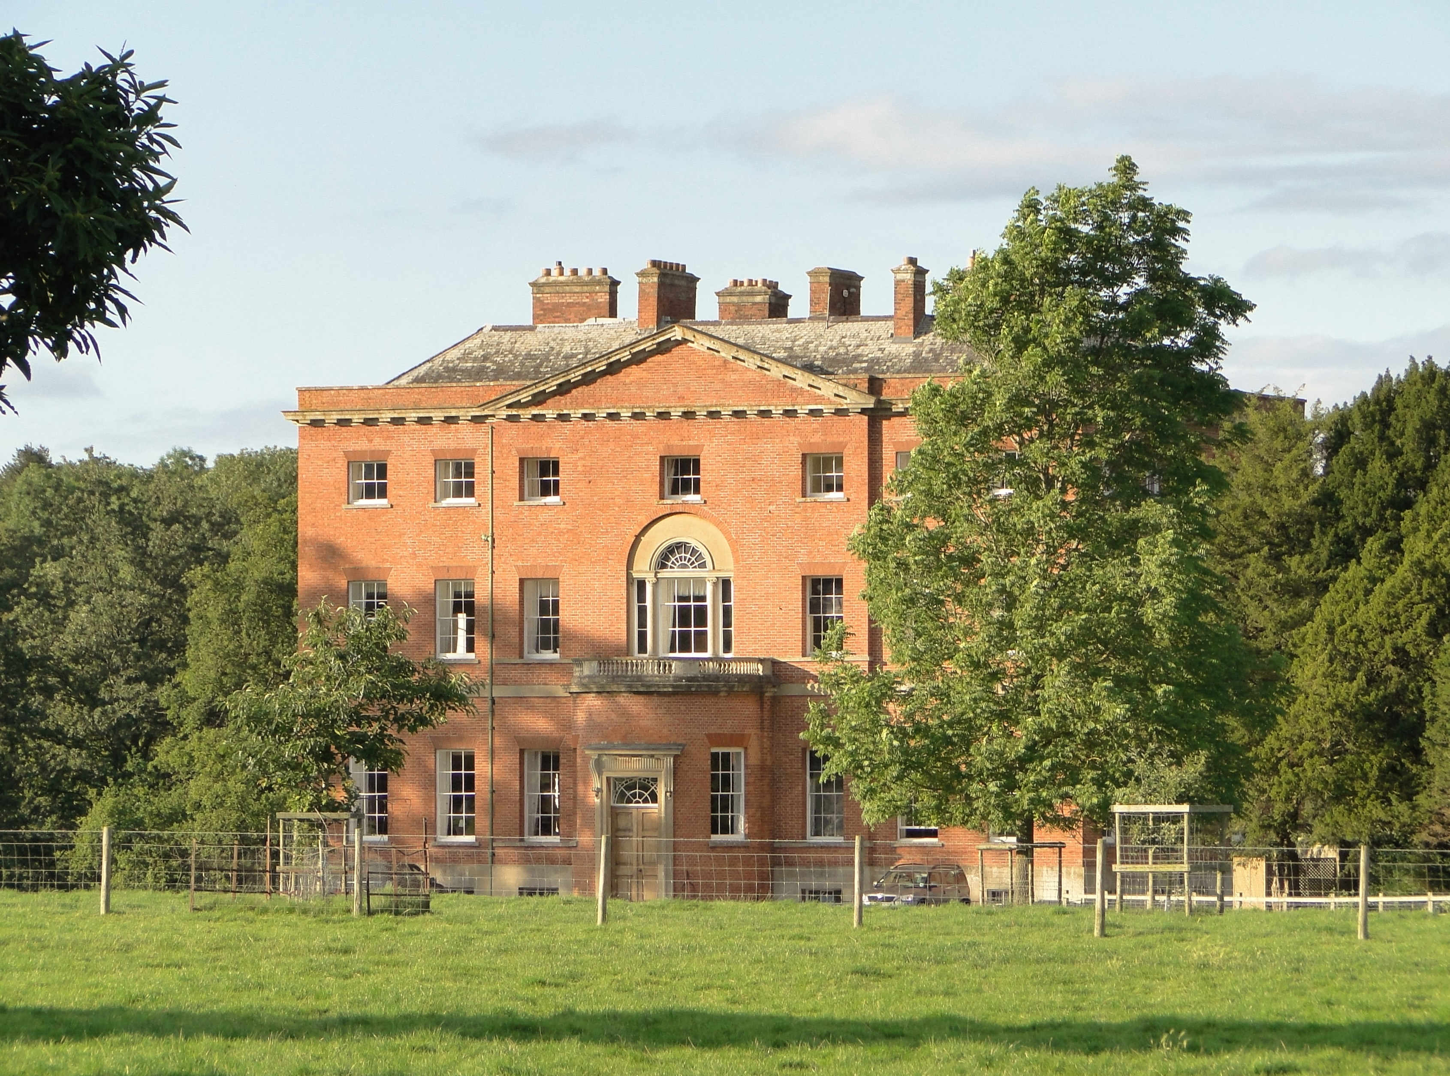
Moccas Court Today
Notes:
Photo: Philip Pankhurst, Creative Commons

Slide 28
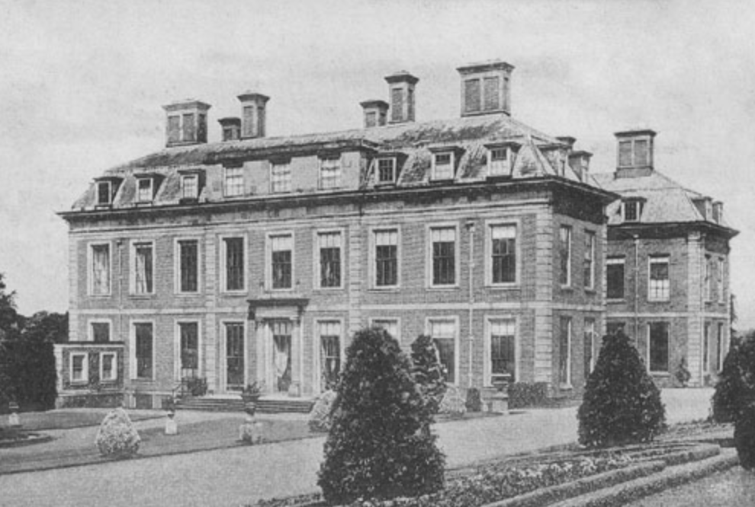
Stoke Edith Park
Notes:
Stoke Edith Park (between Hereford and Ledbury)
The park's historic landscape—originally laid out in the Anglo-Dutch style in the late 1600s—was remodelled in 1792 by the famous landscape designer Humphry Repton.
The manor was destroyed by fire in 1927 not long after the garden opening, despite the efforts of Paul Henry Foley, who although in poor health orchestrated the work of his own fire brigade which desperately tried to contain the fire. Neighbouring fire brigades came to help, at which point Paul Foley collapsed and had to leave the scene. Although he and others had managed to rescue many items of valuable furniture, china and paintings, the building itself was beyond help and eventually only some of the walls remained.
Fortunately those who were inside the building at the time managed to escape, some having hair raising experiences – Miss Windsor, a Maid, found herself cut off by a burning staircase so climbed on to the roof which was being engulfed by flames. Paul Foley ordered the men from the fire brigade to concentrate their efforts on saving her and they did by way of a life line just before the roof caved in. The Housekeeper, Mrs. Bishop, had to grope blindly through the smoke and flames before getting to safety.
Paul Foley seemed to recover, and was well enough to visit London in 1928 but once there he suddenly died. He was 71. The lovely entrance gates and lodge are still intact.
Image: Herefordshire Past (via Herefordshire Archives)

Slide 29
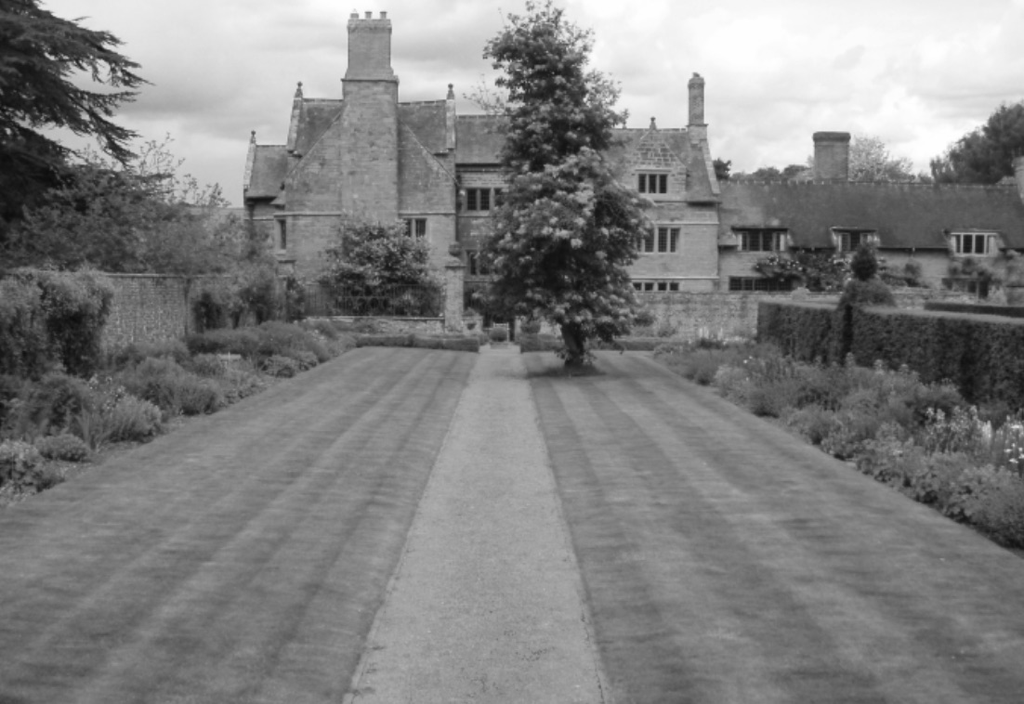
Weston Hall
Notes:
Weston Hall just east of Ross
Featured a large walled garden, a massive Cedar of Lebanon, and ornamental water features.
Note: image courtesy of Graham O’Connell, NGS but reproduced in 1927 style. Not an actual 1927 photo as it has not been possible to source one.

Slide 30
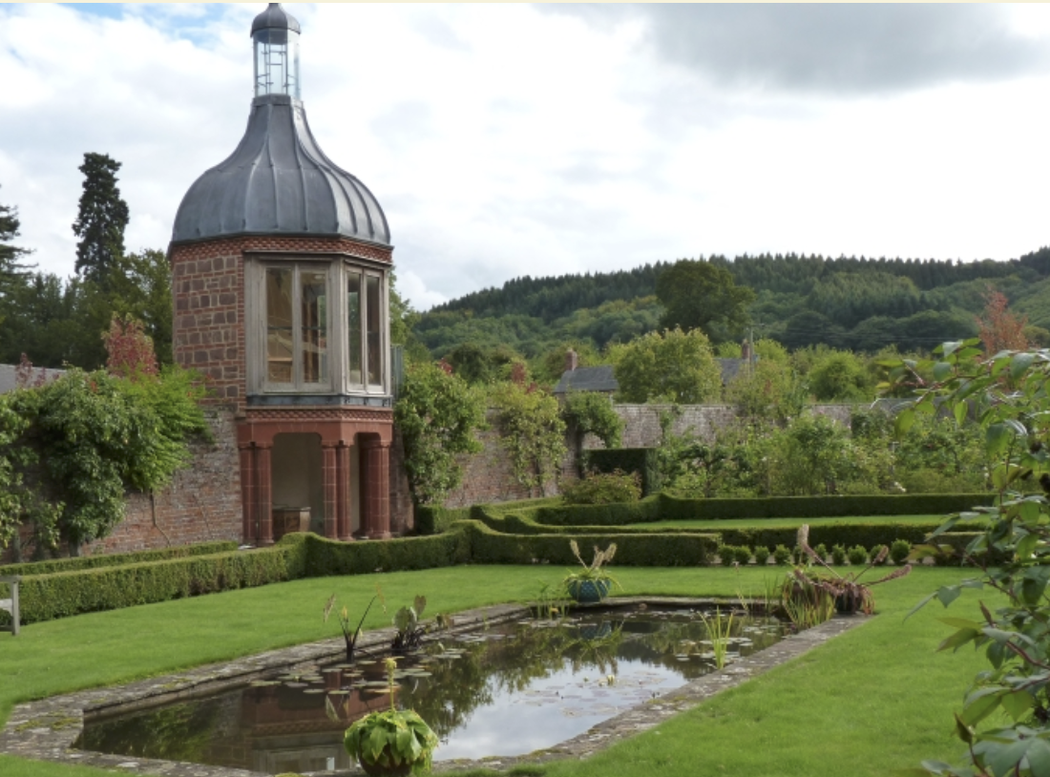
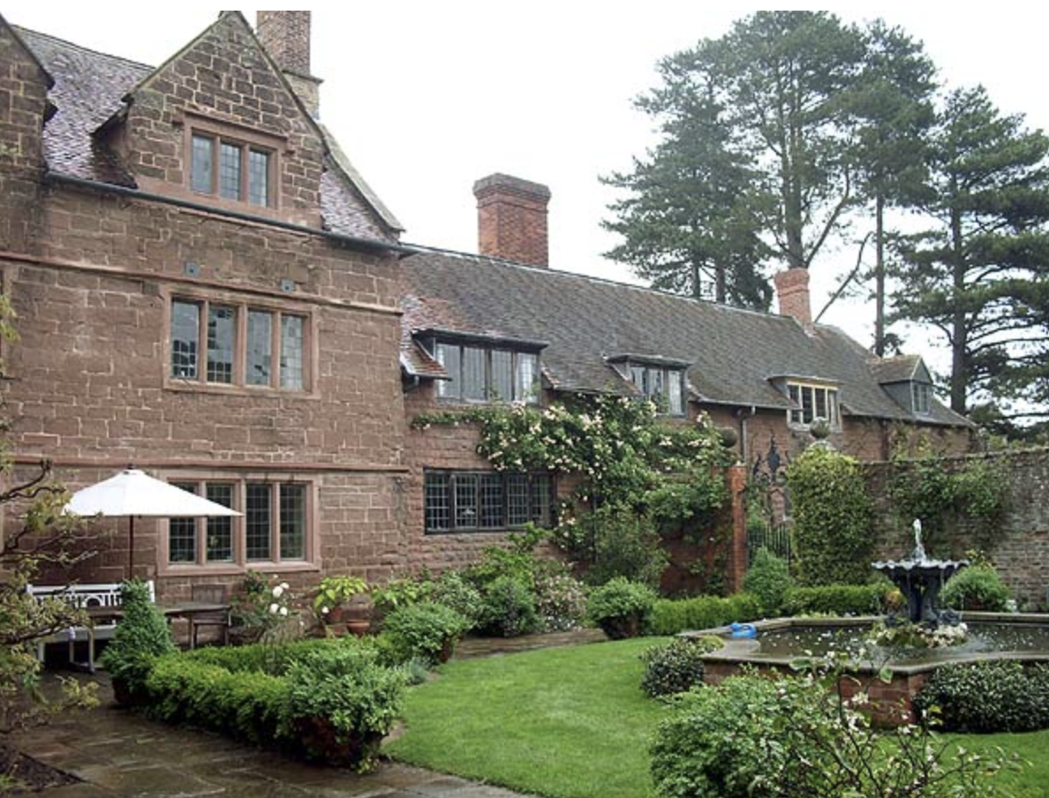
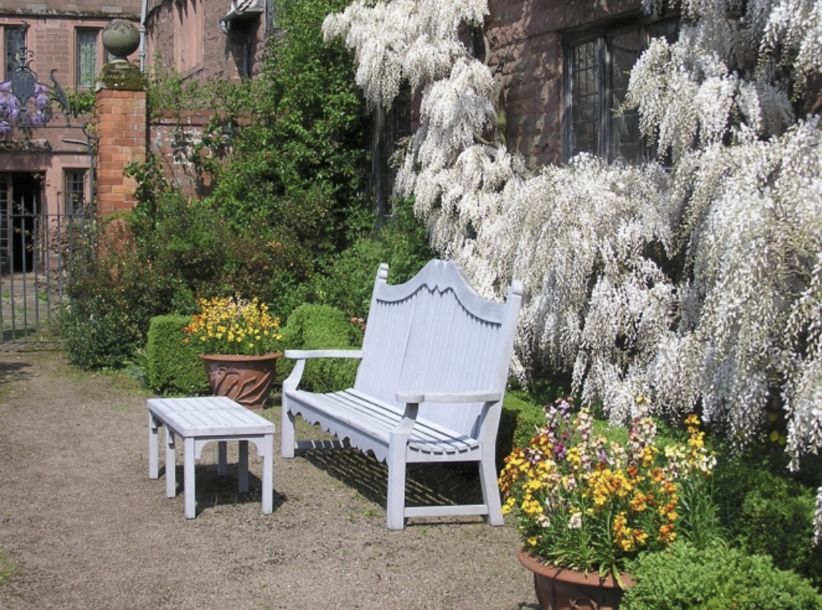
Weston Hall
Open again for the Centenary
Notes:
Give description and opening arrangements
Photos: NGS

Slide 31
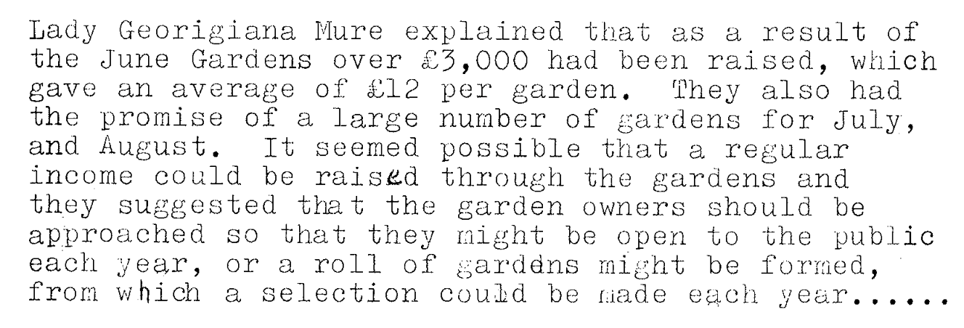
Notes:
Actually £3,675 was raised by 30 June.
At many of the open gardens, the owners welcomed visitors and showed them around just as they do for the National Garden Scheme today. At Caer Beris, near Hay-on-Wye, ‘Lord Swansea was present on the ground, extending a hearty welcome to all’
In 1927, nearly 200,000 people took the opportunity to visit the gardens open under the scheme. The majority of these visitors were likely to be upper or middle-class.
Visitors would also have needed sufficient leisure time and opportunity. In 1927 most working-class people worked long hours, six days a week with time off only on Sunday. While Sundays accounted for 14% of the days between 30 May and 30 September, only 4% of garden openings were on a Sunday. This isn’t surprising given that the garden owners would have used their employees to collect ticket money, show visitors round, serve refreshments and police the grounds. There was opportunity though for most people to visit the gardens on the two bank holidays on 6 June and 1 August and this comprised 6% of the garden openings.
Finally, though the one shilling charge may sound small (5 pence in decimal currency), it was still a reasonable proportion of a labourer’s wage. In 1927, the average weekly wage of a gardener or agricultural labourer was 31 shillings, with women earning substantially less, so based on a six-day week, one shilling represented about a fifth of a day’s work for a man and much more for a woman.

Slide 32
On 7 June 1927 The Times wrote:
Suggestions have been made from many quarters that the scheme should be made an annual one, […] for the purpose of benefiting the national work of the Queen’s Institute for District Nursing. This decision has been greatly influenced by the fact that certain gardens have already been spontaneously offered for the future.
Notes:
Not everyone was in favour of making the scheme permanent. Lady Rayleigh, the President of the Essex County Nursing Association wrote to the Editor of the Chelmsford Chronicle that ‘Under the proposed scheme a good deal of money which might otherwise have gone to county charities will be diverted to provide pensions for Queen’s Nurses, of whom the county employs a very small number’.

Slide 33
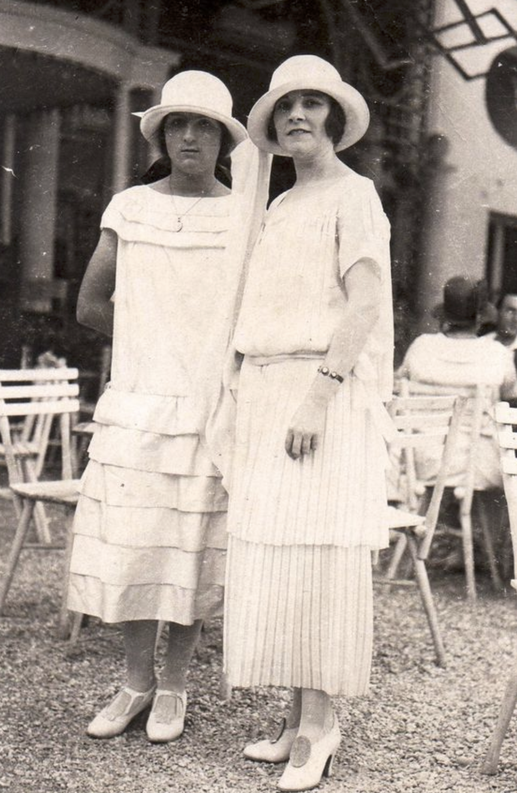
Success in 1927
609 gardens opened
200,000 visitors
£8,191 raised
(about £460,000 today)
Notes:
The first year was a major success. Large numbers of visitors attended the gardens. The money raised made a significant contribution to district nursing.
The 11 gardens in Herefordshire raised £94. May not sound much but was about average for rural counties.
The scheme proved so popular that it became a permanent annual event, which continues today as the National Garden Scheme.
Note: value today (2026) calculated using Bank of England Inflation calculator; this is an estimate based inflation data and is lower than some alternatives.
Image: Vintage dancer; women in 1920s middle class ‘day dress’ fashion

Slide 34
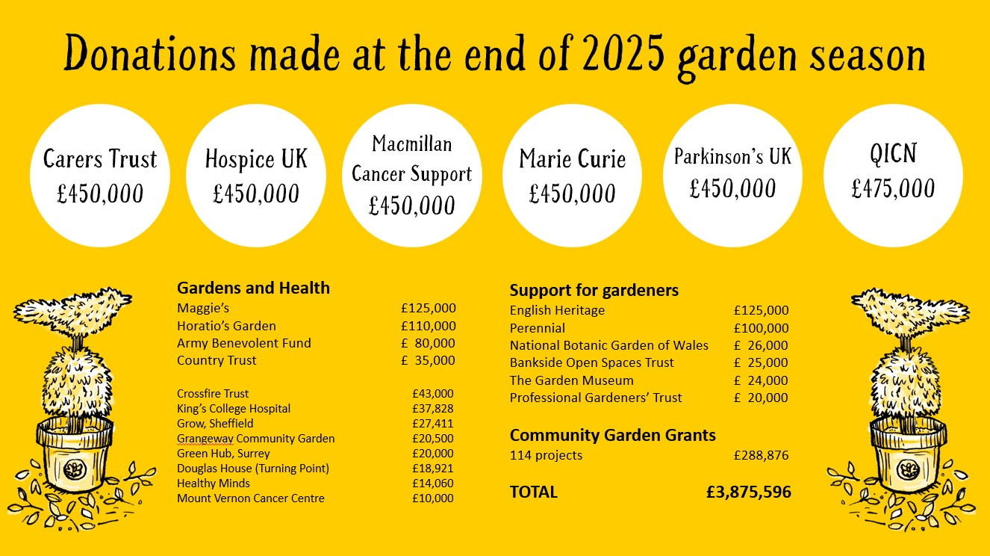
Notes:
It may be nice to compare 1927 with most recent stats (a 2026 graphic will be available in December) if using 2025 you may like to note that there were 4,743 garden openings and almost 600,000 garden visitors in 2025 – supported by over 600 volunteers. The total donated at the end of 2025 makes the overall total £78 million.

Slide 35
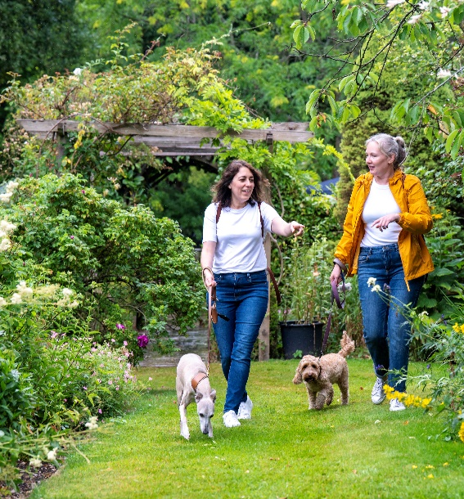
100 years later…2027
Stats and facts about number of gardens opening in 2027 will be available at the end of November 2026
An 'About Us' video is being produced for the centenary and will be the perfect close for this presentation – available end of November / December 2026
Notes:
One hundred years on the National Garden Scheme as it became known has gone from strength to strength. Over 3,500 gardens open each year. The gardens are typically much smaller than the gardens that opened in 1927, but collectively they raise over £3.5 million annually. The money continues to be donated to nursing and health charities, including Macmillan Cancer Support and Marie Curie as well as the QNI. While the cost of admission has risen with inflation and technology has helped its organisation, the essentials of the open garden scheme are unchanged from Elsie’s original idea, made into reality by Lady Georgiana and Millicent. And some things are certain, garden owners will continue to worry about the weather, the number of visitors that come, where will they park, will they behave themselves and how much money will be raised for charity?
Image: NGS [probably just a place holder; a pic of the 2027 Guide may be better]. Women in 2027 clothing

Slide 36
Notes:
Opening your garden for the National Garden Scheme will help us continue 100 years of philanthropy – do speak to the presenter / National Garden Scheme representative at this event to find out more or visit our website ngs.org.uk

Slide 37
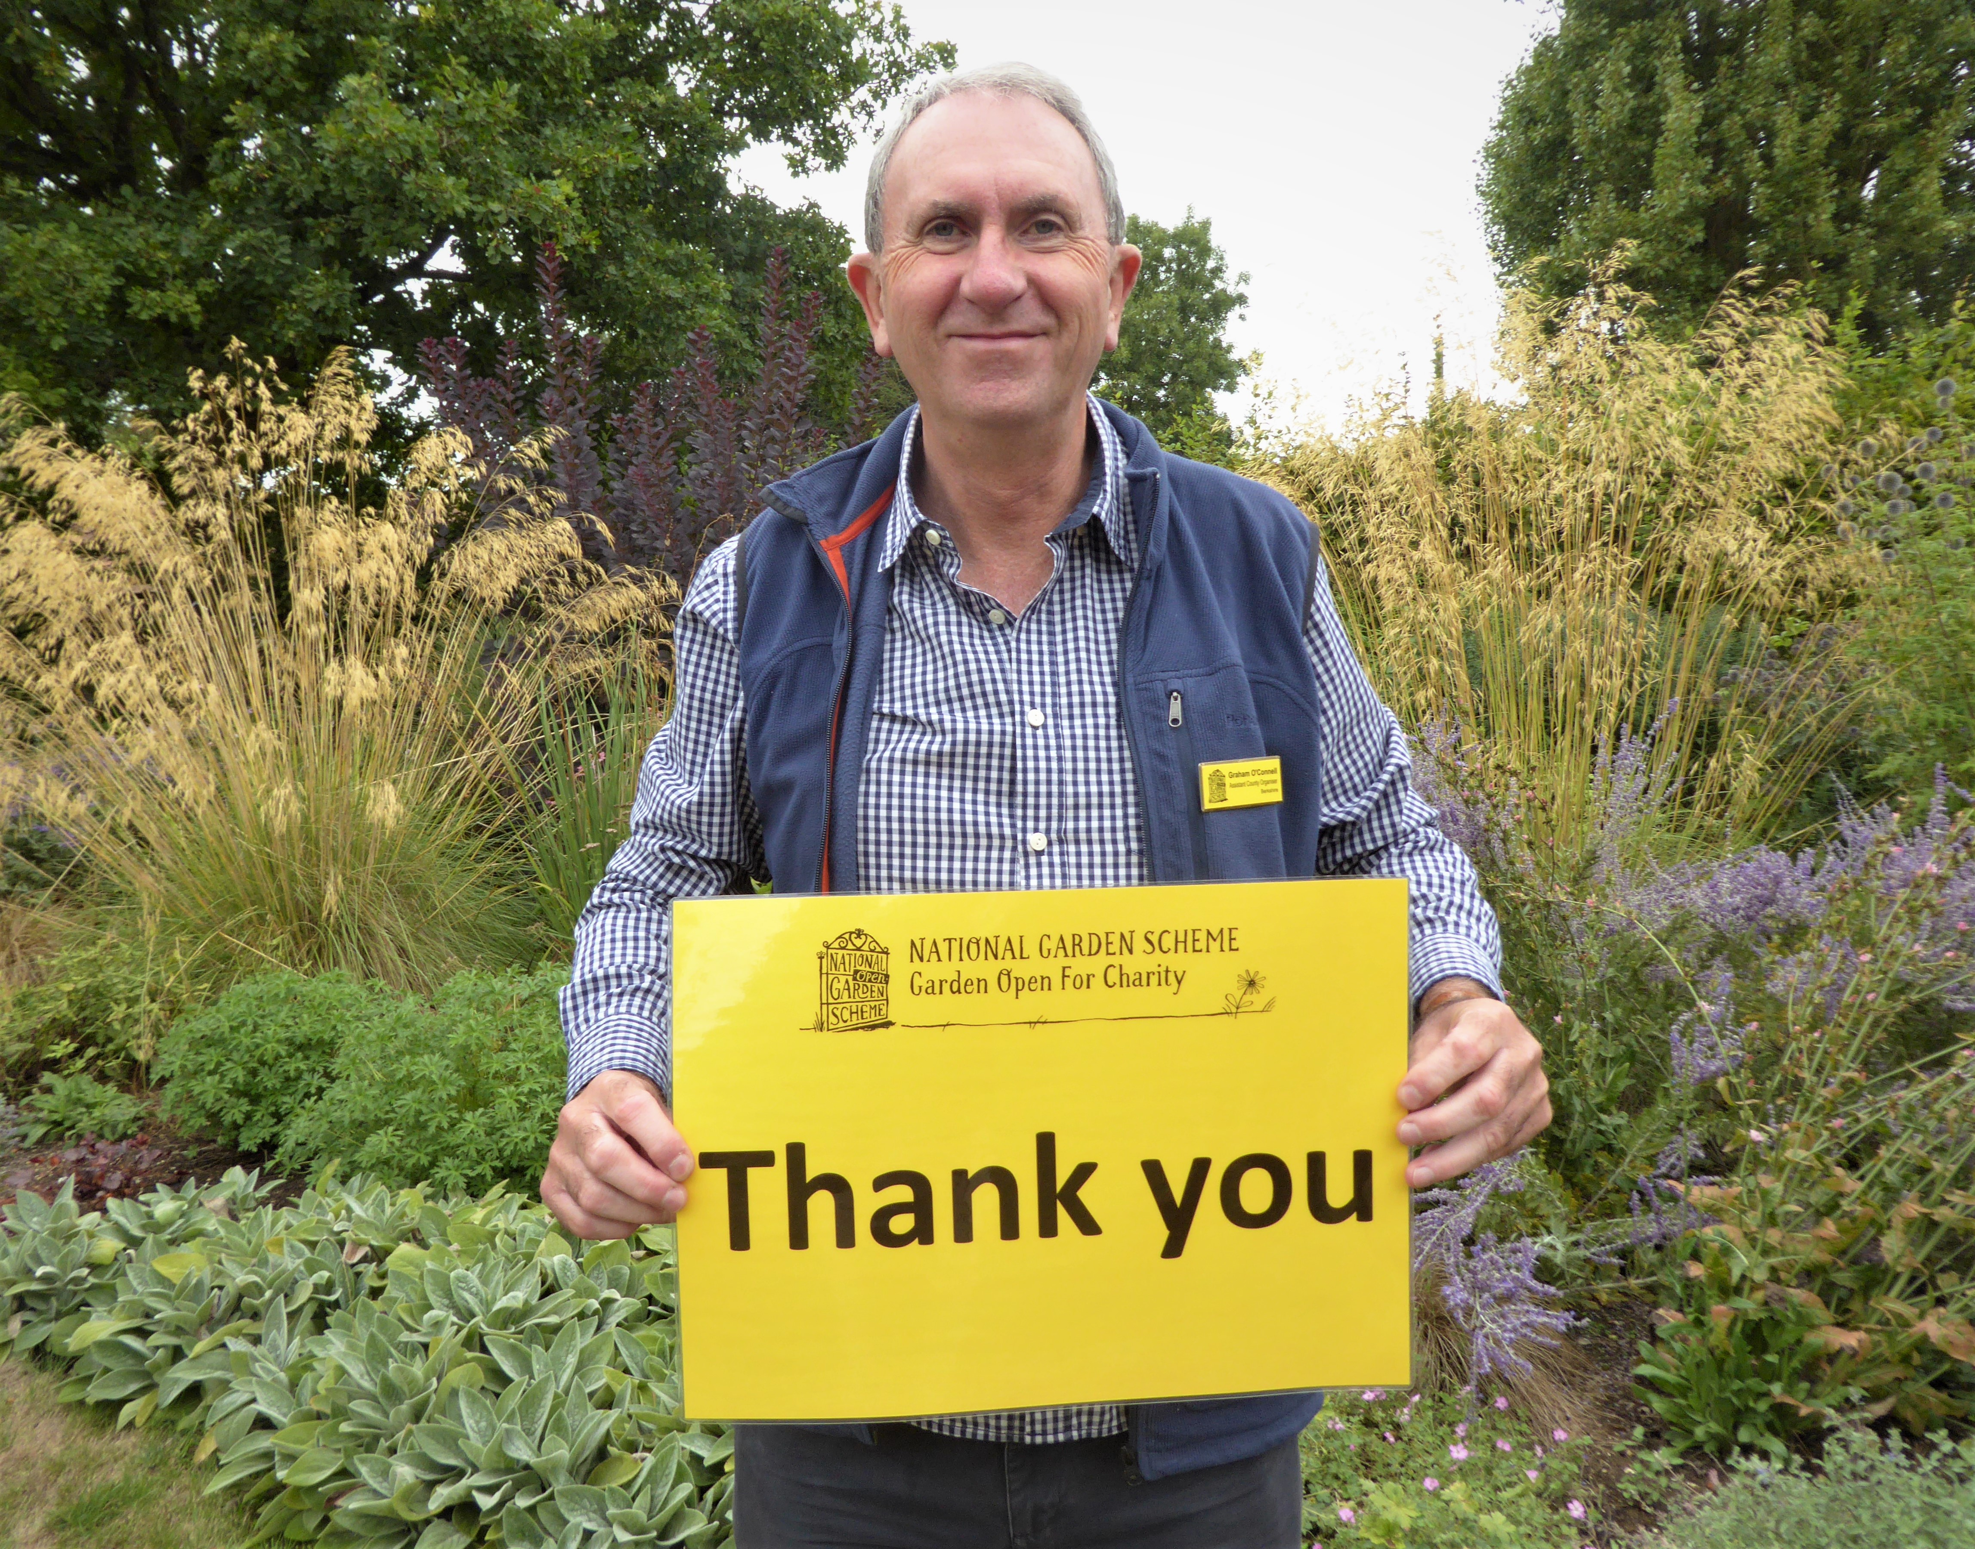
Special thanks go to NGS Volunteer Clare Waters for her meticulous research without which this presentation would not be possible.
©The origins of the National Garden Scheme in England and Wales, by Clare Waters. Master of Arts in Garden History from the University of Buckingham
Notes:
Final quote? Thanks & Questions.
Image: Graham O’Connell
Research Copyright: The origins of the National Garden Scheme in England and Wales, by Clare Waters. Master of Arts in Garden History from the University of Buckingham

Slide 38
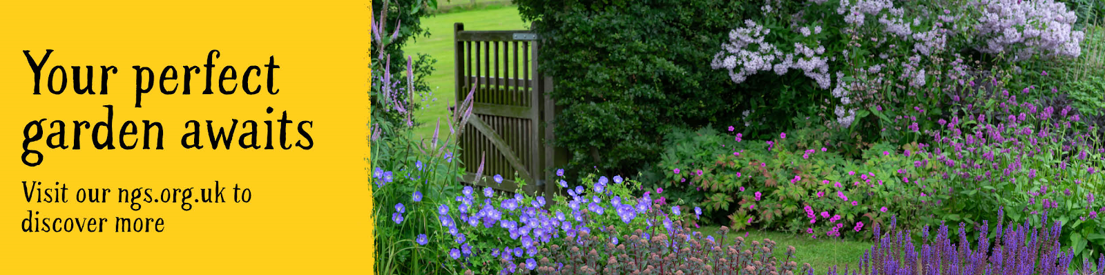
Find out more at: www.ngs.org.uk

Slide 39
Notes:
End Slide. Deliberately blank.
Additional, optional slides follow

Slide 40
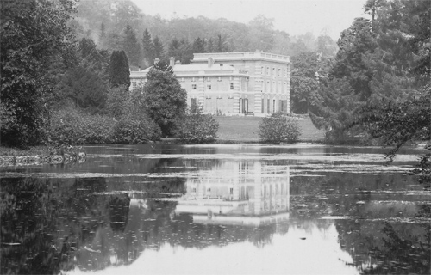
Eywood
Notes:
Eywood
Opened by Charles James Paul Gwyer (1854-1940) and his wife Mary (1862-1950) on 20 July 1927. Sadly the house no longer exists having been demolished in 1954. The park landscaping and the stable block survive, but the porch and some odd stumps of walling are all that remain of the house today.
The gardens were described Below the site of the south front of the house were lawns falling away to Garden Pool, c 100m to the south. Around the whole of the house, and notably still framing the view to Garden Pool, were extensive shrubberies and many mature specimen trees, both deciduous and, especially, coniferous. The shrubbery continued as Garden Wood, which stretched for c 600m from the house enveloping Garden Pool and extending around the north-east side of Flintsham Pool. Traces of walks through the shrubbery can still be seen, for instance a slightly terraced path leading via a tunnel under a fine ashlar bridge 200m south-west of the house towards the kitchen garden (east of which the path is slightly sunken with slag-lined sides). That bridge formerly carried the carriage drive from the Flintsham lodge.
Image credit: Lost Heritage, 2026

Slide 41
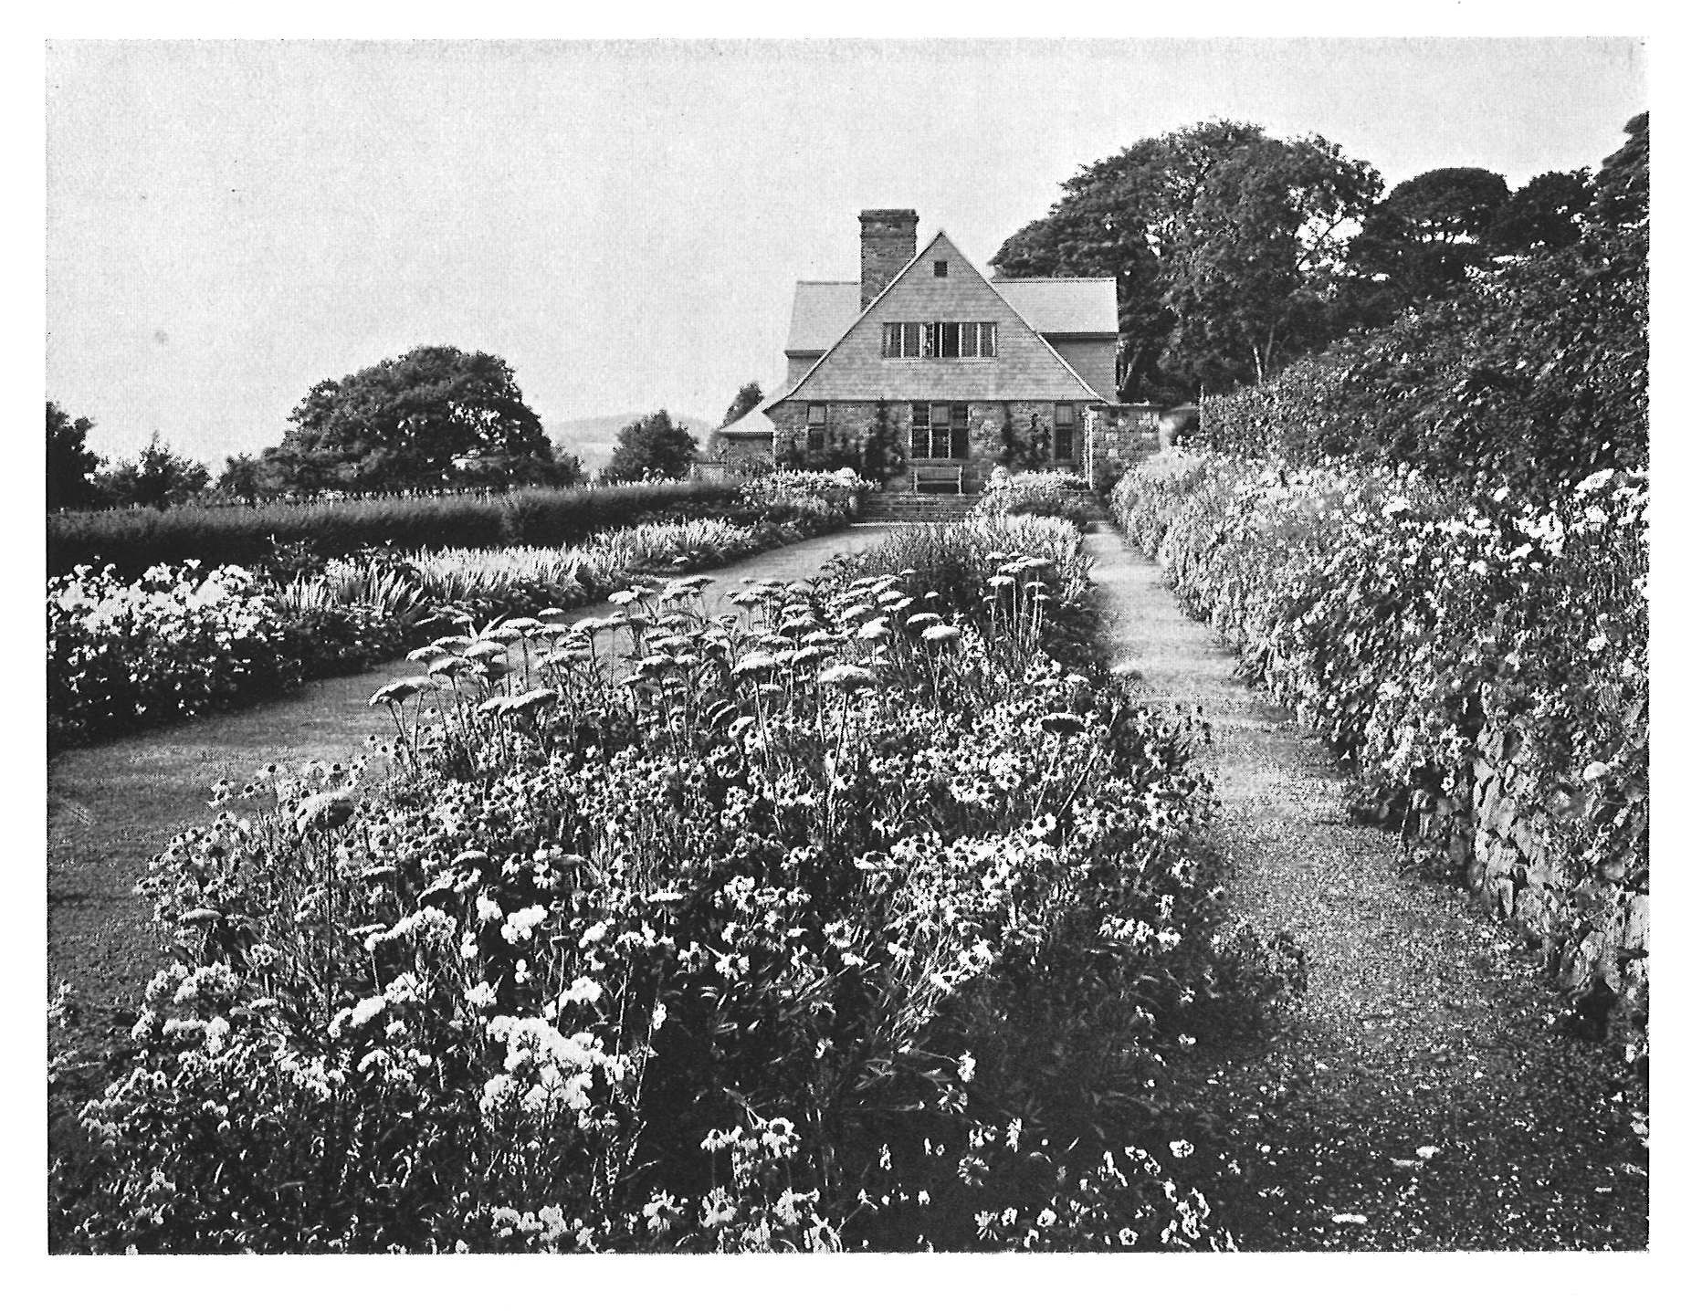
High Glanau Manor, Monmouthshire
Notes:
High Glanau Manor.
Avray Tipping opened both his properties – Harefield House and High Glanau
Image Credit: NGS

Slide 42
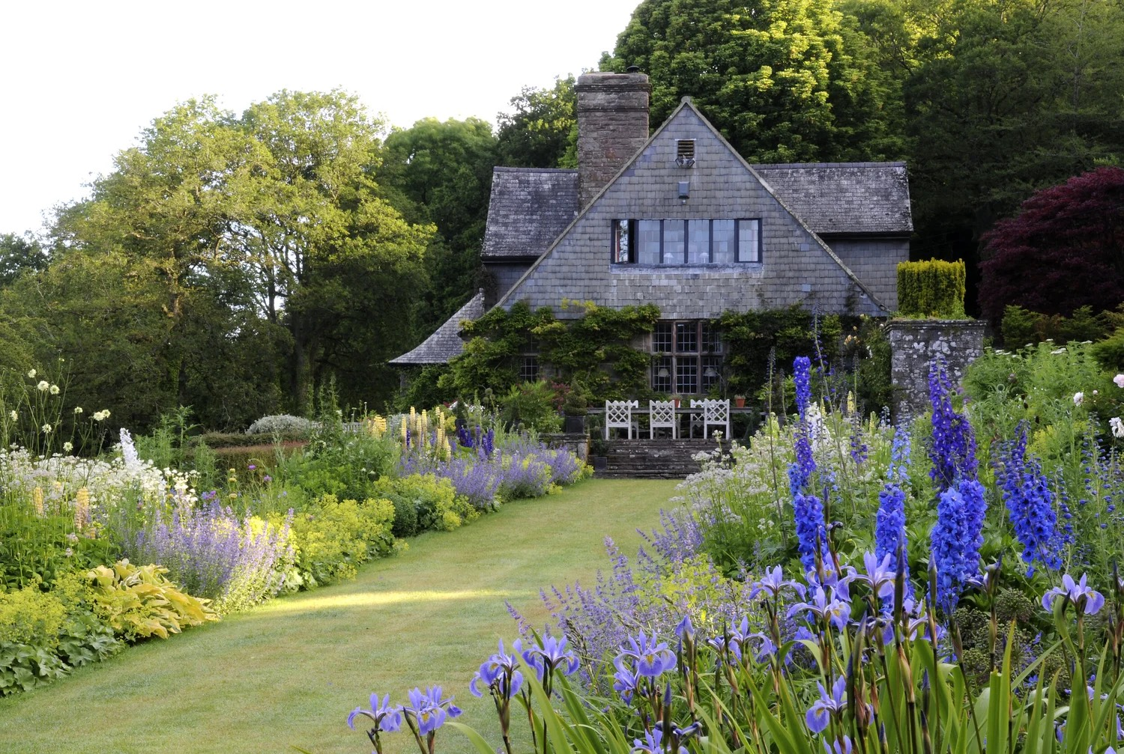
Notes:
High Glenau today. Features in the Gwent booklet.
Photo: NGS

Slide 43
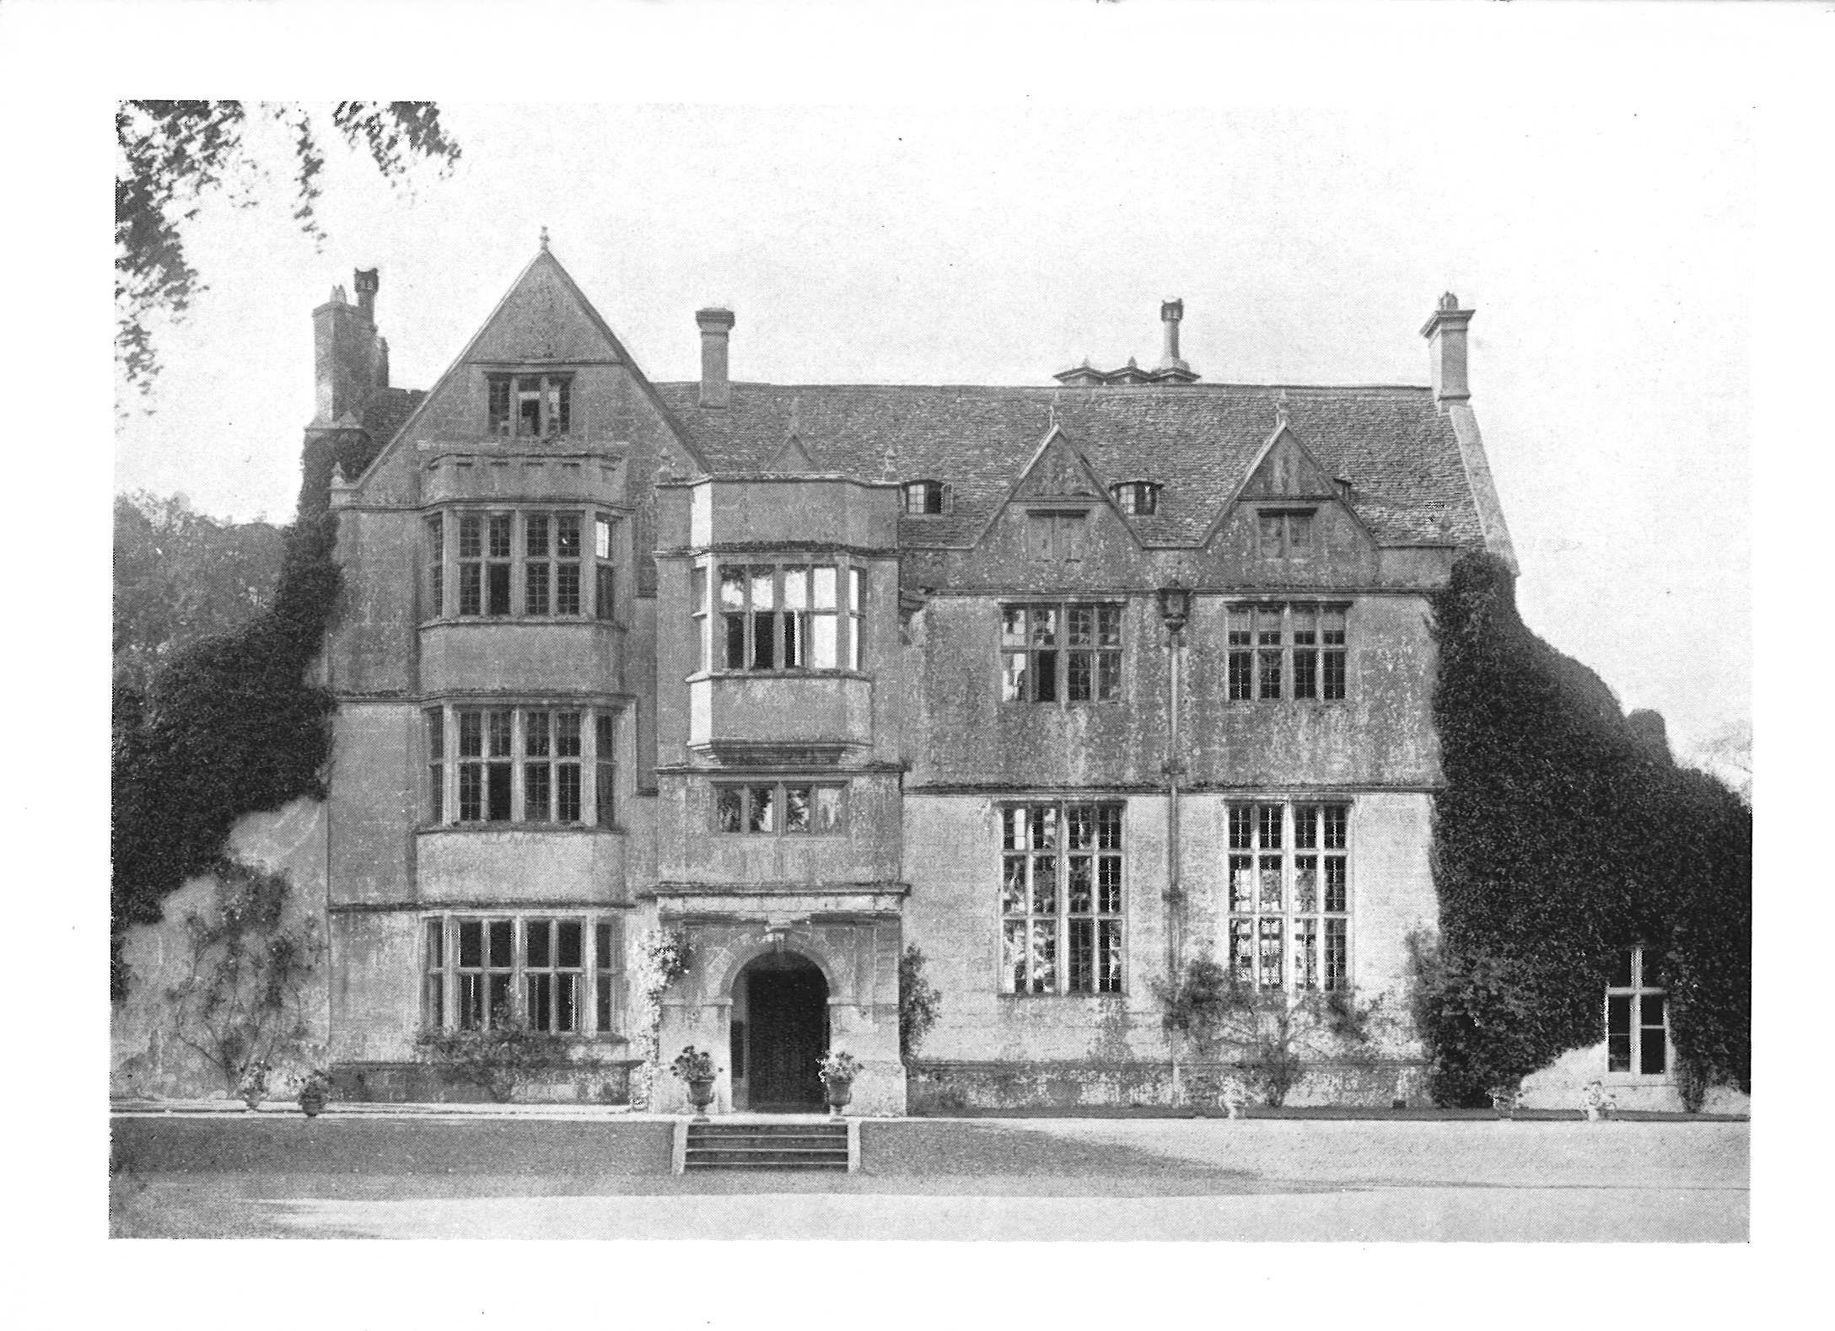
Woollas Hall, Worcestershire
Notes:
Woollas Hall, Eckington, Worcestershire
Now residential flats with a low maintenance garden which is laid to lawn with planted borders. Located adjacent to Deer Park Hall, the tranquil location offers not only superb views over the Vale of Evesham but also offers many wonderful walks including to the ancient bronze age fort with tower and within a short walk of the River Avon.
Image Credit: NGS

Slide 44
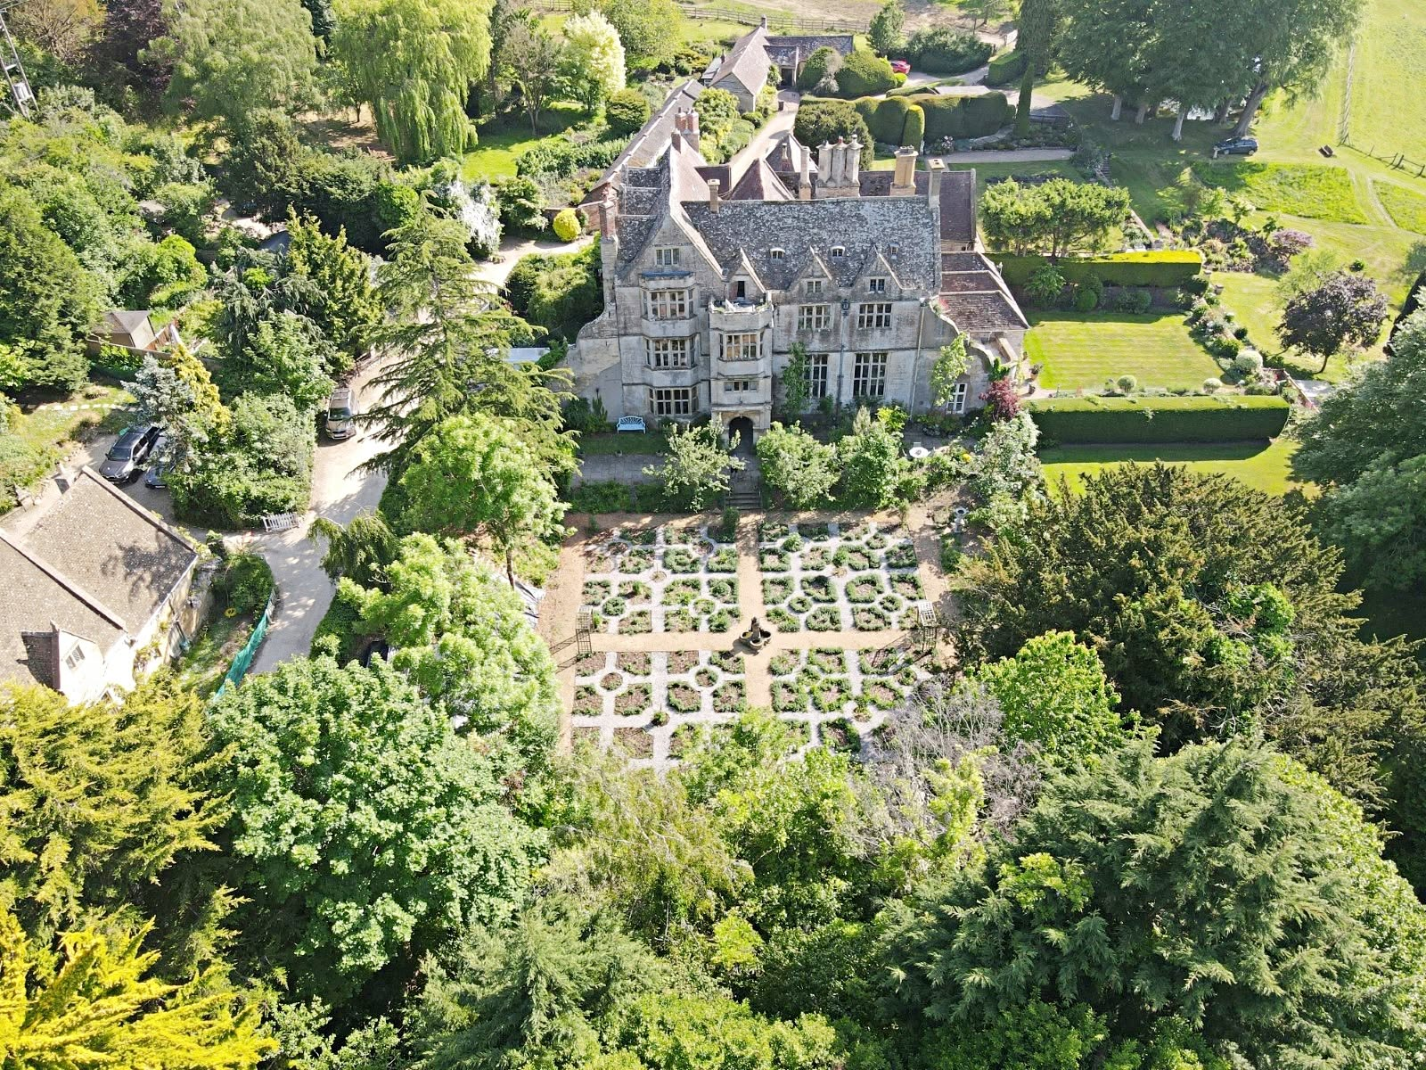
Photo: Courtesy of Nigel Poole
Notes:
Woollas Hall today
Photo: Courtesy of Nigel Poole

Slide 45
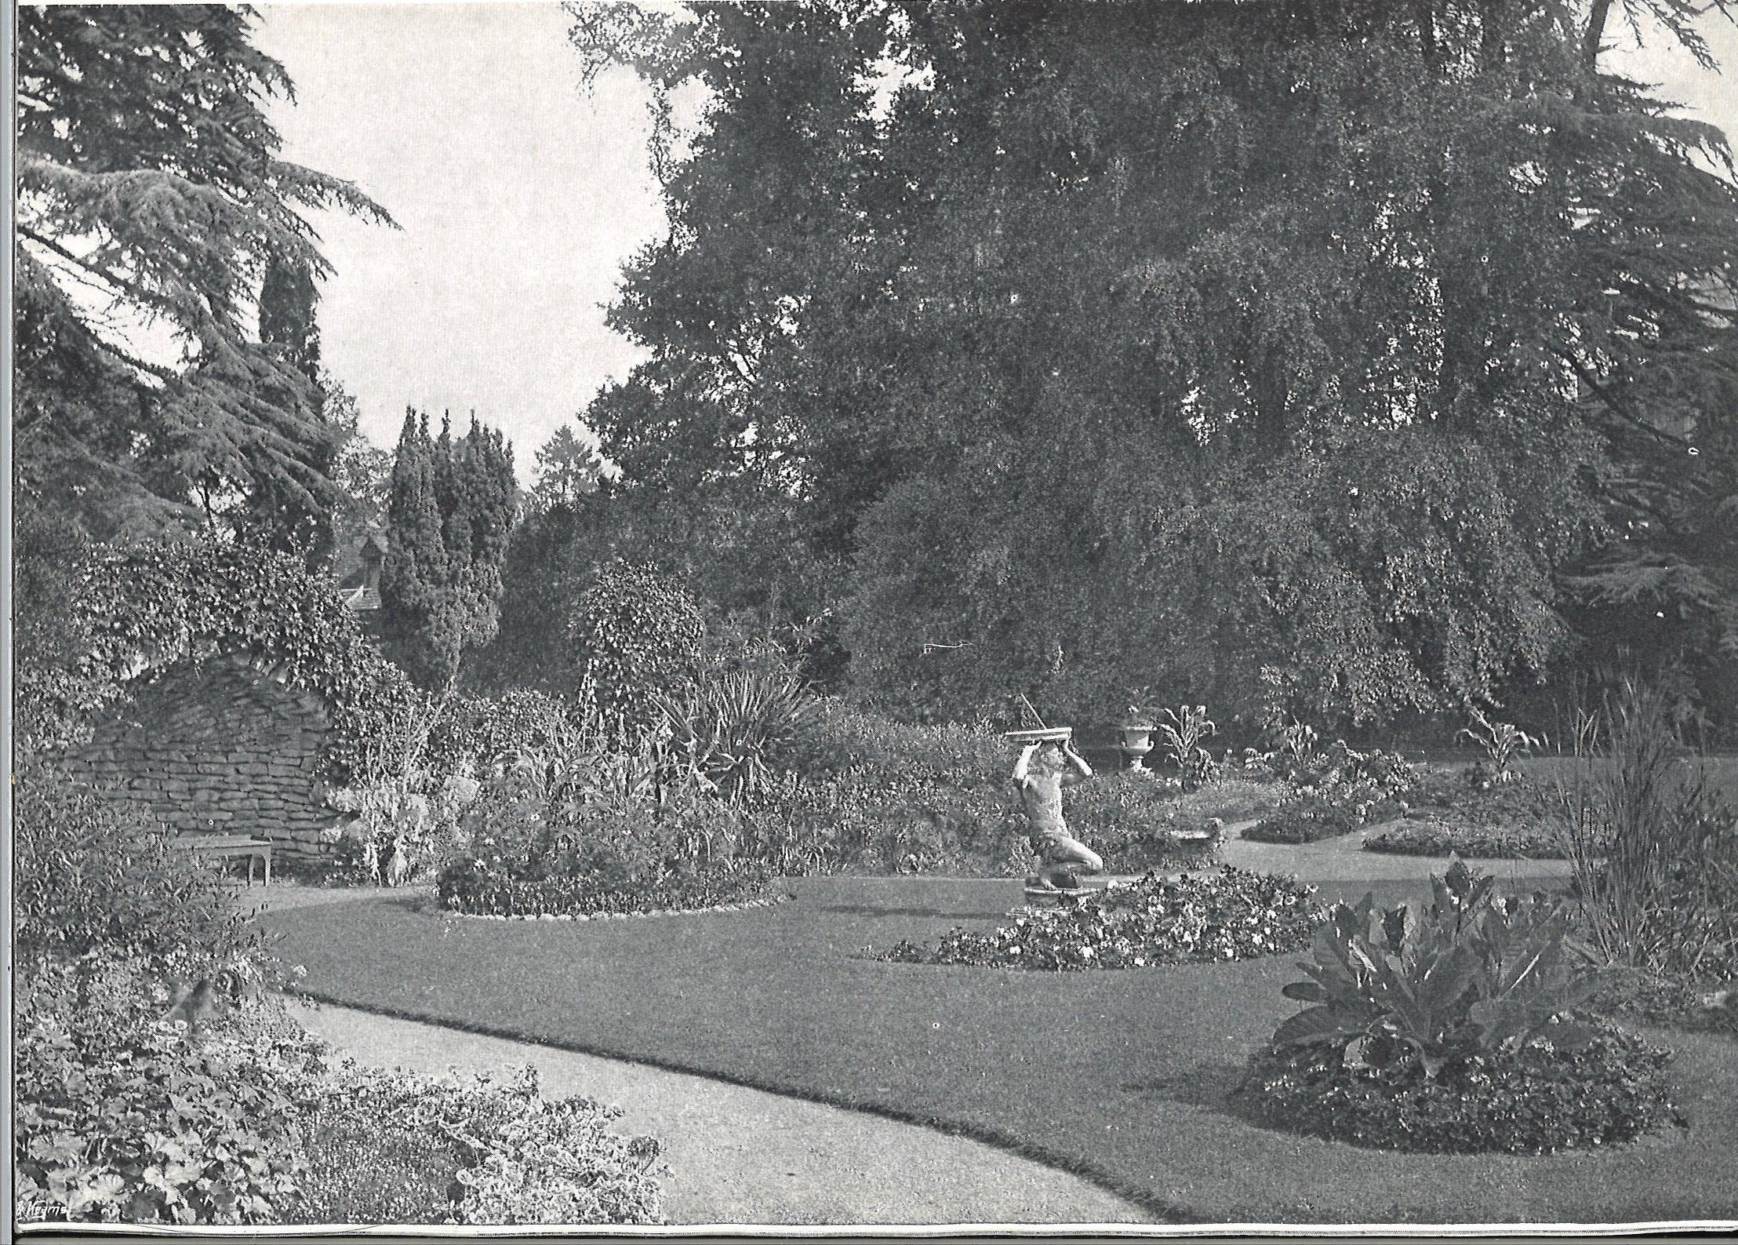
Notes:
Hampton Court, Hope under Dinmore, Herefordshire - opened early on but not in 1927.
Photo NGS

Slide 46
Notes:
Miscellaneous graphics that may be of use with other slides

